Slide 1

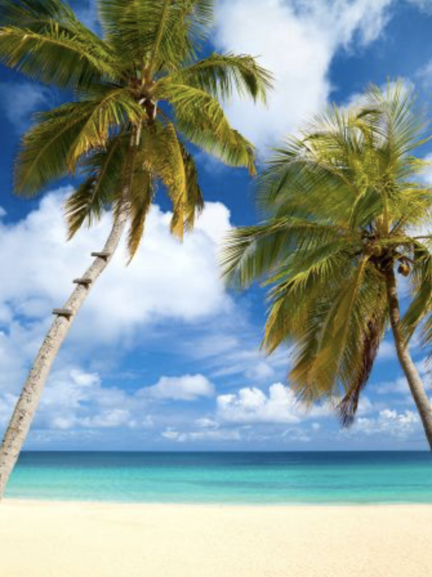
How to Manage a Small Business During a Pandemic Such as COVID-19 in Hawaii
By Kasity Soriano

Slide 2

Who is this targeted to?
For those who would love to start a business in Hawaii!
AND/OR
For those who already manage a small business in Hawaii!

Slide 3
Purpose
Small business owners could face three major issues such as not making enough money/losing money, afraid of getting affected, and not having as much customers as before. Small business owners must always be ready for emergencies. Strategic recommendations should keep a small business in Hawaii running and successful such as managing expenses, following rules, and advertising on social media.

Slide 4
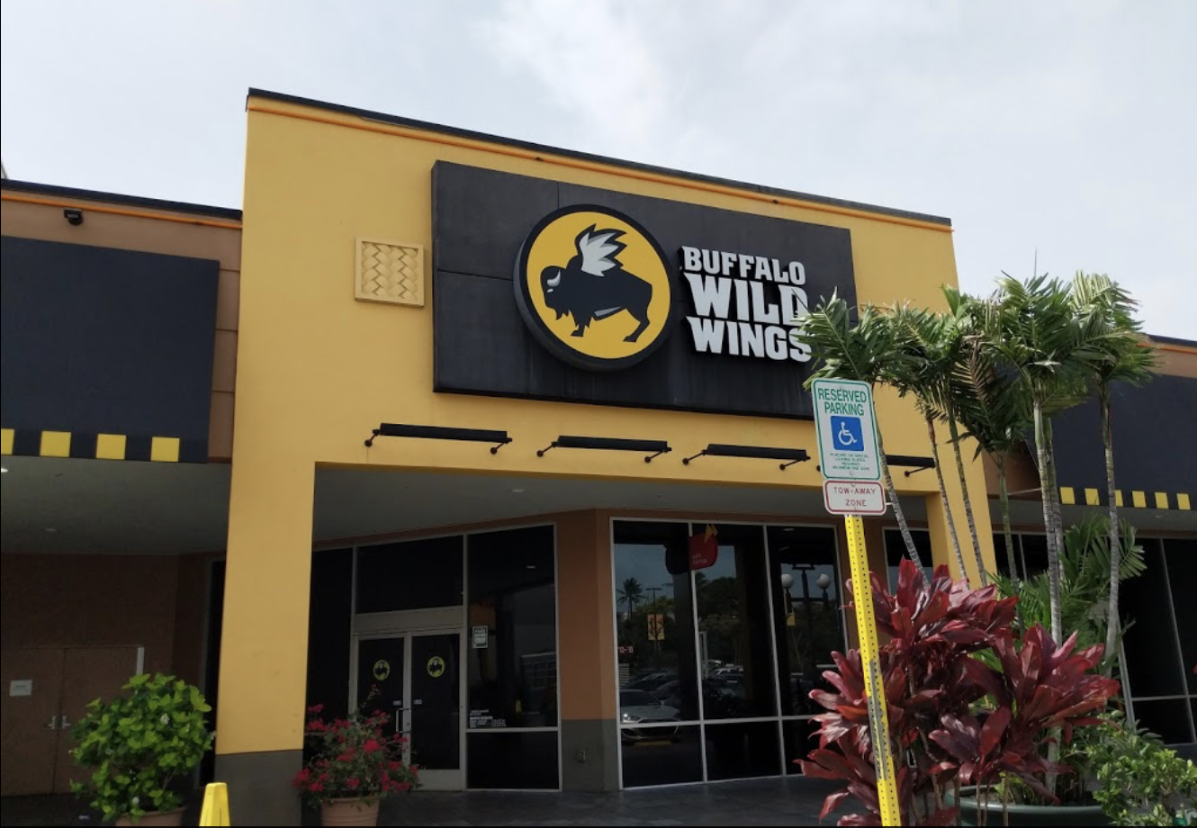
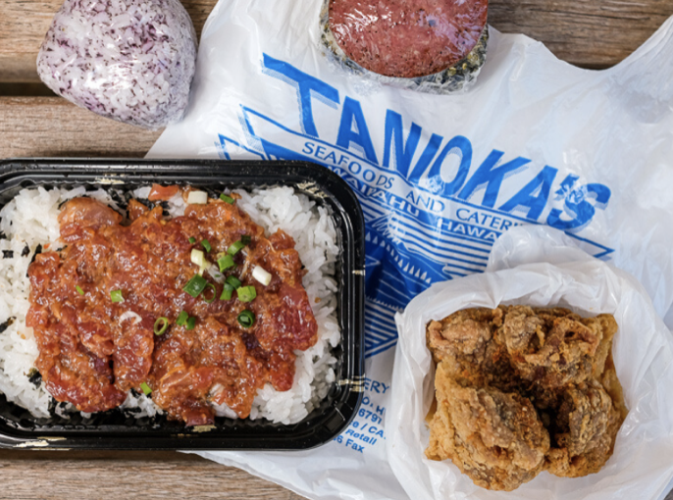
What is Considered a Small Business?
A small business has the same concept but with less employees and less revenue than larger businesses.
Big Business in Hawaii
Small Business in Hawaii

Slide 5
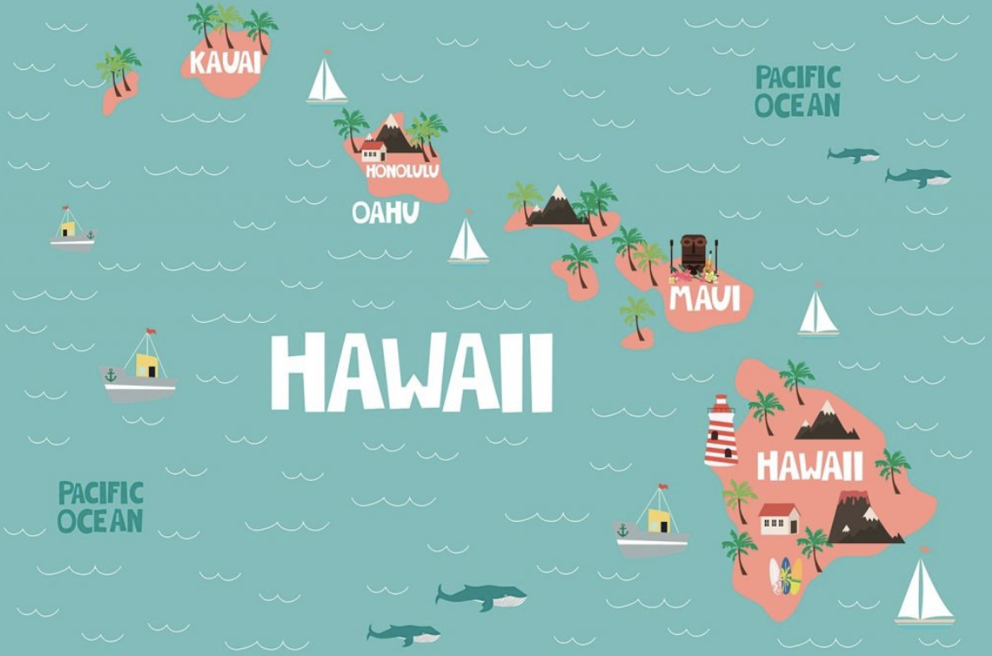
A Bit About Hawaii
Small state with 8 islands.
Population of all islands put together is about 43,000 That is very little compared to other states.
Hawaii has 105,242 small businesses.
Locals are very Aloha spirited which allows many people to support.

Slide 6

The Basics of Coronavirus
Worldwide virus originally from China.
Affects people in different ways. This can lead to mild symptoms to severe illness
Symptoms include , shortness of breath, body ache, loss of taste and much more.
Virus spreads from person to person.
Could be prevented by following rules.

Slide 7
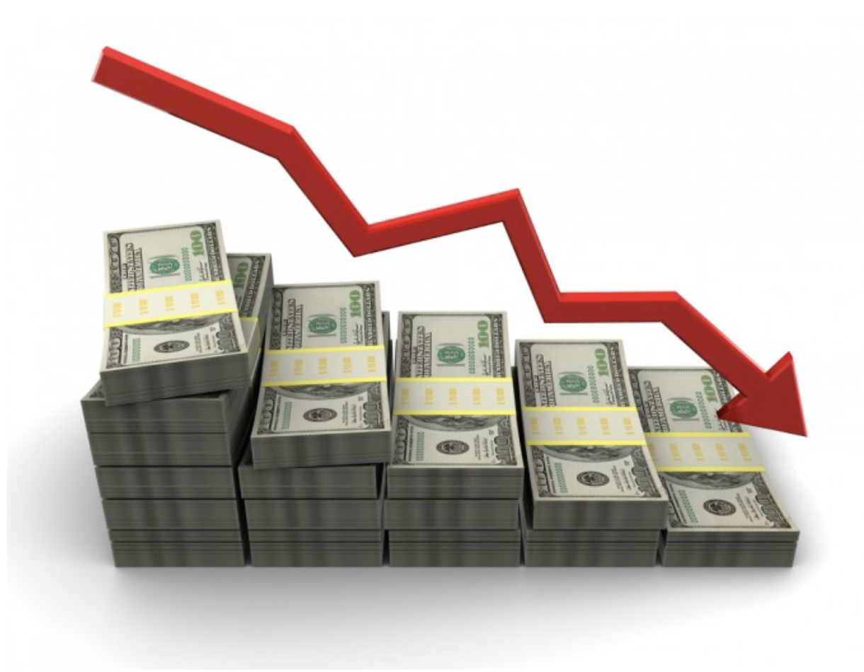
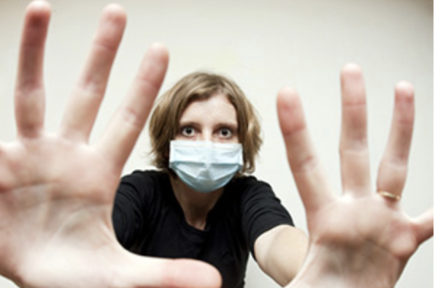
3 main issues businesses could go through because of COVID-19
Most Important: Not making enough money and/or losing money.
Workers and customers being afraid of testing positive for Coronavirus.
Not having as much customers as before.

Slide 8


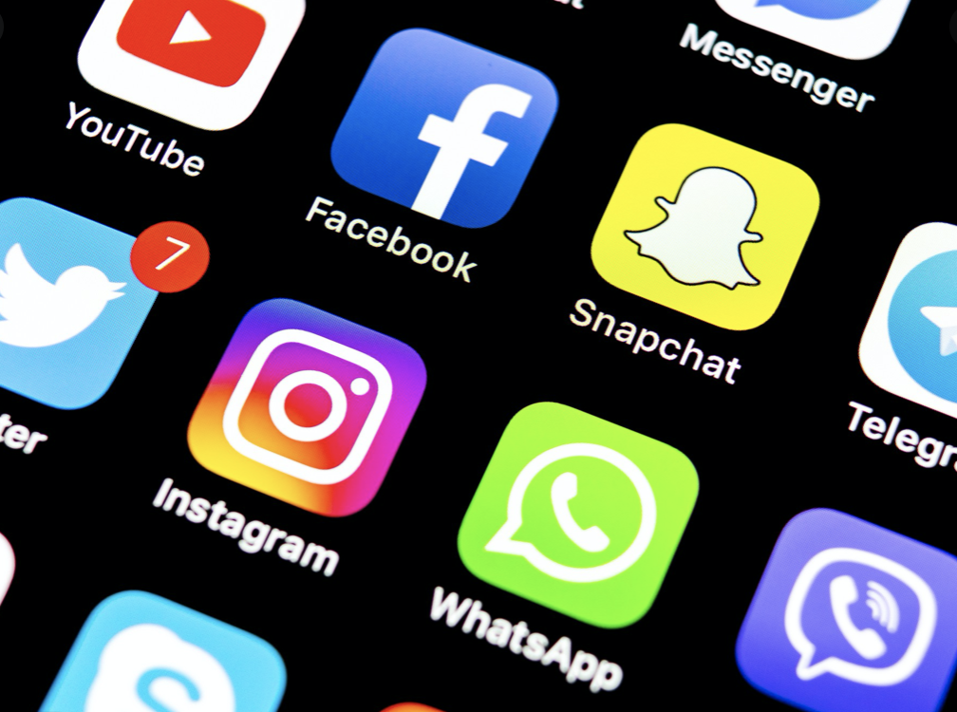
3 Recommendations for business owners
First Important
Manage expenses!
Less payroll
Cheapter utensils
Utilize gas/electricity
Second Important
Follow the state law!
Wear your mask
Stay 6 feet apart
Wash your hands
Third Important
Advertise on social media!
Take pictures
Post on all forms of social media
Stay connected

Slide 9

Continue to do so!!!
Following these 3 recommendations should keep your small business in Hawaii running even during a active pandemic!

Slide 10
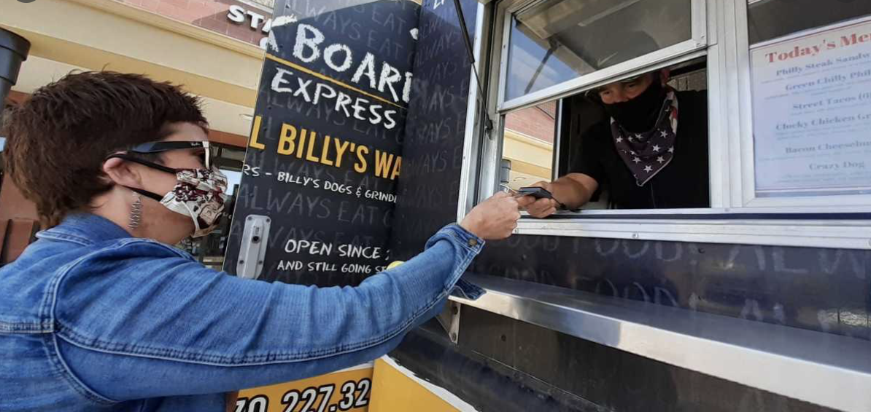
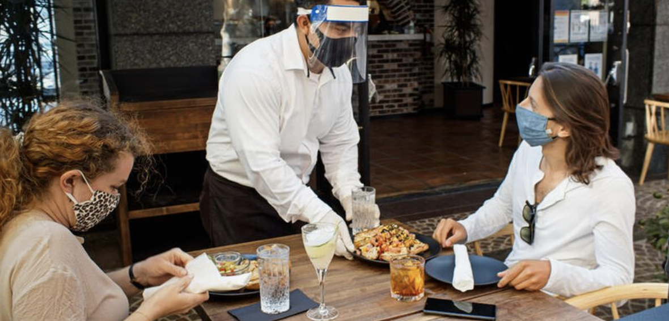
Why?
People love to see businesses who are still open while taking pracatious. The more you engage your business the more people will return to support!

Slide 11


THANK YOU!
Any Questions?

Slide 12
Reference Pages
Associated Press. (1 May 2020). “Population Shrinks in California, Still Most Populous State”. Usnews. Retrieved from https://www.usnews.com/news/best-states/california/articles/2020-05-01/population-shrinks-in-california-still-most-populous-state
Big Island Now. (31 March 2019). “Which Hawaiian Island Suits Your Vacation Style?”. Big Island Now. Retrieved from https://bigislandnow.com/2019/03/31/big-island-takes-top-spot-for-fishing-in-hawaii/
Burt Jeffery. (22 August 13). “HP’s Whitman Warns On Growth After Sales Slump”. Silicon. Retrieved from https://www.silicon.co.uk/workspace/hp-sales-hammered-warns-growth-125545
McCord Daleel. (2020). “Buffalo Wild Wings” USA Restaurants. Retrieved from https://usarestaurants.info/explore/united-states/hawaii/honolulu-county/pearl-city/buffalo-wild-wings-808-260-9464.htm
Richardson Peter. (12 November 2020). “Weekly Update: Global Coronavirus Impact and Implications”. Counterpoint. Retrieved from https://www.counterpointresearch.com/coronavirus-weekly-update/
Sauer M Lauren. (2020). “What Is Coronavirus?” Hopkins Medicine. Retrieved from https://www.hopkinsmedicine.org/health/conditions-and-diseases/coronavirus
(2020). “Eight Major Islands”. Hawaii Visitors and Convention Bureau. Retrieved from https://www.hvcb.org/school-report/eight-major-islands/
(2020). “Neighborhood Favorites”. Midtown Ala Moana. Retrieved from https://www.midtownalamoana.com/places/

