Slide 1


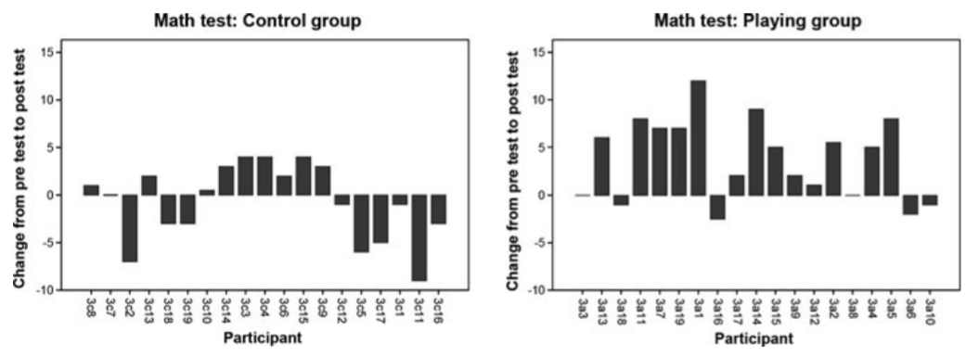
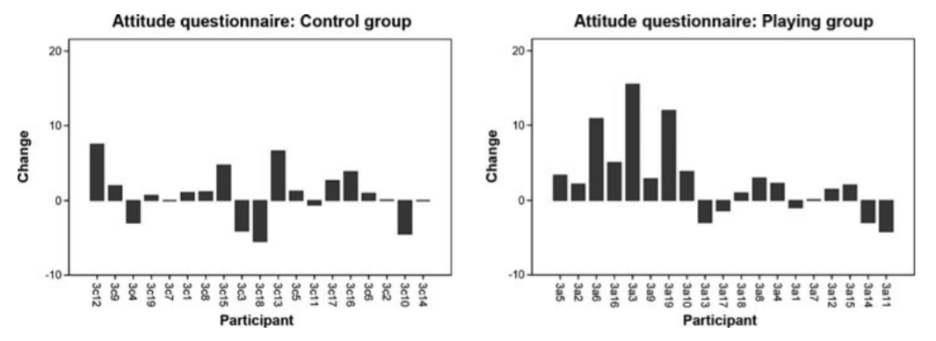

Utilizing Games to Increase
Mathematical Comprehension and Student Engagement
Kalen Lagoc-Chang
University of Hawai‘I at West O‘ahu
Abstract
Methods
Results
This research explores the implementation of games in the classroom and its effects on mathematical comprehension and student engagement. Researchers describe the pros and cons of implementing games in educational settings for both teachers and students. They also provide tips and recommendations for educators who are looking to incorporate games in their teaching practices. Results and conclusions of conducted studies demonstrate that utilizing games in the classroom has a positive effect on students’ mathematical comprehension and increases student engagement.
Created control and experimental group. Experimental group conducted regular game play while control group followed the regular curriculum.
Analyzed pre and post attitude questionnaires. Elicit themes on students’ attitude towards mathematics and self-efficacy levels.
Analyzed pre and post mathematical comprehension test. Statistically compare students’ test scores.
Conduct semi-structured student interviews. Elicit themes and compare with observational data.
Collect data from the classroom. Perform classroom observations and record student reflections and remarks.
Mathematical Comprehension
Game playing group scored, on average, 3.6 points higher than the control group on the post study test.
On average, 13 of 19 students in game playing group increased their test score by 5.8 points while 9 of 19 students in the control group increased 2.6 points.
Student Engagement
On average, the control group increased their mathematical engagement and attitude questionnaire scores by 1 point while the game playing group increased by 2.5 points.
Game playing group indicated increased confidence and enjoyment in explaining mathematical problems.
**There was no indicated direct correlation between students’ mathematical performance and engagement. Further research is necessary to support or oppose this claim.
Introduction
Although there are many students who enjoy mathematics class, there also exists many students who may struggle through the subject due to emphasis on high volumes of memorization and repetition of problems. These students will benefit from multiple means of engaging in academic content. Mathematical comprehension dramatically increased for students who played games that reinforced concepts taught in class (Pareto, Haake, Lindstrom, Sjoden, & Gulz, 2013).
Not only is the goal of mathematics educators to help students get good grades, but to also create students who are authentically excited about learning math. Utilizing mathematical games in the classroom provide students different ways of viewing the content as well as encourages critical thinking and student engagement while problem solving (Buchheister, Jackson, & Taylor, 2017).
Conclusions
Implementing games in the classroom has positive effects on students’ mathematical comprehension.
Utilizing games will “help motivate and engage students in learning math and making learning fun” (Bremner 2012).
Effective mathematical games are grounded in mathematics, self-directed, engaging, and appropriately challenging for all students.
References
Bremner, A. (2012). Singing and gaming to math literacy. Teaching Children Mathematics, 19(9), 582-584. Retrieved from https://www.nctm.org/Publications/teaching-children-mathematics/2013/Vol19/Issue9/technology-from-the-classroom_-Singing-and-gaming-to-math-literacy/
Buchheister, K., Jackson, C., Taylor, C. E. (2017). Math games: A universal design approach to mathematical reasoning. Australian Primary Mathematics Classroom, 22(4), 7-12. Retrieved from http://search.ebscohost.com.libproxy.westoahu.hawaii.edu/login.aspx?direct=true&db=eric&AN=EJ1163821&site=ehost-live&scope=site
Pareto, L., Haake, M., Lindstrom, P., Sjoden, B., & Gulz, A. (2012). A teachable-agent-based game affording collaboration and competition: Evaluating math comprehension and motivation. Educational Technology Research and Development, 60(5), 723–751. Retrieved from http://search.ebscohost.com.libproxy.westoahu.hawaii.edu/login.aspx?direct=true&db=eric&AN=EJ980354&login.asp&site=ehost-live&scope=site
Free clipart from Clipart Station

