Slide 1


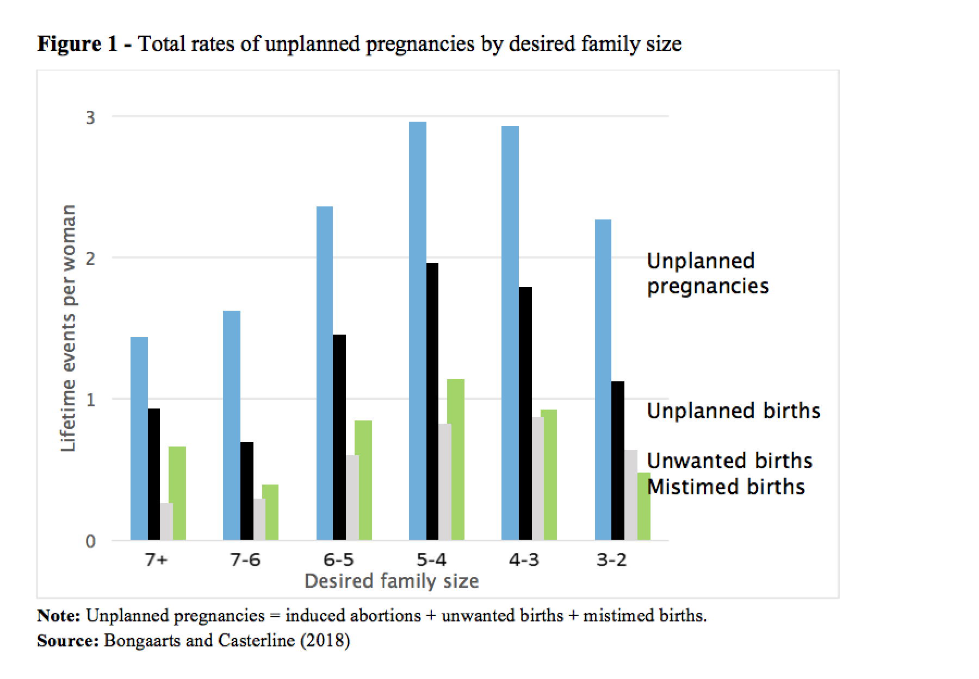
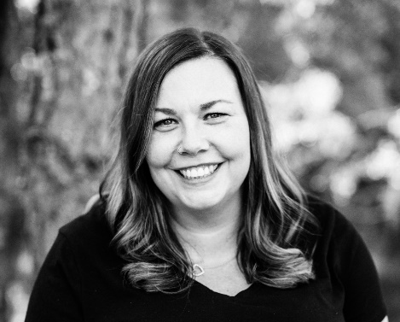
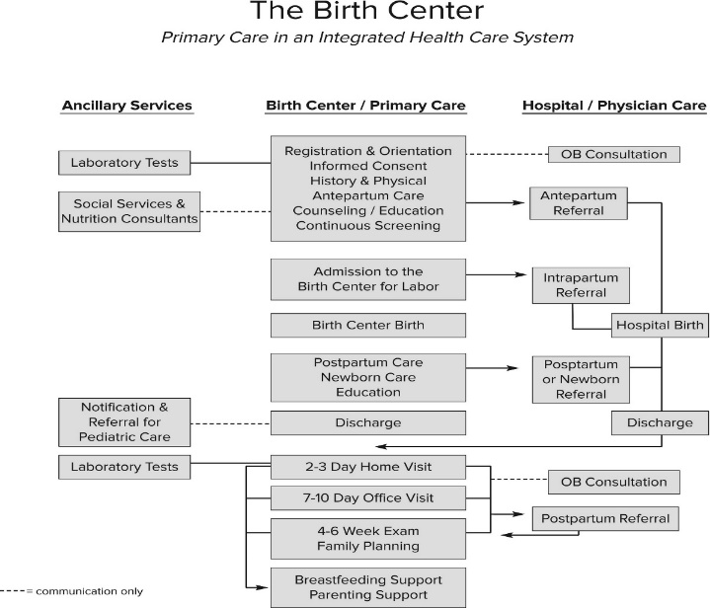

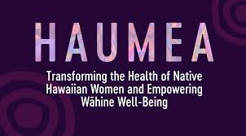
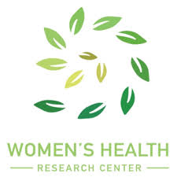


Community Based Participatory Research: Women’s Health & Family Planning in Hawaii County
Willa Woodard Ervin
University of Hawaii West O’ahu
Abstract
Develop a CBPR partnership researching women’s healthcare and family planning (WHCFP) both in accessibility and available providers in Hawaii County and define the scope of care; midwives and Physician’s Assistants (PAs) filling these gaps at a cost savings. Incorporate elders, community members, legislature, and community health committees as well as providers to expand education and promotion of women’s health. Highlight Hawaiian cultural barriers to care and how to respectfully integrate WHCFP with traditional healing practices.
Research Design and Data Collection
CBPR in WHCFP will be centered on the cities of Pahoa and Keaau on Hawaii, incorporating traditional and licensed midwives and healers, PAs, city & state officials, the local health clinic in Pahoa, and elders. Listening to what elders, women, and youth of the community feel they need and/or are lacking, each member on the team brings something equally important to the research. Partners from each group will participate at meetings; everyone will be allowed time to speak and for input at each phase of research. We will work to integrate licensed providers and traditional healers into the clinic, as well as learning opportunities to train local community members preparing for licensure. Expectation of the partnership is to meet regularly, and all be actively involved in research, planning, implementing, and educating the community while also actively learning from local elders, healers, and traditional midwives as well as community leaders what has worked and not worked with WHCFP. Move forward with plans to integrate all traditions and acceptance; once recognition of all care needs has been achieved, continue integration with each community member to work together towards our goal of establishing a birth center/community clinic.
Introduction and Research Question
INTRODUCTION
• The U.S. Census Bureau has estimated population in 2019 for Hawaii County at just below 187,000; 49.8% female (World Population Review, 2019).
• Hawaii County women find it difficult to establish care with one of the few care providers and/or receive the continuity of care she deserves.
• Hawaii County has two women’s health clinics and about ten OB/Gyns to choose from (Google, n.d.). There is one hospital in Hilo (Hilo Women's Health Center, n.d.) and two midwives offering homebirths; no free-standing birth centers (Estes, East Hawaii Midwife Service, n.d.) (Island Mama's Midwifery & Birth Services, n.d.).
• Birth centers serve women for annual exams, family planning, and assessment and treatment of conditions affecting the reproductive system. They improve population health and decrease racial disparity (Jill Alliman DNP, et al., 2019).
• Birth centers serve as a community gathering-place for educational programs and integrate culturally-appropriate traditional healing practitioners.
RESEARCH QUESTION
Can a CBPR partnership fill care gaps, providing access to WHCFP for women of all ages in a culturally-respectful way while also honoring and incorporating traditional healing practices and educating future providers? Is there need in Hawaii County?
HYPOTHESIS
The diversity of history and cultural perspectives on Hawaii need to be identified. Establish a mutually-respectful relationship with understanding and trust involving the entire ‘ohana. “Community health workers, especially in rural communities, are invaluable members of the healthcare team as they are known and trusted members of the community and often have intimate knowledge of resources and challenges occurring at the local level” (Mau, 2010, pp. 23, 25, 27). CBPR partners build lasting and trusting relationships in communities. Midwives and PAs can fill WHCFP care gaps on Hawaii.
With a desired family size near 2 children, women average 2.3 unplanned pregnancies over their lifetimes, equaling 1.1 abortions, 0.6 unwanted births and 0.5 mistimed births (Bongaarts & Casterline, 2019).
Discussion
The CBPR long-term commitment is to ensure a birth center/community clinic is established with working space for each type of care provider and for all WHCFP needs with traditional and heritage respectfulness. Realizing that unplanned pregnancies happen every year and have long-lasting economic impacts on families, specifically women, we must reduce these statistics. Learning from the example of MIA, establishing a birth center/community clinic to aid in accessibility to WHCFP with CBPR, licensed providers can continue apprenticeships with community members. We will further encourage community involvement through a blessing ceremony for the clinic and offer educational opportunities that are on-going to encourage growth and change in the community’s health.
Supportive Results
• Society of Family Planning Research Fund (SFP) supports research on family planning influencing clinical practice, public policy, health services, programs and culture. In 2015, 4 individuals CBPR grants were awarded, $150,000 Reni Soon, MD, MPH, for reproductive healthcare access for adolescents in primary care settings at a community health center. “Community engagement is vital to addressing the reproductive and other disparities in the community, and I’m really glad SFP recognizes the value of community engaged and CBPR projects.” Reni Soon, MD, MPH, University of Hawaii (Society of Family Planning, 2016).
• Hawaii Women’s Health Research Center, together with Division of Family Planning at JABSOM, University of Hawaii, work to enhance women’s health through research in clinical trials, financial and policy studies, and qualitative assessments; currently researching Emergency Contraception and IUDs/Implants (Women's Health Research Center, n.d.).
• Mercy in Action (MIA) is a non-profit organization focusing on the crisis in Maternal / Newborn / Child healthcare worldwide; teach that kindness is a way to remove cultural and accessibility barriers to care. They consult with midwives, doctors, and nurses around the world doing similar work. MIA offers on-line courses and CEUS used by healthcare workers all over the world including cultural competency, global midwifery, and disaster response (Mercy in Action, n.d.).
Conclusions
Hawaii County would benefit from CBPR partnerships on the advancement in WHCFP promoting a birth center and clinic setting. Working in a partnership with multigenerational community members, various care providers, educators, and law makers, CBPR will only strengthen community bonds and benefit women of all ages in both lifelong health and family planning and reproductive issues. The Society of Family Planning, Hawaii Women’s Health Research Center, and Division of Family Planning at JABSOM/University of Hawaii are three examples of differing research projects benefiting WHCFP in communities around Hawaii. Expanding and growing these types of research in a stronger CBPR-based partnership will benefit women and their families now and for generations to come.
PRAMS Health Indicator Report - No contraception at conception- thought couldn't get pregnant
Category | # Yes | % | # No | %
Statewide | 1600 | 27.9 | 4200 | 72.1
Hawai'i County | 300 | 35.3 | 500 | 64.7
<20 | 200 | 41.0 | 200 | 59
20-24 | 600 | 31.2 | 1200 | 68.8
25-34 | 700 | 23.6 | 2100 | 76.4
35+ | 200 | 29.3 | 600 | 70.7
Caucasian | 300 | 23.2 | 900 | 76.8
Native Hawaiian | 700 | 29.5 | 1600 | 70.5
Filipino | 300 | 38.4 | 500 | 61.6
Other | 200 | 37.5 | 400 | 62.5
Married | 700 | 25.7 | 2100 | 74.3
Unmarried | 900 | 30.1 | 2000 | 69.9
Below Poverty Lvl (0-130%) | 1000 | 37.6 | 1700 | 62.4
Income <=$17,000 | 800 | 40.4 | 1200 | 59.6
Low Birth Weight | 200 | 40.7 | 200 | 59.3
References
Bongaarts, J., & Casterline, J. (2019, January 14). Fertility preferences and reproductive outcomes in the developing world. Retrieved from N-IUSSP IUSSP Online News Magazine: http://www.niussp.org/article/fertility-preferences-and-reproductive-outcomes-in-the-developing-worlddesir-denfant-et-fecondite-realisee-dans-les-pays-en-developpement/?print=print
Estes, R. C. (n.d.). East Hawaii Midwife Service. Retrieved August 2019, from East Hawaii Midwife Service: https://www.easthawaiimidwifeservice.com/
Google. (n.d.). OB Gyn in Hilo. (Google Search) Retrieved August 2019, from Google: https://www.google.com/search?client=firefox-b-1-d&q=obgyn+in+hilo
Hilo Women's Health Center. (n.d.). Bay Clinic. Retrieved August 2019, from Hilo Women's Health Center: http://www.bayclinic.org/locations/hilo-women-s-health-center
Island Mama's Midwifery & Birth Services. (n.d.). Aloha, and welcome! Retrieved August 2019, from Island Mama's Midwifery & Birth Services: http://www.islandmamasmidwifery.com/Island_Mamas_Midwifery/Welcome.html
Jill Alliman DNP, C. F., Susan R. Stapleton DNP, C. F., MA, J. W., MBA, K. B., MA, K. S., & Diana Jolles PhD, C. (2019, June). Strong Start in birth centers: Socio‐demographic characteristics, care processes, and outcomes for mothers and newborns. Birth Issues in Perinatal Care, 46(2), 234-243. doi:https://doi.org/10.1111/birt.12433
Mau, M. M.-A. (2010). Health and health care of Native Hawaiian and other Pacific Islander Older Adults. (M. VJ Periyakoil, Ed.) https://geriatrics.stanford.edu/ethnomed/hawaiian_pacific_islander.html. Retrieved August 2019, from Stanford School of Medicine, Ethnogeriatrics: http://geriatrics.stanford.edu/wp-content/uploads/downloads/ethnomed/hawaiian_pacific_islander/downloads/hawaiian_american.pdf
Mercy in Action. (n.d.). Home, Charity Birth Centers. (Mercy in Action) Retrieved August 2019, from Mercy in Action: https://www.mercyinaction.com/
School of Public Health University of California, Berkeley. (2012). Community-Based Participatory Research: A Strategy for Building Healthy Communities and Promoting Health through Policy Change. Retrieved from PolicyLink; Lifting Up What Works: https://www.policylink.org/sites/default/files/CBPR.pdf
Society of Family Planning. (2016). Society of Family Planning 2016 Annual Report. Society of Family Planning, Philadelphia . Retrieved from https://www.societyfp.org/_documents/annual_report2016.pdf
State of Hawai'i, Department of Health. (2017, February 10). PRAMS Health Indicator Report - No contraception at conception- thought couldn't get pregnant- for the State of. Retrieved from Hawai'i Health Data Warehouse: http://hhdw.org/wp-content/uploads/2017/02/PRAMS_Family_Planning_IND_00017.pdf
Women's Health Research Center. (n.d.). Women's Health Research Center. Retrieved 2020, from Women's Health Research Center: https://www.hawaiiwhrc.org/
World Population Review. (2019, July 11). Hawaii Population 2019. (World Population Review) Retrieved from World Population Review: http://worldpopulationreview.com/states/hawaii-population/
Willa Woodard Ervin
University of Hawaii West Oahu
BA Public Administration, Community Health
willawe@hawaii.edu

