Slide 1

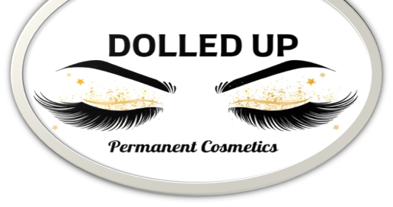
BUSINESS PLAN
PRESENTED BY: TASIA JOSUE

Slide 2
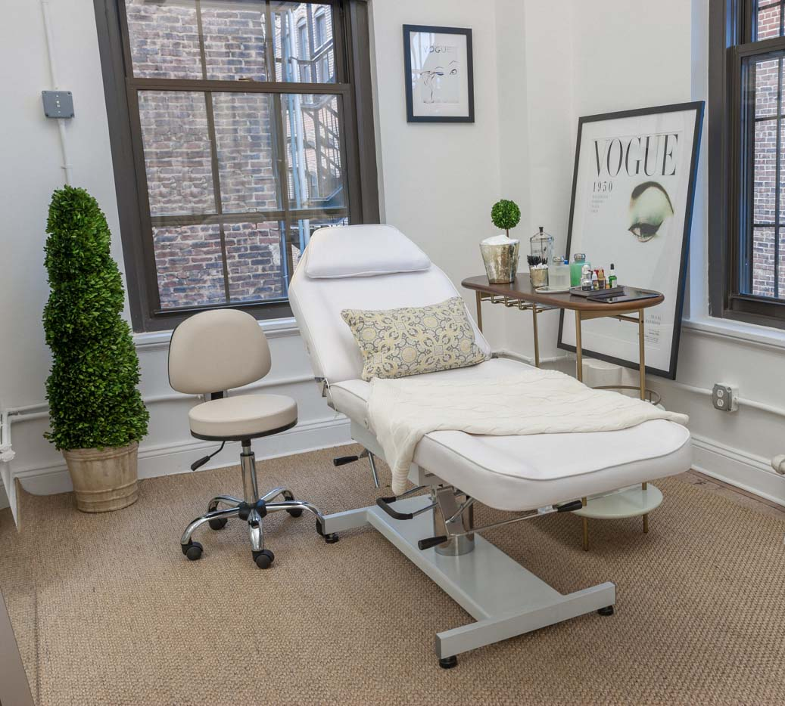
OUR MISSION
"Our mission is to provide our clients with an exceptional, private, and one-on-one cosmetic experience that ensures our client is relaxed, pampered, and walking out of our salon feeling like a million bucks."

Slide 3
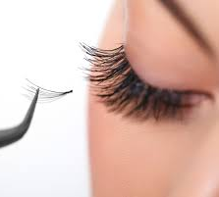
COMPANY DESCRIPTION
OWNER: BRITTANY STARR
ESTABLISHED: 2019
LOCATION: LIHUE
TARGET AUDIENCE: MOTHERS, WOMEN, FASHIONISTAS, LADIES WHO ARE TIRED OF PUTTING ON MAKEUP EVERYDAY
REVENUE: $50,000 ANNUALLY

Slide 4

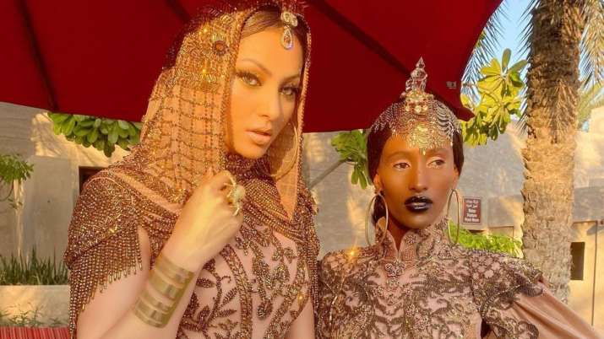

TARGET MARKET
Businesswomen
Fashion Divas
Mothers

Slide 5
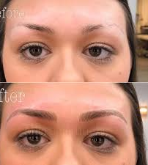
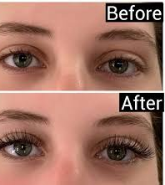
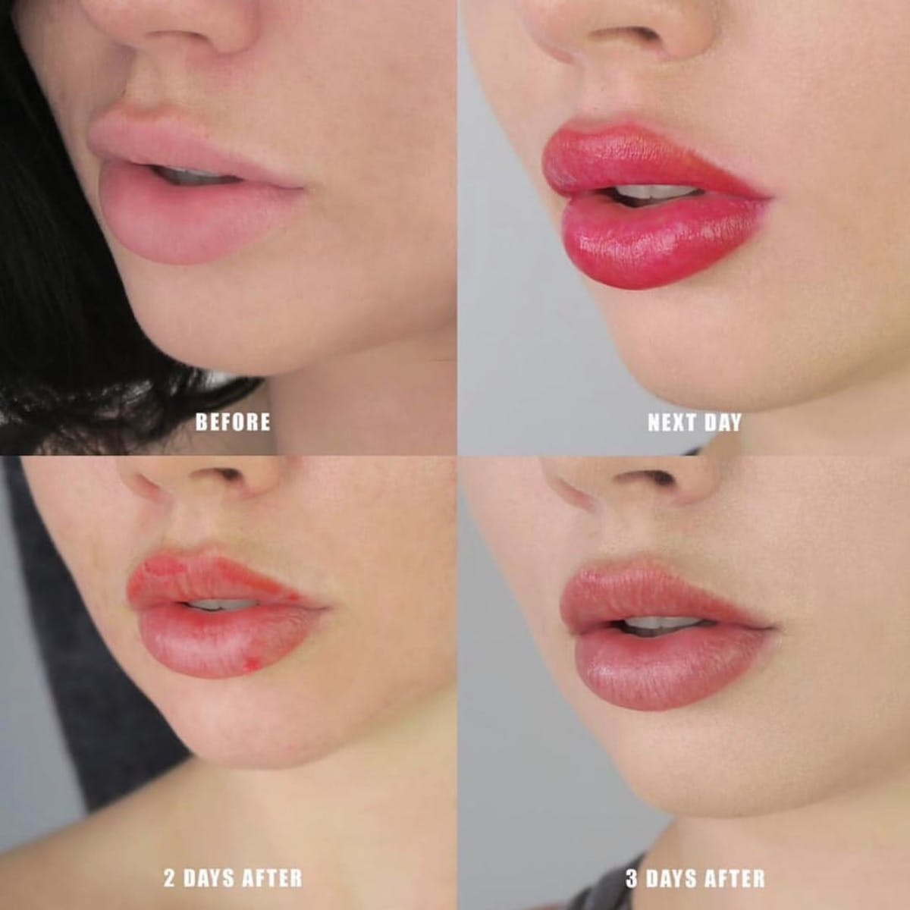
SERVICES
Brows
  Microblading, Powder Ombre, Combination Brows
Eyeliner
  Top and Bottom
Lip Liner/Blush
Lash Extensions
  Classic, Hybrid, Volume
Waxing
  Facial, Body, Brazilian

Slide 6
MARKETING & SALES
Facebook
Instagram
Radio Ads
Business Website
Word of Mouth
Walking Advertisement
Referral Programs and Discounts
Seasonal Promotions

Slide 7
MARKET ANALYSIS
The beauty industry will continue to grow and is expected to reach a market value of $805 billion by 2023
Entry barriers are relatively low
State Regulations, licenses, and inspections
Competitors – already established salons and individuals working out of their home

Slide 8
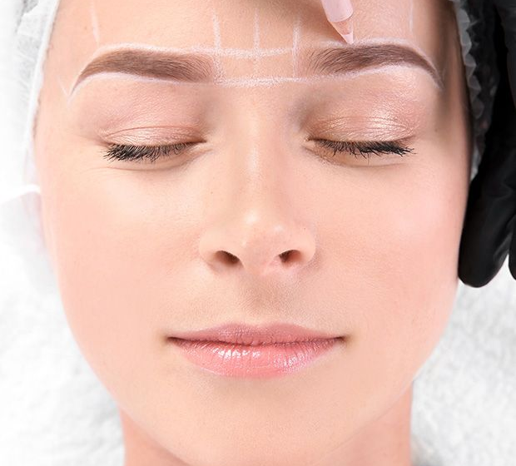
ORGANIZATION & MANAGEMENT
Locally owned and operated
Single member LLC converted into a S-Corp
President = Owner = Esthetician
No Board of Directors

Slide 9
BUSINESS OPERATIONS
Owner/Esthetician
Receptionist
Comestic Procedures
Day to Day Operations

Slide 10
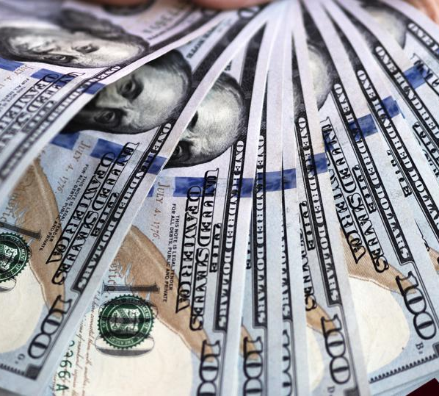
FUNDING
Start-up Costs
  $25,000 - $30,000
Funding Request
  $25,000
Owner's Investment
  $5,000

Slide 11
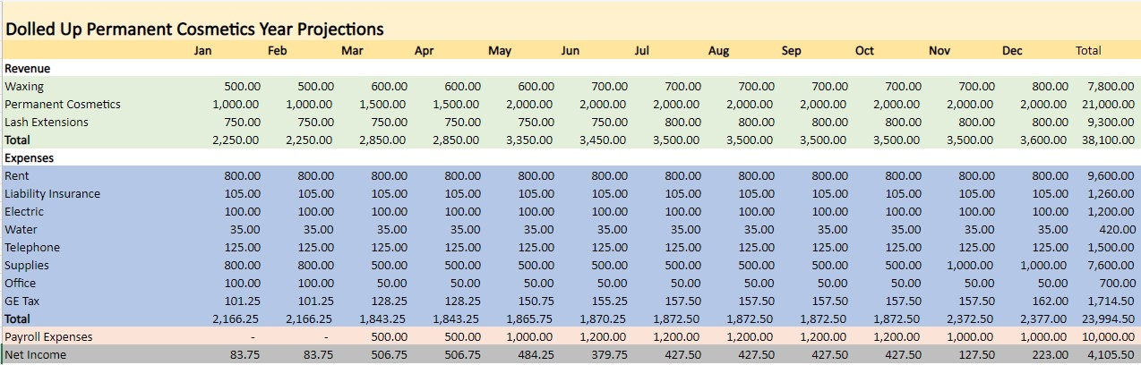
FINANCIALS

Slide 12
REFERENCES
Biron, B. (2019, July 09). Beauty has blown up to be a $532 billion industry - and analysts say that these 4 trends will make it even bigger. Retrieved September 10, 2020, from https://www.businessinsider.com/beauty-multibillion-industry-trends-future-2019-7
Can cosmetic tattooing enhance the make-up industry? (2016, January 20). Retrieved September 10, 2020, from https://www.cosmeticsbusiness.com/technical/article_page/Can_cosmetic_tattooing_enhance_the_makeup_industry/114962
Cosmetics Market Size, Share, Industry Trends and Analysis. (n.d.). Retrieved September 13, 2020, from https://www.alliedmarketresearch.com/cosmetics-market
Culbertson, K. (2020, January 22). [Digital image]. Retrieved October 31, 2020, from https://beautybabeclub.com/microblading-vs-ombre-powder-brows/
Fitzpatrick, K. (2019, March 26). [Digital image]. Retrieved October 31, 2020, from https://www.glambydang.com/blogpost/lashextension101
Ketabchi, N. (2019, August 22). Looks That Thrill - Inside the Booming Beauty Industry. Retrieved September 13, 2020, from https://www.toptal.com/finance/growth-strategy/beauty-industry
Kopp, C. (2020, September 02). Understanding Product Life Cycles. Retrieved October 12, 2020, from https://www.investopedia.com/terms/p/product-life-cycle.asp
(n.d.). Retrieved September 13, 2020, from https://worldpopulationreview.com/us-counties/hi/kauai-county-population
Permanent Makeup FAQ - Society for Permanent Cosmetic, Micropigmentation, Permanent Makeup, Microblading and Cosmetic Tattoo Professionals. (n.d.). Retrieved September 13, 2020, from https://www.spcp.org/thinking-of-getting-a-cosmetic-tattoo/permanent-makeup-faq/
What Is an Average Permanent Makeup Artist's Salary in 2019? (2020, June 03). Retrieved September 13, 2020, from https://www.pmuhub.com/what-is-an-average-permanent-makeup-artists-salary-in-2019/

