Slide 1
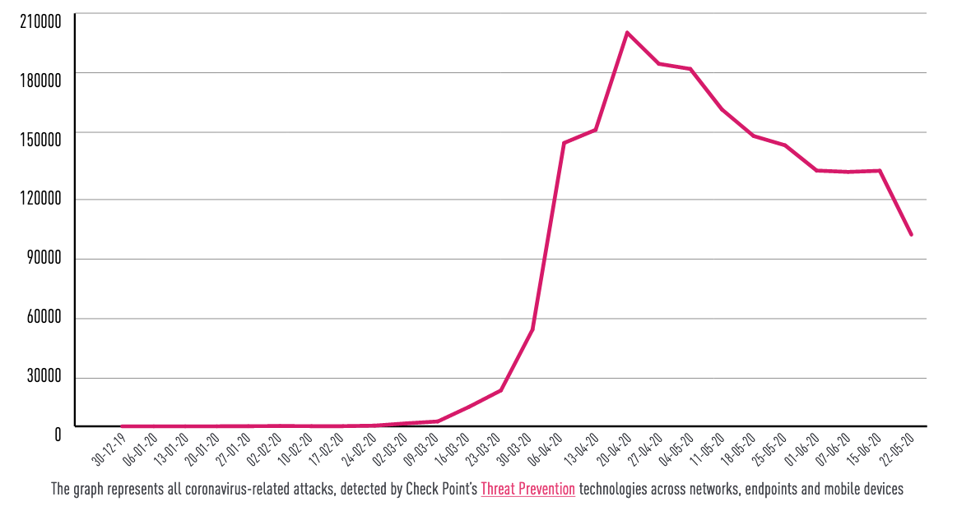
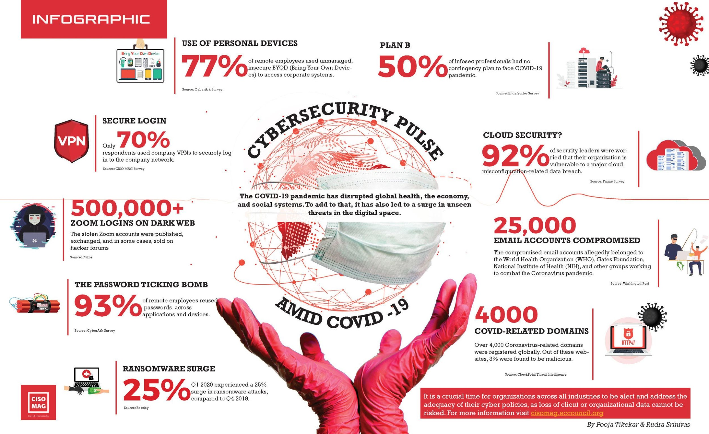
University Logo
Impact of a Global Pandemic on Information Security
University Logo
Taylor Williams
¹University of Hawaii - West Oahu
Abstract
Research Design & Data Collection
The start of the year brought with it the first global pandemic in the age of technology. Never before has technology been as advanced and as a result we are presented with a new set of problems not present during past pandemics. Businesses have elected for employees to work from home and according to statista.com, the number of employees in the United States working remotely over 5+ days per week has increased from 17% to 44% Because of this increase in the remote workforce, many companies have been attempting to find ways to support employee access to critical processes and data while maintaining the security of systems and networks. With this increase in employees working from home and associated vulnerabilities, organizations are becoming increasingly concerned about cybersecurity threats and attacks. The goal of this project is to determine if an increase in the number and type of cybersecurity attacks are attributable to remote workforce requirements in response to the COVID-19 pandemic.
A review of published studies was conducted to identify available data and statistics related to the cybersecurity impact of COVID-19 related to an increased remote workforce. Information was identified related to the change in organizational policies in response to remote workforce requirements and how employees are expected to securely access the company network. The study also identified and evaluated the most common attack vectors to determine if the shift to remote work caused by the pandemic had a negative impact on the cybersecurity of organizations.
Chart 1. Label in 24pt Calibri.
Introduction & Research Question
Results
Discussion
Introduction
Due to covid-19, the way society operates has undergone many changes to include how companies manage information security. To comply with social distancing and reduce the spread of the disease, many organizations are allowing employees to work from home which introduces a new set of security concerns. This project will focus on studies conducted over the course of the pandemic to date to analyze whether the increase in remote work has also led to an increase in cyber-attacks for organizations.
Research Question
What impact has the COVID-19 pandemic had on cybersecurity with the increase in a remote workforce?
What impact has the COVID-19 pandemic had on the type and frequency of cybersecurity threats and attacks that targeted remote workforce users?
Hypothesis
The results are expected to show an increase in cybersecurity attacks, specifically phishing, VPN, and DDoS attacks. From the results, we will be able determine if the increase of attacks is due to the COVID-19 pandemic and vulnerabilities related to a from remote work environment. It is expected that the research and statistical analysis will support the theory that the pandemic caused an increase in the number of attacks and potential actions to decrease or combat future attacks to include training, monitoring, and implementing other safeguards.
The analysis of Data from a study of cyberattack trends conducted by Check Point Research showed a sharp increase in the number of cyberattacks beginning in March 2020 when companies were first required to comply with stay-at-home orders mandated across the country which resulted in increased levels of remote work for both essential and non-essential businesses with the largest spike occurring towards the end of April. Although we cannot attribute this sharp raise solely to remote workers, there appears to be a correlation between the occurrence of these two conditions. According to Panda Security, 47% of employees were victims of a phishing scam due to at-home distractions and 76% of workers saying that remote work is increasing the time it takes to contain a breach, we are able to confirm that remote work during the pandemic is a factor responsible for the frequency and severity of cyberattacks.
According to pandasecurity.com, “covid-19 can already be classified as the largest-ever cybersecurity threat” with the amount of data breaches increasing as the pandemic goes on (43 COVID-19 Cybersecurity Statistics, 2020). The U.S Chamber of Commerce reported that “IBM X-Force, a world-renowned commercial security research team, observed a more than 6,000% increase in Covid-19-themed spam from March 11 to May 8, 2020” (Assessment of Business Cyber Risk, 2020). Insider threat has always been one of the leading security threats to organizations, either through malice or human negligence and poor training. Malicious actors are using the pandemic and the uncertainty around it to take advantage of these vulnerabilities to access company databases and information pulled from online meetings. Considering these statistics and data, as well as the attacks vectors used by malicious actors, we can conclude that the increase of remote work due to the pandemic is causing an increase in cyber-attacks. Using this knowledge, organizations can then implement safeguards and push employee training about security and personal devices to decrease future attacks.
Conclusions
Table 1. Label in 24pt Calibri.
After completing the research necessary for this project, it was clear that there is an increase in cybersecurity incidents and attacks, and a large portion of those incidents and attacks are caused by the increase of remote work. We also see how throughout the pandemic, vectors and methods of attack change over time and we could start to see the trends decrease as organizations develop contingencies and overcome some of the vulnerabilities previously stated. Even at the time of writing this paper, things are constantly changing, and it is up to organizations to remain cognizant of how these changes affect their security posture.
Contact
References
Taylor Williams
University of Hawaii – West Oahu
Email: twillia9@Hawaii.edu
43 COVID-19 Cybersecurity Statistics. (2020, September 01). Retrieved October 17, 2020, from https://www.pandasecurity.com/mediacenter/news/covid-cybersecurity-statistics/
Assessment of Business Cyber Risk. (n.d.). Retrieved October 17, 2020, from https://www.uschamber.com/cybersecurity-covid/
Holst, A. (2020, July 03). Remote work frequency before/after COVID-19 2020. Retrieved September 13, 2020, from https://www.statista.com/statistics/1122987/change-in-remote-work-trends-after-covid-in-usa/
Tikekar, P. , Srinivas, R. (2020). Cybersecurity Pulse Amid COVID-19. Retrieved September 22, 2020, from https://cisomag.eccouncil.org/wp-content/uploads/2020/09/CISO-MAG_July_2020_Main_Magazine_Double_Spread_Page_24-scaled-e1600624835933.jpg

