Slide 1

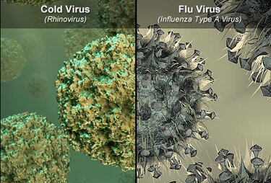
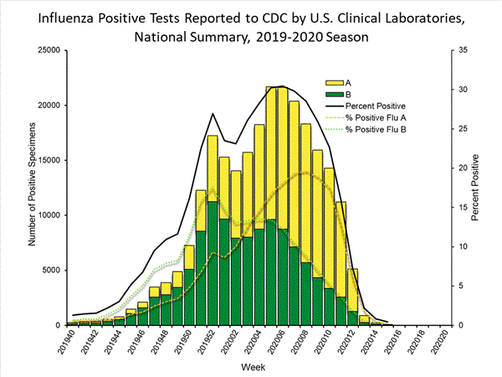
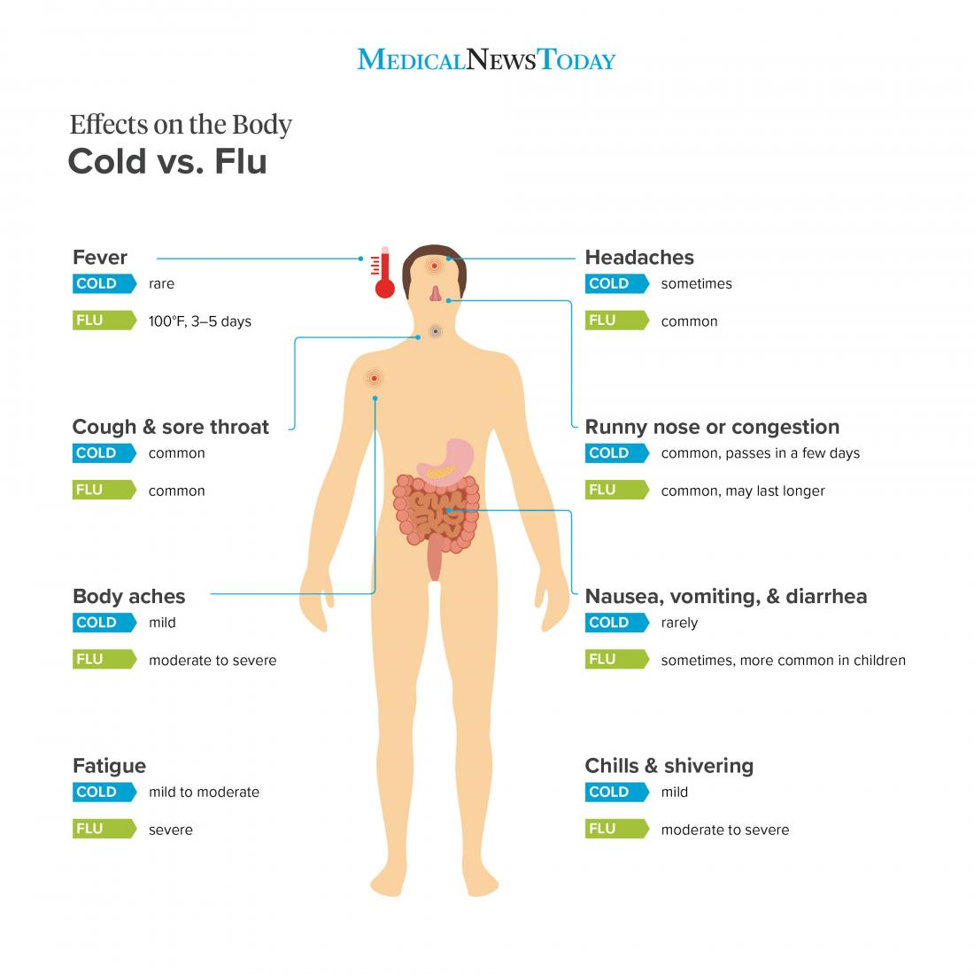

University Logo
Flu Virus vs. Cold Virus: Vaccine for One and Not the Other
Ardena Thompson and Shanel Pagaragan
University of Hawai’i West O’ahu
Abstract
Background Information
Vaccinations are important for all individuals of all ages to protect them from serious diseases and reduce the chances of spreading it loved ones.² The influenza virus is one of the few types of viruses that has a vaccine.
The flu and the common cold are known to share similar symptoms, but the flu is considered more severe and has the capability of making health problems worse.
The cold virus:
An acute infection of the upper respiratory tract
Caused by the rhinovirus, but other viruses can play a role
No vaccine for the common cold
Over-the-counter medication can ease symptoms
The common cold affects millions of people, adults get it at least 2-3 times per year
The flu virus:
A viral infection that attacks the lungs, nose, and throat
Caused by influenza viruses
Flu vaccines reduce flu illness by 40-60%
Figure 1. Microscopic Differences Between the Common Cold and the Flu Virus.
Figure 2. Positive Influenza tests reported in the U.S. during the 2019-2020 season.
Introduction & Research Question
Discussion
The flu virus and cold virus are both known to affect numerous individuals each year. Despite this and the fact that both share similar symptoms, there is only a vaccine for the flu. Unlike the flu, however, the cold is considered a mild illness and consists of countless viral strains.
Due to recent worldly events, my partner and I chose this topic in relation to those current events. With the discussion of vaccines and the need for vaccines for COVID-19, our research question is: Why is there a vaccine for the flu but not the cold?
Results From Scientific Sources
Both the common cold and the flu are caused by a virus, but there are different levels of severity between the two.
There are numerous discussions on vaccines, more specifically for the flu due to the seasonal flu every year.
    There are discussions of creating a universal influenza vaccine with the use of new technology. However, there are limitations such as fully understanding the influenza virus.
Producing a vaccine for the common cold has proven to be difficult.
Compared to the flu, the common cold is considered mild and is not nearly as fatal.
Differences between Influenza and the Common Cold⁴
  Influenza is often linked to secondary bacterial infections
  Estimated 3 to 5 million cases of severe illness caused by influenza each year, with 250,000-500,000 deaths
    risk is greater for high risk groups (children and the elderly)
Development of Universal Influenza Vaccine¹
  Numerous topics of the influenza virus, ranging from the history of the influenza virus and possible pathways on how to reinvent and expand the flu vaccine.
  Universal vaccination for the influenza has many possibilities of being discovered by the improvement of the selection of vaccine strains, understanding B-cell responses, or understanding the body’s immunity through immunization.
Vaccines for the Common Cold and a Possible Cure^{3 and 6}
  Producing vaccinations is extremely difficult because the sources and antigens of the virus vary greatly
  Uncertainty in regards to its effectiveness
  A study was conducted using adenovirus vaccines to prevent the common cold in healthy people. However, there was no significant difference in common cold incidence and the evidence did not support the use of it.
  An approach that has been looked into is preventing rhinoviruses from replicating inside cells. This has been accomplished in mice and human cells in culture. The approach is to temporarily disable a non-essential protein in cells that all viruses need in order to replicate.
Looking Ahead
There is a difference in severity between the flu virus and cold virus. In comparison to the common cold, the flu causes more deaths per year. Therefore, there is a higher demand for a flu vaccine than one for the common cold.
A vaccine to prevent the common cold is difficult to produce due to its antigenic variability and the numerous viruses and bacteria that can play a role. On the positive side, the common cold does not typically last long, and in most cases, individuals recover without the need for medical treatment.
New approaches to a cold vaccine prove hopeful for the future.
Although vaccine effectiveness varies each year for the flu, studies have shown that vaccination reduces risk by 40-60%.
    The benefits for flu vaccination include preventing influenza illnesses, flu-associated hospitalization, and a reduction in severity if an individual still gets sick.
Figure 2. Cold symptoms are far less severe than flu symptoms.
References
¹ Michelle C Crank, John R Mascola, Barney S Graham, Preparing for the Next Influenza Pandemic: The Development of a Universal Influenza Vaccine, The Journal of Infectious Diseases, Volume 219, Issue Supplement_1, 15 April 2019, Pages S107–S109, https://doi.org/10.1093/infdis/jiz043
² Centers for Disease Control and Prevention. “Reasons for Adults to Be Vaccinated.” Centers for Disease Control and Prevention, Centers for Disease Control and Prevention, 2 May 2016, www.cdc.gov/vaccines/adults/reasons-to-vaccinate.html.
³ Guerra, C. V., & Hidalgo, R. (2013, June 12). Vaccines for the common cold - Simancas‐Racines, D - 2013: Cochrane Library. Retrieved from https://www.cochranelibrary.com/cdsr/doi/10.1002/14651858.CD002190.pub4/abstract
⁴ Mayrhuber, E. A.-S., Peersman, W., van de Kraats, N., Petricek, G., Ćosić Diviak, A., Wojczewski, S., & Hoffmann, K. (2018, December 12). "With fever it's the real flu I would say": laypersons' perception of common cold and influenza and their differences - a qualitative study in Austria, Belgium and Croatia. Retrieved from https://www.ncbi.nlm.nih.gov/pmc/articles/PMC6292159/
⁵ Weekly U.S. Influenza Surveillance Report. (2020, April 17). Retrieved from https://www.cdc.gov/flu/weekly/index.htm
⁶ Goldman, B., & Huber, J. (2019, September 17). Scientists close in on a cure for the common cold. Retrieved from https://scopeblog.stanford.edu/2019/09/16/scientists-close-in-on-a-cure-for-the-common-cold/

