Slide 1


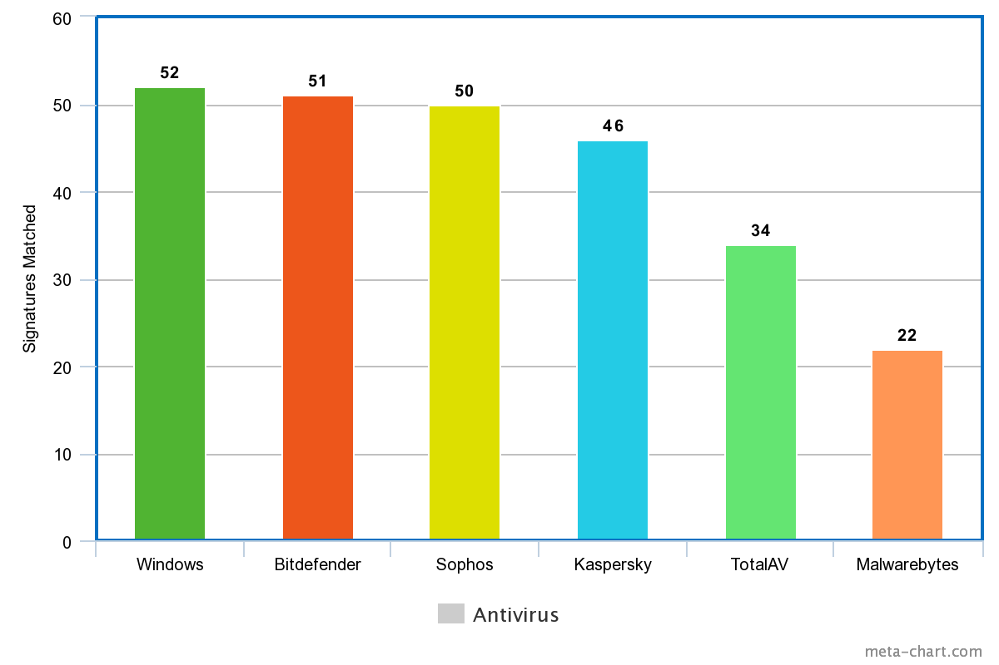
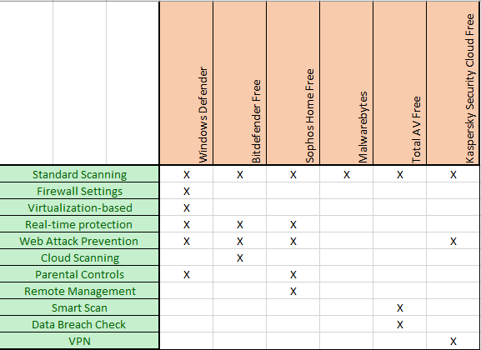
ANALYSIS OF FREE ANTIVIRUS SOFTWARE COMPARED TO WINDOWS DEFENDER ON WINDOWS COMPUTERS
Christian de Anda
University of Hawaii – West Oahu
Abstract
Research Design & Data Collection
The data will be collected by a series of tests and looking at the functions present and operational. The first test will see if the anti-virus will detect and/or prevent malware from executing. The malware that will be used for this test is not actual malware but a safe file whose only purpose is to test antivirus software. The second test will use malware signatures in hashed MD5 format to test if the anti-virus will detect it. The final test will look at the features that come with AV products like password managers and real-time/scheduled scans.
The main research instrument that will be used will be a Windows 10 virtual machine installed on a personal computer system. The antivirus programs used in this research project are Windows Defender, TotalAV free, Bitdefender Antivirus Free Edition, Kaspersky Security Cloud, Sophos Home Free, and Malwarebytes. The test tools used to test the antivirus software will be the WICAR.org website, and AMTSO Security Features Check. These tools will emulate activities like browser exploits, phishing pages, drive-by and manual downloads containing malware, and more. Malware signatures will be obtained from the VIrusShare.com website and the website VirusTotal which will analyze the hashes for a match to a known malware exploit.
The purpose of this project is to compare the security characteristics of various free consumer antivirus products. The goal for this project was to conclude which antivirus is currently the most secure and functional while also comparing additional and unique features based on a score from 1-10 depending on the results of the test and functionality.
Introduction & Research Question
Introduction
With millions around the world migrating to working from home there is a surge of people who are not well informed about the danger and proper protections they need on their personal computers. Fortunately, free software can help protect against malicious activity on your computers and or networks, and one of them is the antivirus. Many companies offer free antivirus products, but which products are effective as some may cause problems in performance or use the façade of free antivirus to gain access to a PC. Antivirus protection is a must-have for every computer due to the constantly evolving practices of malicious threats and increased risk.
Research Question
How does the performance of Microsoft Windows Defender security software compare to free anti-virus products?
How does the additional features of third-party anti-virus products impact the decision to purchase additional security software for Windows based computer systems with Microsoft Defender?
Hypothesis
Microsoft Windows systems do not need additional anti-virus protection as Windows Defender is effective for everyday use and basic security. However, should users seek additional features, there are some free anti-virus products that provide features Windows Defender does not have.
Chart depicting phase2 results.
Discussion
1st Phase - Some features that were a great addition to the tools would be the real-time/ web protection to stay away from harmful sites and malicious downloads, the data breach checker, a password manager, and VPN but in my opinion, it is not worth downloading a 3rd party AV for an additional feature.
2nd Phase - It was interesting to see that there were some areas where for some malware all of them detected it, and somewhere only the two least performing only detected it. I also did them in sets where the first set contained malware from early in the 2010 decade and all, but Malwarebytes did good (at least 20/25) and as the sets progressed across the board the detection was lower in each phase.
3rd phase - It was interesting to see the way the AV’s interacted with the malicious test files. All the text files were not able to be downloaded except TotalAV and the other AVs would only detect the files when they are already on the system.
I gave Windows Defender a 9/10, Bitdefender a 7/10, Sophos 7/10, Kaspersky a 6/10 , TotalAV a 5/10, and Malwarebytes a 3/10.
Results
The phase 1 results are in the chart down below. Some noticeable takeaways is that all anti-virus contained standard scanning, and that Windows features were specially designed for the Windows Operating system while Kaspersky, TotalAV, Bitdefender and Sophos contained at least one thing Windows Defender did not have. Phase 2 results are displayed on the bar graph on the top right where Windows Defender got the most signatures detected, and Malwarebytes had the least. For the third test, which focused on the applications that supported real-time or web-based protection functions included with some of the AV software, functioned properly and blocked the download link completely, except for Total AV. For the next series of tests done on AMTSO, the results were like the last where Kaspersky and Bitdefender had both desktop notifications and webpage warnings. Sophos had desktop warnings, Windows Defender had webpage warnings and all four blocked the download and Total AV did not respond to the threat.
Chart depicting phase 1 results
Conclusions
Looking at the results, based on the features, Windows Defender, Kaspersky and Sophos would win in this department. Based on Phase two Windows had the highest detection rate, with Bitdefender and Sophos close behind. Finally, Windows defender, Kaspersky, Sophos, and Bitdefender performed exceptionally and blocked all the tests on AMTSO.
Contact
References
Christian de Anda
Email: cdeanda@hawaii.edu
Anderson, S. (2020, May 15). Is Windows Defender Good Enough in 2020? (You Won't Like the Answer). Retrieved November 17, 2020, from https://www.safetydetectives.com/blog/windows-defender-vs-antiviruses-is-defender-enough-for-you/
Aslan, O., & Samet, R. (2020). A Comprehensive Review on Malware Detection Approaches. IEEE Access, 8, 6249-6271. doi:10.1109/access.2019.2963724
Batt, S., & Simon Batt (306 Articles Published). (2019, June 21). 5 Ways to Safely Test Your Antivirus Software. Retrieved November 17, 2020, from https://www.makeuseof.com/tag/how-to-safely-test-your-antivirus-software/
Fearn, N. (2020, August 11). Why is it important to actually use antivirus software? Retrieved November 17, 2020, from https://www.windowscentral.com/why-it-important-actually-use-antivirus-software
Johansen, A. G. (2019). What is antivirus software? Antivirus definition. Retrieved November 17, 2020, from https://us.norton.com/internetsecurity-malware-what-is-antivirus.html
Kan, M. (2020, January 27). The Cost of Avast's Free Antivirus: Companies Can Spy on Your Clicks. Retrieved November 17, 2020, from https://www.pcmag.com/news/the-cost-of-avasts-free-antivirus-companies-can-spy-on-your-clicks
Real-World Protection Test Methodology - AV-Comparatives. (2020, October 08). Retrieved November 17, 2020, from https://www.av-comparatives.org/real-world-protection-test-methodology/
Security Tip (ST04-005). (2019). Retrieved November 17, 2020, from https://us-cert.cisa.gov/ncas/tips/ST04-005

