Slide 1

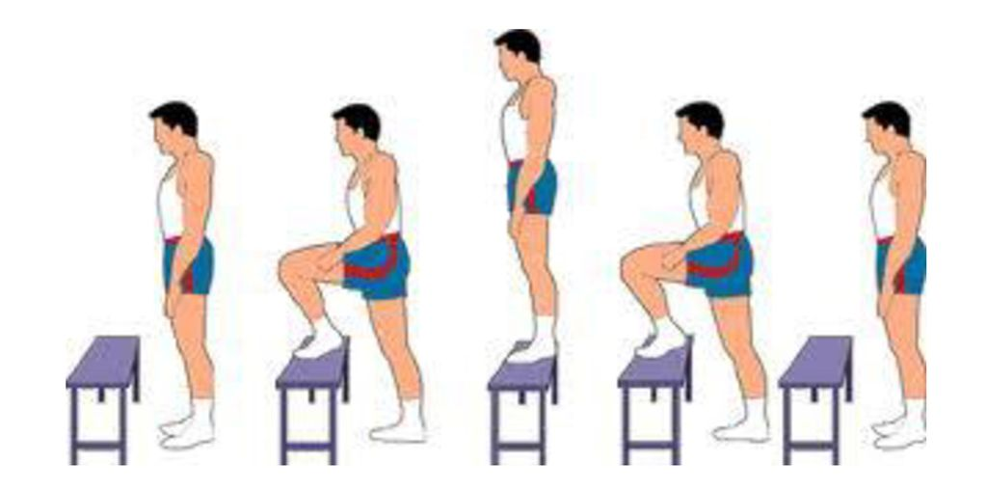
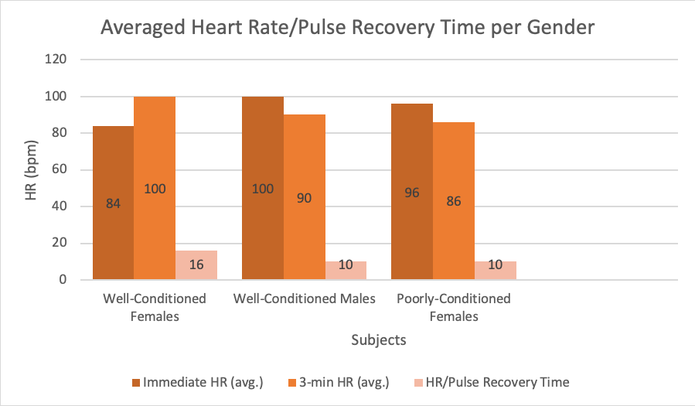
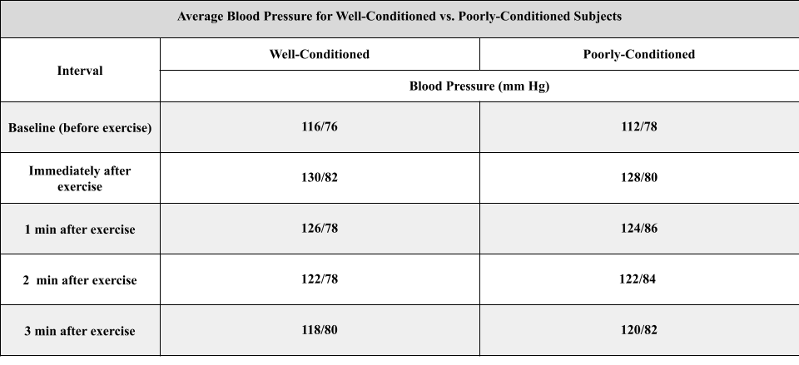
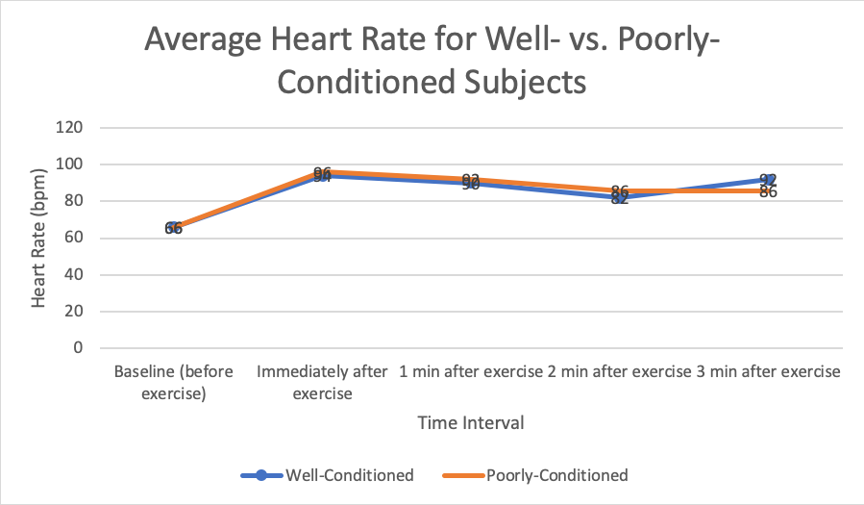

Measurements of Blood Pressure and Heart Rate in College Students
Jamie Ann Delos Reyes, Ardena Thompson, Tanner Gomes, Rylee Sampson, Malia Yadao, and Rebecca Romine
University of Hawaiʻi – West Oʻahu
Abstract
Six subjects, three well-conditioned and three poorly conditioned, performed the Harvard Step Test.
The well-conditioned subjects had a quicker heart rate recovery of 27 bpm after exercising compared to the poorly-conditioned subjects heart rate recovery of 20 bpm
The well-conditioned subjects were physically fit and were able to regulate blood pressure and pulse after exercise better than the poorly-conditioned subjects
Cardiovascular health is important because it can indicate the presence of cardiovascular diseases. Testing blood pressure and pulse after exercise in well-conditioned and poorly-conditioned subjects indicate the health advantages and differences seen in cardiovascular health based on lifestyle choices and habits.
Figure 1: Example of Harvard step test being performed
Results
Averages for BP were rounded to the nearest even whole number.
Averages for HR were rounded to the nearest whole number.
Figure 2. Heart Rate/Pulse Recovery Time per Gender
Introduction
Discussion
Medicine aims to increase life expectancy by promoting healthy living. The leading cause of death worldwide is heart disease for both men and women. Risk factors for heart disease include age, ethnicity, genetics, high blood pressure, and obesity. Regular exercise and physical activity have many positive effects on heart physiology.¹
The average heart rate for females is 72-80 beats per minute (bpm) and for males is 64-72 bpm.¹ Exercise results in acute increases in heart rate (HR) and systemic blood pressure (BP) through the sympathetic nervous system, and promotes long-term adaptations of cardiovascular health including decreased HR and BP.¹ A physically fit subject has lower resting heart rate than subjects in poor physical condition. Subjects in excellent physical condition exhibit a resting heart rate as slow as 40 bpm.¹ The aim of this experiment was to determine the effect of exercise on HR and BP.
Table 1. Average Blood Pressure for Well- vs. Poorly-Conditioned Subjects
Cardiac physiology is an important topic for healthy living, and can be studied through the assessment of HR and BP. Changes in BP plays a role in blood flow to other vital organs.1 Based on the results, the Harvard Step test provided the subjects assistance in determining the importance of heart health through exercise. When the heart takes longer after exercise to decrease and normalize, this is can be an indication that the heart is not healthy. In the results, there were a few subjects whose BP and HR remain elevated even after three minutes of exercise. In Hawaii, there was approximately 36.8% of college students who has high blood pressure.2 High BP meant having a BP with systolic 130-139 mmHg and diastolic 80-89 mmHg.3 One of the limitations for this experiment was the unequal amount of gender roles in each test. Another limitation is the possible inaccuracy of recording the data due to human error and inexperience.
Research Design & Data Collection
Conclusion
Baseline blood pressure was taken after subjects quietly stood for two minutes⁴
The Harvard step test consisted of a sequence of steps onto and off of a 20 inch tall platform for male subjects and 16 inch tall platform for female subjects done at a steady pace of “Up-up-down-down, up-up-down-down”, with each “Up-up-down-down” sequence completed in two seconds⁴
Bench stepping continued for at least two minutes and did not exceed five minutes⁴
After completion of bench stepping, HR and BP were taken immediately, then again at one, two and three minutes post-exercise⁴
When exercising, the heart needs more oxygen, and the heart has to pump faster to get the blood through the rest of the body. During exercise, the cardiac output increases more than the total resistance decreases, so the mean arterial pressure usually increases by a small amount. Pulse pressure increases because of an increase in both stroke volume and the speed at which the stroke volume is ejected. BP and HR was elevated because it takes time for the pressure and pulse to return back to normal after exercising for a certain amount of time. Having high blood pressure would only cause the blood pressure and heart rate to increase then start to fall back to normal. The cardiac output increases with exercise due to a large change in heart rate. Overall, as the body exercises it needs more oxygen, meaning the heart has to pump more blood to the body causing the heart rate and blood pressure to increase.
Figure 1. Average Heart Rate for Poorly-Conditioned Subjects
1. Marieb, Elaine N, and Katja Hoehn. Human Anatomy & Physiology . 11th ed., Pearson Education, 2019, Pearson.com
2. “Trends: High Blood Pressure-Some College, Hawaii, United States.” Edited by America's Health Rankings, America's Health Rankings: United Health Foundation, United Health Foundation, 2019, www.americashealthrankings.org/explore/annual/measure/Hypertension/population/hypertension_Some_College/state/HI.
3. “Facts About Hypertension.” Centers for Disease Control and Prevention, Centers for Disease Control and Prevention, 25 Feb. 2020, www.cdc.gov/bloodpressure/facts.htm.
4. Lucien Brouha M.D. (1943) The Step Test: A Simple Method of Measuring Physical Fitness for Muscular Work in Young Men,Research Quarterly. American Association for Health, Physical Education and Recreation,14:1,31-37,DOI: 10.1080/10671188.1943.10621204

