Slide 1

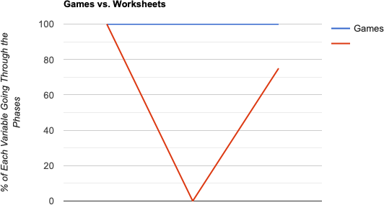
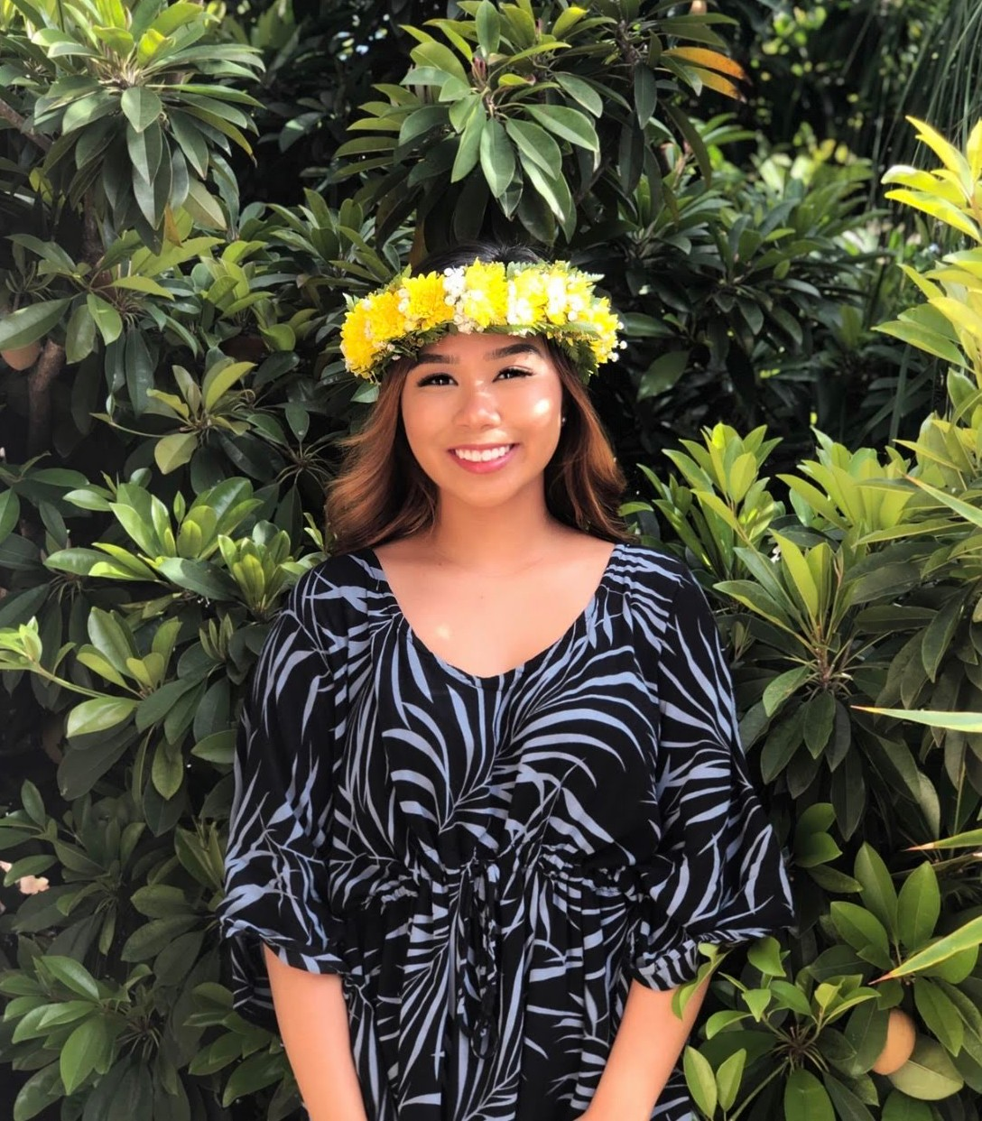
Building Math Fluency With Games!
University
Logo
University
Logo
Krysten Caraang
University of Hawaii at West O’ahu – Kapolei, HI 96707
Abstract
Research Focus
Discussion
Various studies have shown that when teachers provide repeated opportunities for students to play games in the math classroom, it often results in the development of computational fluency, mathematical thinking, and fun mathematical practice. Developing computational fluency is necessary under the Common Core State Standards for Mathematics. Timed tests and drill techniques don’t have the same ability to provide meaningful practice that games do. When students develop their computational fluency off timed tests or drilled techniques, they arrive at the conditioned state of automacy. They can quickly identify or recognize answers, but they cannot justify why and how they got their answer. Studies show that overtime, students can lose their computational fluency because they weren’t based on their own understanding. On the other hand, when games are used to build fluency, students become actively engaged with the tasks and experiences in the games, which challenge them to build their math understanding. Procedural fluency and conceptual understanding develops through problem solving, and reasoning that students go through as they play and interact with their peers and teachers to justify their answers (Rutherford, 2015).
This research project was focused around one question:
Does playing games increase math fluency, reasoning, understanding and engagement more than worksheet practice?
To help find information to support my hypothesis, research was conducted through the National Council of Teachers of Mathematics and at a seminar at the Hawaii Council of Teachers of Mathematics Conference. The articles and seminar information discuss and support key points related to the hypothesis.
Based on the different resources, majority of them agree that playing games increases math fluency more than doing worksheet practice. Students must progress through each of the three phases to develop fluency and mastery. Worksheets tend to ignore the second phase and move quickly between Phase 1 straight to Phase
3. As a result of this, students gain automacy through repetition, rather than mastery through meaningful learning experiences provided by games. Games provide students with the opportunity to choose strategies and to justify their reasoning to solve problems. Games must be paired with student-student and student-teacher interactions, so students can reflect on and examine their mathematical understanding and explain their reasoning. When this happens, students’ reasoning strategies develop along with their motivation and interest.
Results
Worksheets
Conclusions
Games strengthen students reasoning, understanding and justification skills, while also building their fluency by providing meaningful learning opportunities in each phase of learning.
Games increase students’ motivation, engagement and learning more than if they were just to do worksheet practice.
Games result in mastery of numbers and computations, instead of automacy and memorization resulted through timed tests.
Introduction
Effective teaching practices provide experiences that help students to connect procedures with the underlying concepts and provide students with opportunities to rehearse or practice strategies and to justify their procedures. Practice should be brief, engaging, purposeful, and distributed (Rohrer, 2009). Too much practice too soon can be ineffective or lead to math anxiety (Isaacs & Carroll, 1999). Often, students are being drilled with worksheet after worksheet to help them gain math fluency. Mathematical practices should be brief, engaging and purposeful. Teachers need to start replacing these fluency worksheets with math games that strengthen fluency, engagement, problem solving skills and reasoning.
Phase 1
Phase 2
Phase 3
Phases Students Must Go Through to Gain Fluency (Bay- Williams & Kling, 2014)
References
Phase 1: Counting to find the answer; ex: using fingers to help keep track of their counts to solve 4 + 9 = ?
Bay-Williams, J. M., & Kling, G. (2014, November). Enriching Addition and Subtraction Fact Mastery through Games. Retrieved from https://www.nctm.org/Publications/Teaching-Children- Mathematics/2014/Vol21/Issue4/Enriching-Addition-and-Subtraction-Fact-Mastery-through-Games/
Lum, J. (2019, September). Aha! Finding the Joy in Mathematics Hctm Conference 2019. AHA! Finding the Joy in
Mathematics HCTM Conference 2019. Honolulu.
Rutherford, K. (2015, April 27). Why Play Math Games? Retrieved from https://www.nctm.org/Publications/Teaching-Children-Mathematics/Blog/Why-Play-Math-Games_/
Phase 2: Deriving answers using reasoning strategies based on known facts, such as solving 4 + 9 by thinking, “Five plus five
Contact
equals ten, and two more will make twelve.”
Krysten Caraang
University of Hawaii at West O’ahu Email: kjnc@Hawaii.edu
Phase 3: Mastery or efficient production of answers. Ex: “What is 4 + 9?” a child might call out, “Twelve,” and explained, “I just knew it.”

