Slide 1

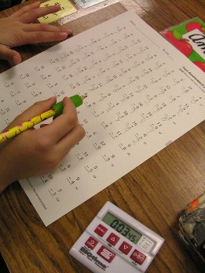
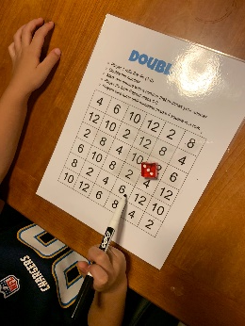





Math Fluency
University Logo
^{Macy Thoemmes}
University of Hawaii West O’ahu, Kapolei, HI 96707
Abstract
Method
Research and Discussion
The goal of this study is to recognize the fact that there are numerous ways to teach and enhance a child’s math fluency skills, aside from the typical timed test, flash cards, and worksheet strategies. Research shows that that there are far more effective strategies to use as a way to test and build a child’s sense of math fluency. In order to be an effective teacher, it is important to understand the three phases of learning basic facts. Being aware of these stages in teaching will provide a positive impact on student learning. Teachers must understand the phases that students progress through as well as the significance of meaningful practice in order to effectively build mastery of fluency skills. Meaningful practice is an essential part in learning math fluency because it gives students the opportunity to find interest in the topic and understand how it is significant in the real world. Meaningful practice comes in a variety of different forms including using story problems, ten frames, and games (Bay-Williams 2014). All of these are ways to build math fluency without the unnecessary stress that traditional fluency tests hold.
The method used to find essential information to support the hypothesis was to conduct research through articles found in the National Council of Teachers of Mathematics as well through other journal articles from the University of Hawaii West Oahu Library online databases. The last resource that was used was an organization called YouCubed. All the research included articles that highlighted the key points of the hypothesis by explaining the importance of meaningful practice as a way to enhance students’ math fluency
According to Bay-Williams, there are three phases of learning basic facts that students must progress through to become masterful in their fluency. The first step is modeling and/or counting all or counting on to find the answer. This is where students begin to learn number sense. The second step is deriving answers using reasoning strategies based on known facts. This is an essential stage where students begin to become familiar with strategies to use to solve equations. In this stage, students learn and develop a variety of strategies that they can use to solve their math facts. The last step is mastery or efficient production of answers. In this stage, students have mastered their math facts and can find answers based upon knowing from memory. In order to progress through these three steps, the use of meaningful practice is important. Providing students the opportunity to play games, use story problems, and other practices that are relevant and interesting to students will engage them in the practice of learning math fluency skills (Bay-Williams, 2014).
Research
The common understanding of math fluency is for students to memorize math facts so that they have speed and accuracy when faced with simple calculations (Boaler, 2015). However by gearing students in this direction, students fail to understand why and how those math facts work. Instead, they focus on memorizing what they see. This becomes a problem when students forget what they memorize. In this case, they will be unable to figure out the answer again because they don’t know the reasoning behind it.
Introduction
Conclusions
Math fluency is something so important for people of all ages to have. It is a valuable skills taught in school but the standard, commonly used timed tests don’t seem to have a lasting effect on students' math fact fluency in addition, subtraction, multiplication and division. The pressure of memorizing answers with a purpose of answering a hand-full of questions faster than the clock timer goes off, can often be ineffective when it comes to remembering how to answer basic math facts. Teacher’s need to incorporate a variety of teaching activities to enhance students’ math fluency.
By understanding the three phases of learning basic math facts, teachers can help guide their students through understanding the significance of strategies and reasoning when learning their math facts.
Meaningful practice is an important way to help students progress through the three phases because it allows students to be engaged in their learning.
Timed Test
Can causes Math Anxiety
Uses memorization
Math Games
Engaging tool for students
Uses reasoning and strategy
Contact
References
Macy Thoemmes
University of Hawaii West Oahu
Email: macyit@hawaii.edu
1. Baroody, A. J. (2016). Curricular Approaches to Connecting Subtraction to Addition and Fostering Fluency with Basic Differences in Grade 1, PNA, 10(3), 161-190.
2. Bay-Williams, J. M., Kling, G. (2014) Enriching Addition and Subtraction Fact Mastery through Games, Teaching Children Mathematics. 21(4).
3. Boaler, Jo. (2014). Fluency Without Fear: Research Evidence on the Best Ways to Learn Math Facts. YouCubed. Stanford Graduate School of Education.
4. Rushton, S.J., Hadley, K.M. & Stewart, P.W. (2016). Journal of the International Society for Teacher Education, 20(2), 48-56.

