Slide 1
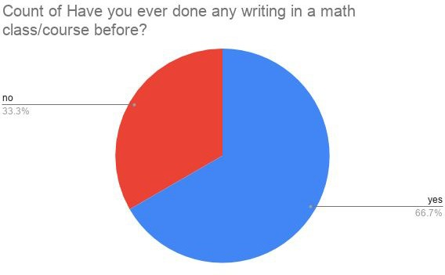
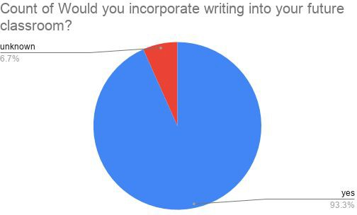

Writing in Mathematics
It is important to incorporate writing into a math classroom because it helps the students collect all their thoughts on paper and reflect on their work (Bixby, 2018). By writing down what the student is thinking and doing while solving a math problem, the student will gain a deeper understanding of the content (Bossé, 2008). Students will also realize that they’re not just being graded on the final answer, but the process of their thinking as well (Bixby, 2018).
Writing tasks also also allow students to practice their communication skills (Bostiga, 2016). The process of gathering ideas, making them understandable for others, and writing it down helps students practice and refine how they communicate with others. Students can also critique their peers writing, and create viable arguments when they disagree (Bostiga, 2016).
The materials used for this research poster are two National Council of Teachers of Mathematics (NCTM) articles and one article thought East Carolina University. These articles support the hypothesis and also give some insight into the research question. This research poster also includes a survey that was given out to sixteen elementary preservice teachers at the University of Hawaii at West O’ahu. The survey not only gives background information on how often these particular people have seen writing in a mathematics course, but it also shows how many preservice teachers are willing to incorporate writing into their future classroom.
Based off of the research conducted, incorporating writing into mathematics classes will be beneficial to the students. Writing in mathematics will give students a better understanding of concepts because they will be diving deeper into the problems (Bossé, 2008). When writing tasks are incorporated into the math class, students can also be assessed on more than just the final answer to a problem (Bixby, 2018). Sometimes students are so focused on getting the right answer to a problem, that they don’t even think about the process of how or why they got the final answer. When students write about their thought process, they can then apply those same thoughts and processes to a more challenging problem and maybe not get the correct answer, but they did apply the correct process. Through writing, the teacher can visually see the thought process of the student and determine if there are any misconceptions about the mathematical process or content (Bixby, 2018). Not only will writing increase understanding in students, it will also increase a students communication skills (Bostiga, 2016). Students can gather their ideas on a math concept, organize them, and revise them all thought writing. Then students can critique each other and create valid arguments on their peers work (Bostiga, 2016).
The survey results presented in Figure 1 show that about 67% of the elementary preservice teachers have written in a math course before. Some preservice teachers stated that they have only written in college math courses, while others did not specify when they have started writing in math courses. About 33% of the preservice teachers surveyed have never done any writing in a math class before. The survey results presented in Figure 2 show that about 93% of elementary preservice teachers would incorporate some sort of writing into their future classroom. One preservice teacher that was surveyed mentioned that they would incorporate writing and drawing as an option for students to explain their thinking. One preservice teacher stated that they would have students writing occasionally, while another stated that they would require the students to write in a math journal daily. The rest of the preservice teachers surveyed did not answer the question, thus about 7% remain unknown.
Recently, there has been a push to incorporate more writing into mathematics classrooms. By including more writing in the math class, students will have more opportunities to practice their writing skills in a class other than English. Typically math and English are seen as two completely different subjects with little in common. However, students can benefit from more mathematical writing tasks. When implemented correctly, these tasks can improve the students thought processes and increase complex thinking. Teachers should also stress academic vocabulary in their math classes. Occasionally, teachers may need to adjust definitions or theorems to more student friendly language (Bossé, 2008).
Students will not only gain a deeper understanding of the content and increase critical thinking, but they will also practice their communication skills when writing in the math class.
As a teacher, writing can give insight into student thinking.
Writing tasks can be used as a warm up, an assessment, and as an exit ticket. Writing tasks include a daily math journal for notes, an entrance pass about what the student already knows about a concept, or an exit pass to write about what they have learned or what the student is still confused about.
Research Question:
What are the different types of writing tasks that could be incorporated into a mathematics classroom?
Hypothesis:
If teachers incorporate more writing in their classroom, then the students will become better thinkers and problem solvers because they are reflecting on their thought process through writing.
1. Bixby, M. (2018). Effective and Efficient Use of Math Writing Tasks. Journal for Research in Mathematics Education, 112(2).
Bostiga, S., Cantin, M., Fontana, C., & Casa, T. (2016) Moving Math in the Write Direction. Journal for Research in Mathematics Education, 22(9).
3. Bossé, M. & Faulconer, J. (2008). Learning and Assessing Mathematics through Reading and Writing. School Science & Mathematics, 108(1).
Figure 1. Amount of elementary preservice teachers who have written in a mathematics course.
Figure 2. Amount of elementary preservice teachers who would incorporate writing into their future classroom.

