Slide 1


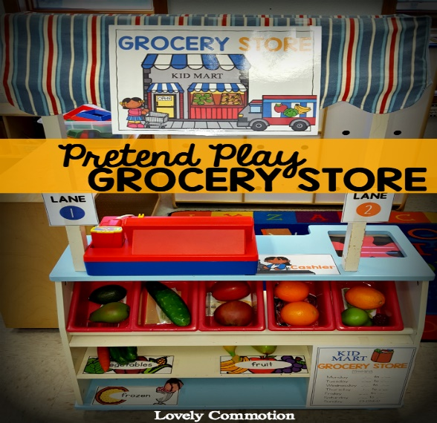
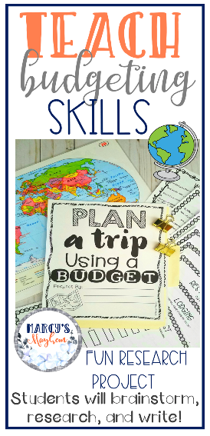

Integrating the world into Math Classrooms
^{Rapunzel Yao}
University of Hawaii at West Oahu – Kapolei, HI 96707
Abstract
Research Focus
Discussion
Integrating the real world into math problems have shown to spurs students’ interest, especially when the work is challenging and relevant or has personal connections with the students. Research from different sources explains the importance of creating math problems that are practical and have relevant connections in math. These problems teaches the students that almost every form of mathematics can be applied to real-life. Mathematics will help the students understand and explain things around them, the true purpose of math (Kitchen, 2016). With this, not only will teachers enjoy teaching even more, but students can use the skills they learn later in life.
The research project was focused on these questions:
How can teachers turn the world outside the math classroom into a math problem that’s both fun and challenging?
How do you make your lesson relevant to the students?
What are some Real-World Math Strategies?
To help find the necessary information to support the hypothesis, research was conducted through the National Council of Teachers of Mathematics using journal articles and other organizations. The articles used in the research supported the hypothesis by providing examples of how to bring real world into math problems, and other key points related to the research.
Based on the different resources that were researched, everyone agreed that using real-world context in the mathematics classroom that involves problem formulation and question development brings a powerful learning experience that every child can enjoy. Students are able to make connections between what they are learning in the classroom and their daily lives. Real world math brings meaning to math, it offers authentic experiences, and it increases their motivation and engagement. When the students are doing all these hands-on activities, it helps them learn about money, budgeting, baking and cooking, building, and managing time. In traditional math, students get the right answer and go on to the next problem. But in Math connections, students asked to prove how they got their answers by explaining, often in writing, their thinking processes.
Methods
Introduction & Hypothesis
Introduction: Today, more and more teachers are connecting math problems into the real world, however, student interest and engagement are still not increasing. Instead of depriving away from the question “When will I ever use this?”, students still find the questions boring. The questions being asked are too focused on precise, abstract, formal calculation which is necessary, but students find them less interesting. Instead, students should be given concrete or abstract work that involves problem formulation and question development to make learning math meaningful (Meyer, D.).
Hypothesis: I believe that if teachers integrate abstract work or lessons that are more relevant to the students but also fun and challenging, students will be more motivated, increase their interest in math, and build more skills that they can use in the real world.
Ways To Integrate the Real World in the Math Classroom
Conclusions
By relating mathematics to students' everyday lives,
it increases students’ problem-solving abilities and conceptual understanding.
They’ll become more invested in learning mathematical processes
No more “When will I ever use this?” questions.
Contact
Rapunzel Yao
University of Hawaii at West Oahu
Email: Rapunzel@hawaii.edu
References
Albert, L. R., & Antos, J. (2000). Daily Journals. Mathematics Teaching In The Classroom, 5(8), 526–531. Retrieved from https://www.nctm.org/Publications/mathematics-teaching-in-middle-school/2000/Vol5/Issue8/Daily-Journals-Connect-Mathematics-to-Real-Life/#
Mayer, D. (2014, September 14). Real work V. Real World {Blog post}. Retrieved from blog.mrmeyer.com
Wuolle, S. (2016). Real World Connections in the Secondary Mathematics Classroom. Retrieved from https://pdfs.semanticscholar.org/12ff/e1590bd8bd2af3adfd753f362f2703eb84dd.pdf

