Slide 1

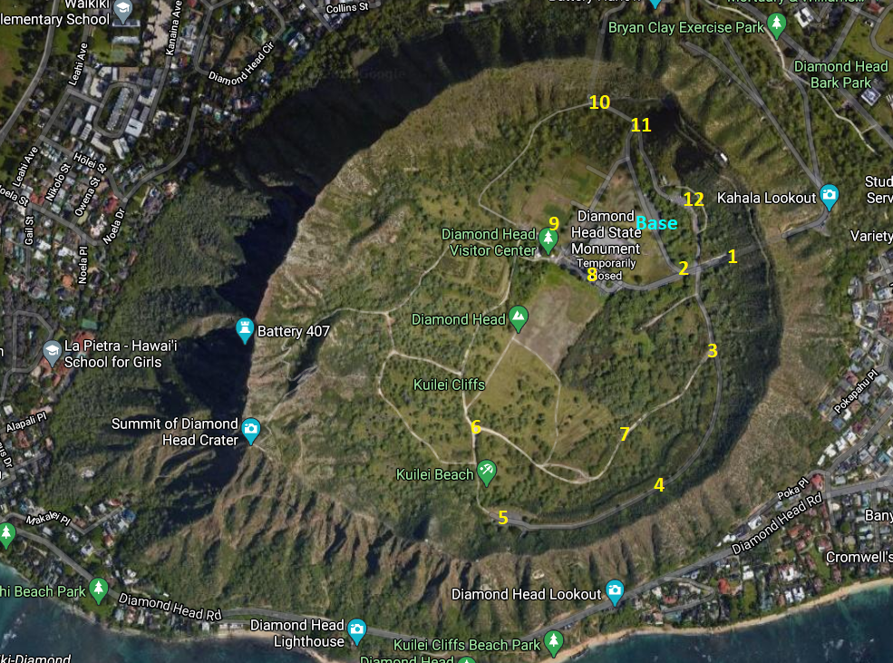
Determining the Effectiveness of LoRa and LoRaWAN Technology within a Mobile Medical Unit (MMU)
Bobby Jo Balmonte;
¹University of Hawaii West Oahu,
Abstract
Research Design & Data Collection
During disasters, communication is utmost important as it is the lifeline of many mobile medical units such as firefighters, paramedics, search and rescue teams, medical strike teams and other first responders. From hurricanes, to tsunamis, to wildfires and earthquakes, communications by radios, cellphones and satellites are the primary modes of communication. But sometimes, based on the severity, these modes of communications become inoperable. Mobile medical unit rely on accurate information communication to provide proper assessment and care when responding. This is where LoRa and LoRaWAN technology comes into play. LoRa is wireless radio frequency and LoRaWAN is the network. The purpose of this experiment and study is to determine the effectiveness of LoRa and LoRaWAN within a Mobile Medical Unit (MMU). The focus will be, if LoRa and LoRaWAN technology has the capability to communicate accurate information from the field to base station.
Field Exercise Training (FTX) will be the main focal point of gathering data from this project. During the FTX, data’s will be gathered to include; distance, time, location, frequency operations, hours of operation, speed, connectivity, capability and graphic user interface (GUI) from the Base station. Weight and size of the LoRa Nodes and base station will be measured along with the power consumption that these technology requires to be functional. Also, any other additional pertinent requirements will be gathered at this point. An AAR (after action report) will also be completed to capture any other findings from DET 1 and UHM College of Engineering.
Results
Locations 1. Location Points
Introduction & Research Question
Discussion
Introduction
Detachment 1, HQ 154 MDG relies on heavy and bulky hand-held radios for communication that requires programming to a certain frequency when deployed to a CBRNE incident. These frequencies are regulated by FCC and can only be utilized in the state that is programmed in. These frequencies cannot be utilized in another state or face hundreds of thousands in fines. Also, the capability of the DET 1 requires rapid mobility when responding to DOMOPS missions anywhere and anytime. This has been proven many times over and communications is always an issue as towers become overloaded and/or disabled. Finding another technology that does not rely on regulated frequencies, towers and are lightweight will greatly enhanced the capability of the DET and any other Mobile Medical Unit.
Research Question
The primary objective of this research is to provide another modes of communication that any MMU (i.e. DET 1) can utilized without the limitations of cell towers, regulated frequencies and lightweight with long battery life. LoRa and LoRaWAN will be the focal point of this research as it fits all the requirements. This technology will be tested on the CIA (Confidentiality, Integrity and Availability).
Hypothesis
The more data requirement that is place on the LoRa nodes will greatly impact CIA, therefore finding the balance of data necessity will need to be the priority.
The current set-up of the nodes, base station and programming were limited to line of sight communication. This is reflected on the data that was gathered base on the reception quality and data location (Refer Data 1). Location 1 poor quality due to higher elevation from the base station and the location were inside the tunnel. Location 7 poor quality was due to being in a ravine with heavy shrubbery. Location 8 was nonexistent was due to being behind a building, blocking the line of sight from the bases station. The rest of the locations were clear..
The following feedback of the user experience was provided for the current design.
1. Simplify the on/off indicator such as having steady green and red light or a sliding switch with painted indicator’s that either reveals green and red.
2. Determine battery level simply by either visually or audibly.
3. Light indicators were legible under bright sunny conditions.
4. Toggle switch feels fragile; it is suggested to have tactical feel like that of a handheld transceiver button.
5. Indicator to determine if the device is connected to the base station like that of a signal indicator on a cell phone.
.
Table 1. Data Locations and Results.
Location | Longitude | Latitude | Distance from base (meters) | Reception quality
Base | 21.264554 | -157.803133 | 0
1 | 21.263440 | -157.801653 | 190 | Poor
2 | 21.263173 | -157.801653 | 160 | Clear
3 | 21.261575 | -157.801846 | 350 | Clear
4 | 21.259023 | -157.802798 | 600 | Clear
5 | 21.258262 | -157.806343 | 800 | Clear
6 | 21.260060 | -157.806937 | 650 | Clear
7 | 21.260281 | -157.803347 | 500 | Poor
8 (side of bldg.) | 21.263465 | -157.80405 | 170 | Clear (line of sight)
8 (back of bldg.) | 21.263465 | -157.80405 | 170 | None existent
9 | 21.264162 | -157.805049 | 190 | Clear
10 | 21.266608 | -157.804414 | 290 | Clear
11 | 21.266128 | -157.803498 | 210 | Clear
12 | 21.264603 | -157.802434 | 70 | Clear
Conclusions
The current design as of now is not capable of being effective within a Mobile Medical Unit (MMU) environment.
.
Contact
References
YOUR PHOTO
Phone:
Bobby Jo Balmonte
University of Hawaii West Oahu
bobbyjo@hawaii.edu
808-656-6740
Wiklundh, K. C. (2019). Understanding the IoT technology LoRa and its interference vulnerability. 2019 International Symposium on Electromagnetic Compatibility - EMC EUROPE. https://doi.org/10.1109/emceurope.2019.8871966
Islam, M. S., Islam, M. T., Almutairi, A. F., Beng, G. K., Misran, N., & Amin, N. (2019). Monitoring of the Human Body Signal through the Internet of Things (IoT) Based LoRa Wireless Network System. Applied Sciences, 9(9), 1884. doi:10.3390/app9091884
Queralta, J. P., Gia, T. N., Tenhunen, H., & Westerlund, T. (2019). Edge-AI in LoRa-based Health Monitoring: Fall Detection System with Fog Computing and LSTM Recurrent Neural Networks. 2019 42nd International Conference on Telecommunications and Signal Processing (TSP). doi:10.1109/tsp.2019.8768883
Centelles, R. P., Freitag, F., Meseguer, R., Navarro, L., Ochoa, S. F., & Santos, R. M. (2019). A LoRa-Based Communication System for Coordinated Response in an Earthquake Aftermath. Proceedings, 31(1), 73. https://doi.org/10.3390/proceedings2019031073
Farhad, A., Kim, D., Kim, B., Mohammed, A. F., & Pyun, J. (2020). Mobility-Aware Resource Assignment to IoT Applications in Long-Range Wide Area Networks. IEEE Access, 1-1. doi:10.1109/access.2020.3029575
Moore, D. (2019, October 25). LoRaWAN Will Co-exist with the 5G Ecosystem as a De Facto Unlicensed LPWAN Standard. FierceWireless. https://www.fiercewireless.com/sponsored/lorawan-will-co-exist-5g-ecosystem-as-a-de-facto-unlicensed-lpwan-standard-0.
Slats, L. A Brief History of LoRa®: Three Inventors Share Their Personal Story at The Things Conference. https://blog.semtech.com/a-brief-history-of-lora-three-inventors-share-their-personal-story-at-the-things-conference.

