Slide 1
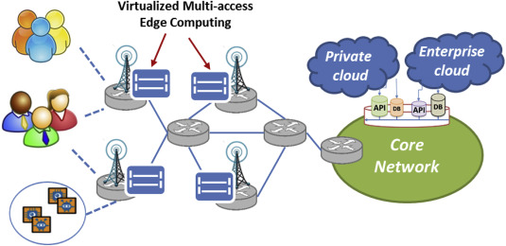
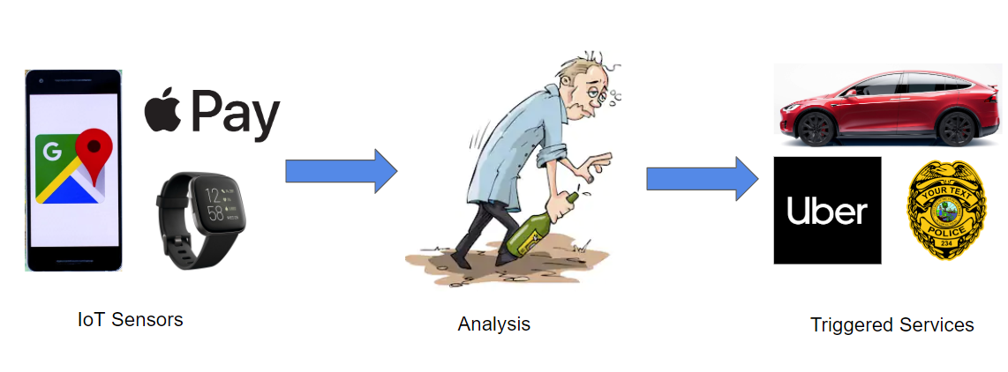
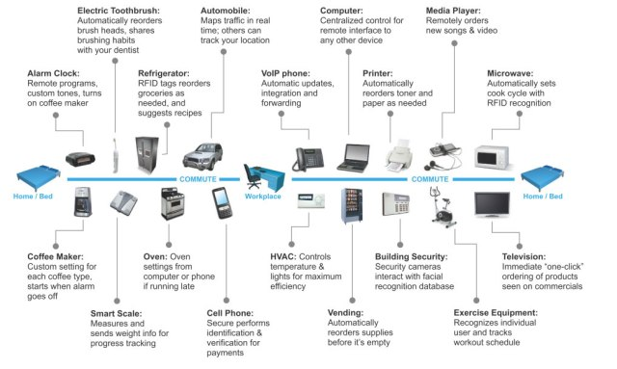
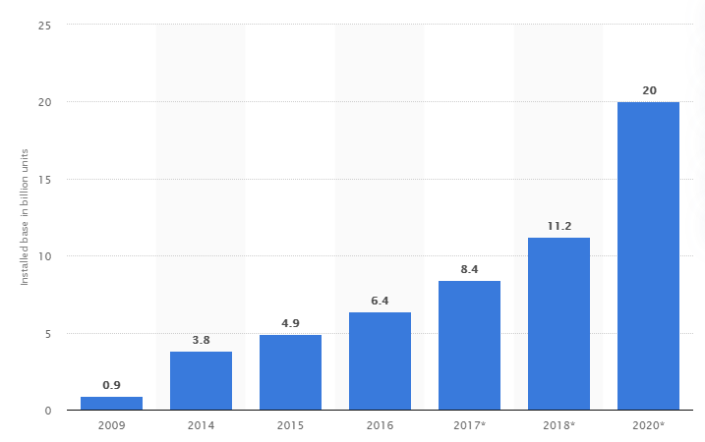
Effects of 5G and Multi-access Edge Computing on the Internet of Things
Ryan Young, AS
University of Hawai’i - West O’ahu
Introduction
Multi-Access Edge Computing (MEC)
Internet of Things (IoT)
Network of interconnected objects with provides services for information transfer, analytics, applications and communications
Collects, transmits and shares data
Examples: Smart watches, devices and sensors that enable industrial and home remote automation, monitoring, and robotics
IoT Growth Drivers
Consumer demand for better goods and services
Business demand for increasing efficiencies
Government initiative
“We will improve America’s digital infrastructure by deploying a secure 5G Internet capability nationwide. These improvements will increase national competitiveness, benefit the environment, and improve our quality of life.”
(National Security Strategy of the United States of America, 2017, p.3)
Network architecture change from a centralized cloud to network edge where computing resources are closer to the customer
Reduces latency, time it takes a message to traverse the network
Reduces congestion, number of packets which need to travel to the core
Unlocks development of new IoT devices which need:
  Mobility management
  Geo-distribution
  Location awareness
  Scalability
  Ultra-low latency
Figure 1
Multi-access edge Computing (MEC) Network Architecture.
5G Network
Applications & Limitations
Capable of supporting 1000 times more traffic than 4G LTE technology
Five core technologies:
  Millimeter Waves - opens more spectrum by using smaller waves
  Small Cell Networks- many small cells relay signals around objects
  Massive MIMO - increase capacity of networks by a factor of 22 or more
  Beamforming - Triangulation algorithm plots best route rather than a broadcast
  Full Duplex - Same frequency can be used to transmit and receive at the same time
“Just imagine being able to download an HD movie in under a second and let your imagination run wild.” (IEEE Spectrum, 2017)
Moves towards a Tactile internet: dealing with processes and objects in perceived real time:
  Ultra low latency with extremely high availability, reliability and security
  Humans able to control robots in real time
  Humans capable of catching a falling object remotely
New 5G and Multi-Access Edge Computing (MEC) network capabilities enable new IoT product and service offerings
Shared data between IoT devices also results in new products & services
Reduced cost to create future services & products since more IoT devices are already collecting relevant data
Applications: Autonomous Vehicles, Remote Surgery, Smart Farming
Example: Wearable IoT devices share purchase, heart rate & GPS data → Data is analyzed → Concludes user likely drunk → Smart car presents warning as user gets into the car → Uber advertises a coupon as an alternative to driving vehicle
Privacy: Do I really want to share all this data (police, insurance company, targeted advertising)?
Security: Who could obtain and use this data? Potential criminal use of Personally Identifying Information (PII).
Research Questions
How will the expansion of the Internet of Things (IoT) affect my life?
Why does Multi-Access Edge Computing (MEC) matter?
What’s the difference between the 5G network and the 4G network?
What is the combinatorial effect of these new technologies?
Table 1
Summary of Broadband Network Cellular Technology
Conclusions
Mobile Network | Year Deployed | Minimum Speed Requirement (Stationary)
2G | 1991 | 40 kbit/second*
3G/IMT-2000 | 2000 | 2 Mbit/second
4G/IMT-Advanced | 2009 | 1 Gbit/second
5G/IMT-2020 | 2020 | 20 Gbit/second
Growth in IoT is driven by consumers and businesses. Development of 5G is also supported by government.
New network architectures Multi-Access Edge Computing (MEC) and 5G will increase the speed, reliability and responsiveness of IoT devices
Increased capability will unlock new IoT product offerings
Privacy and Security are two major topics of concern
Figure 1
Examples of IoT Devices.
Figure 2
Growth of IoT Devices (billions)
*Theoretical maximum
Contact
References
Ryan Young
University of Hawai`i – West O`ahu
ryaney@hawaii.edu
U.S. Executive Office of the President. (2017). National Cyber Strategy of the United States of America. Washington, DC.
Nordrum, A., & Clark, K. (2017, February 6). Everything you need to know about 5G. IEEE Spectrum, 27.
Hsieh, H. C., Chen, J. L., & Benslimane, A. (2018). 5G virtualized multi-access edge computing platform for IoT applications. Journal of Network and Computer Applications, 115, 94-102.
O'Dea, S. (2020, February 27). IoT Device Installed Base Worldwide 2009-2020. Statista. Retrieved from www.statista.com/statistics/764026/number-of-iot-devices-in-use-worldwide/
IoT Devices [Digital image]. (2016, December14). Retrieved from https://blackboxparadox.com/2016/12/14/one-day-in-your-high-tech-life/
Tabbane, Sami. (2018, October 17-18). 4G to 5G Networks and Standard Releases. Presentation at the ITU Asia-Pacific Centre of Excellence Training on Traffic engineering and advanced wireless network planning, Suva, Fiji.

