Slide 1

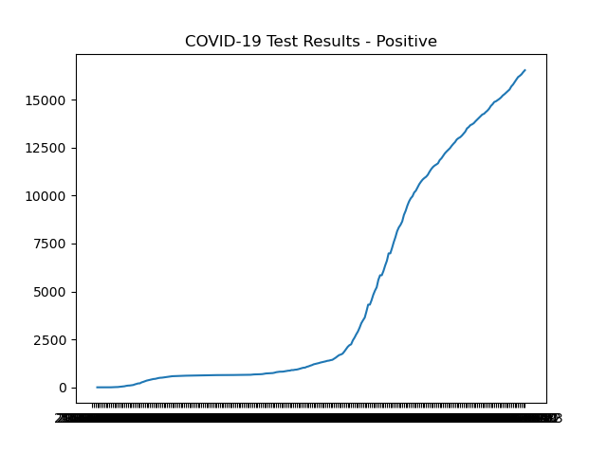
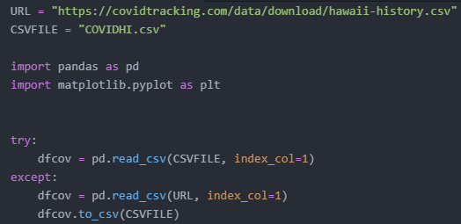
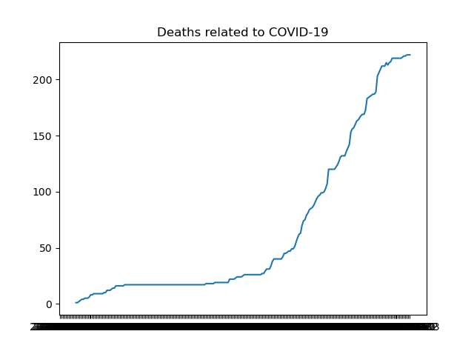
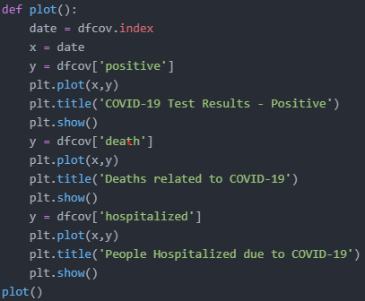
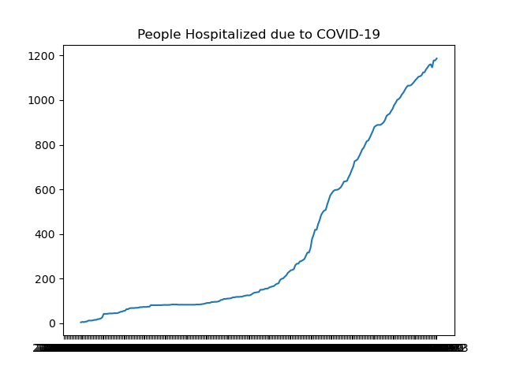
Using Pandas and Matplotlib on COVID-19 Data
Christian de Anda;
¹University of Hawai’I – West Oahu
Introduction
Code Created
With the internet flowing with data, there is a need to have it organized and formatted to be visually appealing. Lucky for us, by using Pandas and Matplotlib, we can modify and plot standard data from a CSV file to a more readable format with a visualization, in this case, the visualization is a line graph. Due to Covid-19 being a serious problem there is both a need for this data and an excess of this data available to the public. By utilizing this data, we can see information by dates, on who is tested positive, tested negative, deaths, hospitalized, and much more by state or even globally. By using python, specifically python libraries such as Pandas and Matplotlib, I will use raw data from covidtracking.com and adjust it and plot the data on a line graph.
Initial –
This code starts off by assigning variables to the URL used for the data and for the CSV file. Its useful to use a link to the URL because the data is updated daily and will grab data from that link if no CSV file with the name COVIDHI.csv is present. Importing the two python libraries is a must do step as we can't use the methods without importing them. The next chunk looks for the CSV file in the current directory, if none is found then it will grab the data from the link and call it COVIDHI.csv
Pandas -
This function below is responsible for dropping all empty columns, then removing unnecessary columns with either redundant or minimal information (majority of the values are missing) and then sorts them by descending date before exporting the data frame to an updated CSV file with a different name.
Matplotlib –
This function will use the date/index from the data frame as the X axis and positive results (1st graph), deaths (2nd graph), hospitalized people (3rd graph) as the Y axis. Using .plot to assign the values, .title to title the graph, and .show to display the graph. When the function is called all 3 graphs will appear in a popup in succession.
By running this code in a command line we receive an updated csv file with COVID data, and three different graphs depicting the positive cases, deaths, and hospitalizations associated with COVID. Due to the sheer number of values contained in the CSV for the index (dates) the details are very small but can be hovered over in the pop up for more information. Assuming the data for other states on the site carries the same format as Hawaii’s this code can be reused and applied to that.
Pandas and Matplotlib
Pandas
Pandas is a python library that is mainly used for data structuring and analysis. It accomplishes this by organizing data in rows by using data structures called series or data frames. The reason why this works well is that all the data in each column are the same data type and the data in each row is related or connected. A data frame is pretty much a mold to place the data in and can be edited using many methods with arguments to do things such as remove/add columns or rows or select/isolate columns and create sets. For this project, I used a data dump of COVID-19 data in Hawaii from a CSV file and used pandas to read the CSV file and put the data in a data frame. I then used pandas to drop all the empty columns and removed columns that contained unnecessary information. Next, I used pandas to organize the index(date) so the data frame starts with the oldest date which was mainly for the line graph.
Matplotlib
Matplotlib is also a python library that specialized in creating visualizations from data. Data visualization is important because it allows the users to get a gist of the data and make observations or predictions based on that data. In this case, I will be using Matplotlib to make a line graph showing the number of positive cases daily using the data frame made with Pandas. This could be used to see a basic pattern of positive cases Hawaii has had over throughout the years. By changing a variable, we can see other information such as deaths or hospitalizations on a line graph as well.
Click here to insert your Results text. Type it in or copy and paste from your Word document or other source.
Results
Contact
References
Christian de Anda
Email: cdeanda@hawaii.edu
J. D. Hunter, "Matplotlib: A 2D Graphics Environment", Computing in Science & Engineering, vol. 9, no. 3, pp. 90-95, 2007.
Data structures for statistical computing in python, McKinney, Proceedings of the 9th Python in Science Conference, Volume 445, 2010.

