Slide 1

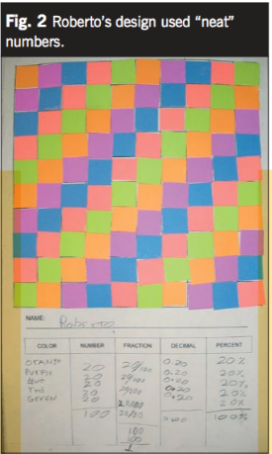
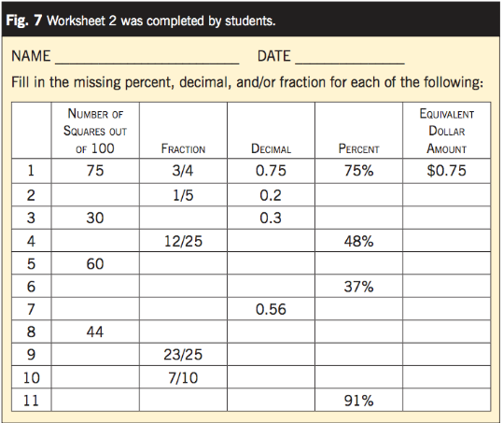
Mathematics and Art Integration
Brittney Yoshimura
UH West Oahu
Abstract
Research Focus/Methods
Results
Art integration to math can be done at all ages. The higher the grade level, the more advanced art concepts may be used. What educators have found so far is that students can use paintings to learn about shapes and lines (parallel and perpendicular), and they can also use Optical Art to help them find fractions and its equivalents. Educators have also found that struggling in math can cause anxiety for the student, and that art can help ease that anxiety. The resources used in this research shines a light on the importance of art and how it can be used in the classroom to impact a student’s learning experience.
To find the necessary information to support the hypothesis, research was conducted by the NCTM (National Council of Teachers of Mathematics) and other educators from different organizations. The journals and articles used for the research explain what those educators found and concluded, and provided examples of work from their students to help justify their conclusions.
Art Education Journal (1): In his research, educator David Rufo found that his student took on the persona of the “Math Hater” because of how much she disliked math. His method of using creative art in the classroom helped her go from “Math Hater” to “Math Helper”.
Art Education Journal (2): Tara Carpenter and Jayme Gandara were able to use their research to conclude that collaboration between University art professors and elementary teachers can help in creating a unit with more art integration. They were able to work with other educators in person and through google. They created an art-based project that was accessible through google and was made public for sharing.
NCTM Article: From this article educators learned that art can be used to help ELL students build conceptual knowledge of math topics through visuals and manipulative models. In this article, educators learned how to integrate a specific form of art (Optical) into a specific math lesson (fractions and equivalents).
Introduction & Research Question
The value of Art and Music in the classroom has decreased and students are missing out on a chance to discover a whole world of knowledge that they might want to know about. Art can be integrated into math in many ways, but it’s up to the teacher to find out what effective methods to use. If teachers can use art as a method of instruction while teaching math, then students can gain knowledge on different types of art, famous artists, and how it can be used to learn a skill because they will be able to represent their learning target through their artwork.
How can educators incorporate aspects of art into a math lesson?
First figure above shows an example of Optical Art being used to learn about fractions and their equivalents.
Second figure is an example of their Formal Assessment
Conclusions
With all this research, educators were able to conclude that art can be helpful with a student’s math experience through many different ways. Art used as a teaching method can aid students that rely on visuals to understand concepts (ELL). It can not only be a fun project, but it can also be a great escape from the horrors of math anxiety. Brain breaks are always a good idea. Lastly, educators learned that collaboration with a University art professor is possible and it can open many doors to integrating art into the entire curriculum, hitting every subject.
Discussion
Majority of the resources used suggests that Art can be integrated into the classroom fairly easy, and it can be used in multiple ways to help improve a student’s learning experience with math. Whether it’s used as a manipulative, a teaching method, or a “brain break”, students like the “Math Hater” can benefit from the integration.
Contact
References:
Rufo, D. (2017). Math Hater: How One Child Overcame Her Math Anxiety Through Self-Administered Art Therapy. Art Education, 70(5), 6–10.
Carpenter, T., & Gandara, J. (2018). Making Connections: Collaborative Arts Integration Planning for Powerful Lessons. Art Education, 71(4), 8–13
Scaptura, C., Suh, J., & Mahaffey, G. (2007). Masterpieces to Mathematics: Using Art to Teach Fraction, Decimal, and Percent Equivalents. NCTM.
Brittney Yoshimura
University of Hawaii West Oahu
Email: by7@hawaii.edu

