Slide 1

Basics of Python Coding
ICS 111
Autumn Gamble

Slide 2
Functional vs Object-Oriented (OOP)
Functional or “Algorithmic” Programming
This approach “dives-in” to writing algorithms to solve the problem.
This approach works will with shorter, simpler programs.
Object-Oriented Programming (OOP)
This approach first designs specific objects (classes) to solve the problem.
This approach makes the software much more portable but takes longer.
The remainder of this project will focus on OOP.

Slide 3
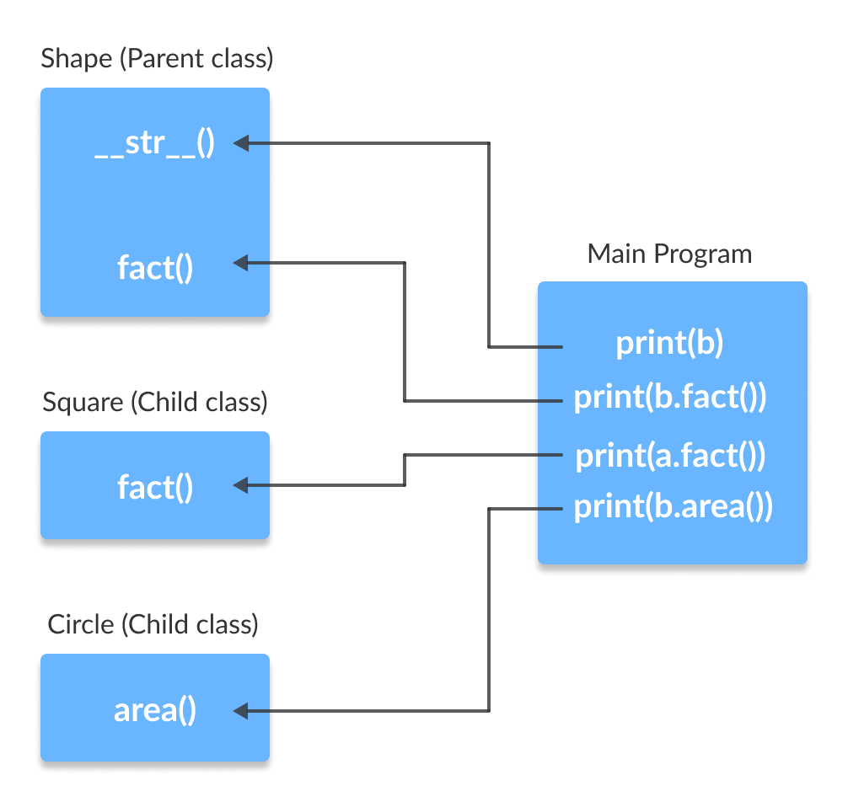
Classes
Classes provide the basic building-blocks of OOP.
# Python program to # demonstrate instantiating # a class class Dog: # A simple class # attribute attr1 = "mammal" attr2 = "dog" # A sample method def fun(self): print("I'm a", self.attr1) print("I'm a", self.attr2) # Driver code # Object instantiation Rodger = Dog() # Accessing class attributes # and method through objects print(Rodger.attr1) Rodger.fun() Output: mammal I'm a mammal I'm a dog
Classes are user-defined data structures and methods (functions to operate on the data structures).

Slide 4
Constructors
# A Sample class with init method class Person: # init method or constructor def __init__(self, name): self.name = name # Sample Method def say_hi(self): print('Hello, my name is', self.name) p = Person(‘Autumn') p.say_hi() Output: Hello, my name is Autumn
Constructors are used to initialize the object’s state.
One method of a Constructor is the _ _ init _ _ method.

Slide 5
The Three “Pillars” of OOP
Encapsulation
Packages data structures and related methods together.
Inheritance
Enables efficiencies by following the natural structure of the data.
Polymorphism
Simplifies code by allowing reuse of names of functions or methods.

Slide 6
Encapsulation
Using OOP in Python, we can restrict access to methods and variables. This prevents data from direct modification which is called encapsulation. In Python, we denote private attributes using underscore as the prefix i.e single _ or double __.
class Computer:
def __init__(self):
self.__maxprice = 900
def sell(self):
print("Selling Price: {}".format(self.__maxprice))
def setMaxPrice(self, price):
self.__maxprice = price
c = Computer()
c.sell()
# change the price
c.__maxprice = 1000
c.sell()
# using setter function
c.setMaxPrice(1000)
c.sell()

Slide 7
Inheritance
#parent class
class Bird:
def __init__(self):
print("Bird is ready")
def whoisThis(self):
print("Bird")
def swim(self):
print("Swim faster")
# child class
class Penguin(Bird):
def __init__(self):
# call super() function
super().__init__()
print("Penguin is ready")
def whoisThis(self):
print("Penguin")
def run(self):
print("Run faster")
peggy = Penguin()
peggy.whoisThis()
peggy.swim()
Peggy.run()
Inheritance is a powerful feature in object oriented programming. It refers to defining a new class with little or no modification to an existing class. The new class is called derived (or child) class and the one from which it inherits is called the base (or parent) class.
Output:
Bird is ready
Penguin is ready
Penguin
Swim faster
Run faster

Slide 8
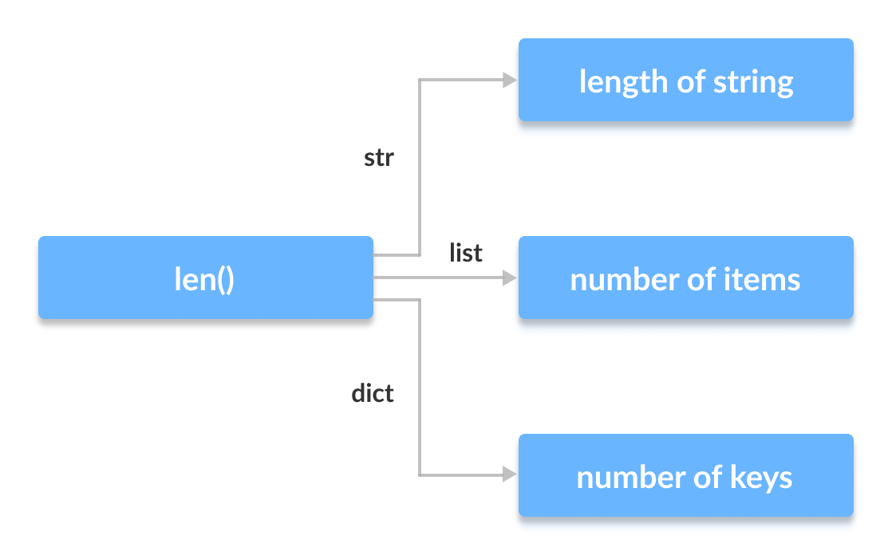
Polymorphism
class Parrot:
def fly(self):
print("Parrot can fly")
def swim(self):
print("Parrot can't swim")
class Penguin:
def fly(self):
print("Penguin can't fly")
def swim(self):
print("Penguin can swim")
# common interface
def flying_test(bird):
bird.fly()
#instantiate objects
blu = Parrot()
peggy = Penguin()
# passing the object
flying_test(blu)
flying_test(peggy)
Output:
Parrot can fly
Penguin can't fly
Polymorphism is a very important concept in programming. It refers to the use of a single type entity (method, operator or object) to represent different types in different scenarios.

Slide 9
Resources
https://www.programiz.com/python-programming/inheritance
https://www.programiz.com/python-programming/polymorphism
https://www.programiz.com/python-programming/object-oriented-programming

