Slide 1

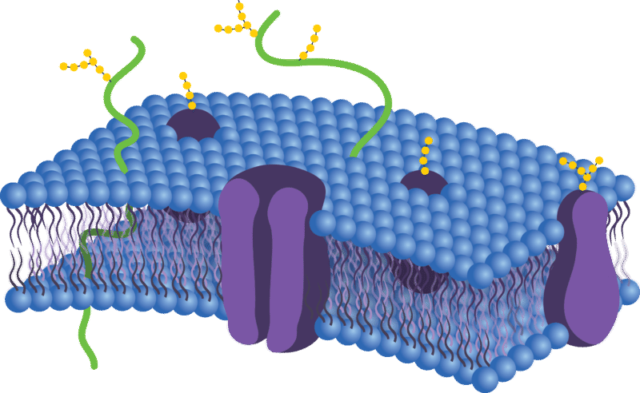
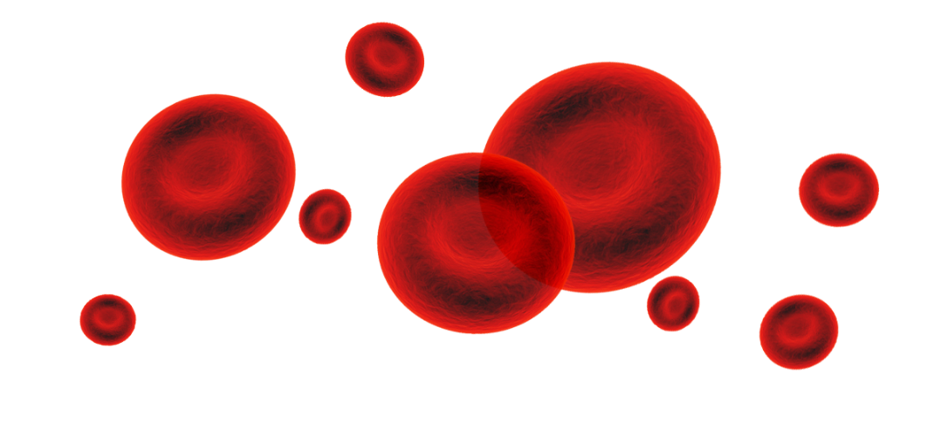
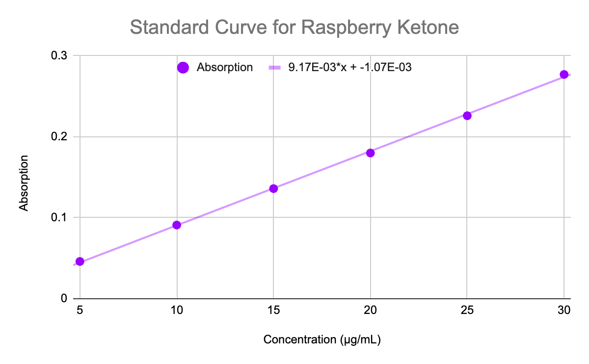
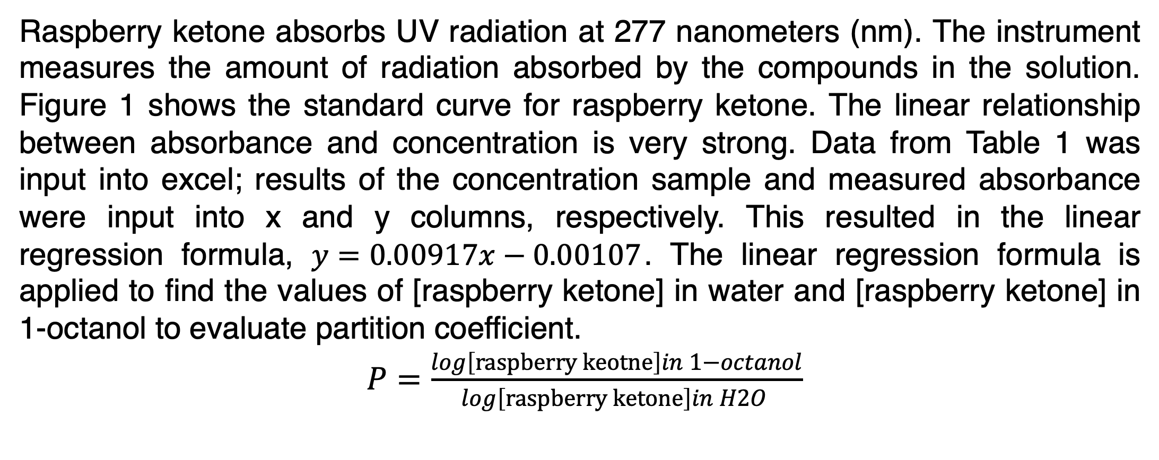
Partition Coefficient of the Anti-Obesity Health Supplement Raspberry Ketone
Pashyn Morimoto, Bradley O. Ashburn*
Mathematics, Natural, and Health Sciences Division University of Hawai‘i West Oʻahu, Kapolei, HI 96707
Abstract
Data Summary
Sample number | Volume of raspberry ketone solution used (ml) | Concentration of solution (μg/ml) | Volume of 1-octanol (ml) | Measured Absorbance (dimensionless) | Calculated Concentration in H2O layer (μg/ml) | Calculated Concentration in 1-octanol (μg/ml)
1 | 40.0 | 20.0 | 10.0 | 0.026 | 2.952 | 17.048
2 | 40.0 | 20.0 | 10.0 | 0.025 | 2.843 | 17.157
3 | 40.0 | 20.0 | 10.0 | 0.029 | 3.279 | 16.721
Health supplements are widely used among the general public for a variety of applications, however due to not being regulated by the Food and Drug Administration, there is typically scant independent scientific studies on their physicochemical properties. One such supplement that has shown promise for enhanced weight loss is 4-phenyl-2-butanone, commonly referred to as raspberry ketone¹. This study experimentally determined the partition coefficient of raspberry ketone.
The partition coefficient is a physicochemical trait that indicates whether a substance will be absorbed by plants, animals, humans, or other living tissue; or if it will be carried away and disseminated in water. These values are important to medicinal chemists in determining how compounds may be distributed in the human body².
A standard curve of concentration versus absorbance was created to measure the partitioning of raspberry ketone in a mixture of water and 1-octanol, which was determined to be 0.74. This value indicates a hydrophobic preference. Experimental details and discussion of the results are provided herein.
Table 2: Partition data for raspberry ketone
Data Analysis
Raspberry ketone absorbs UV radiation at 277 nanometers (nm). The instrument measures the amount of radiation absorbed by the compounds in the solution. Figure 1 shows the standard curve for raspberry ketone. The linear relationship between absorbance and concentration is very strong. Data from Table 1 was input into excel; results of the concentration sample and measured absorbance were input into x and y columns, respectively. This resulted in the linear regression formula, $y=0.00917x−0.00107$. The linear regression formula is applied to find the values of [raspberry ketone] in water and [raspberry ketone] in 1-octanol to evaluate partition coefficient.
$P=\frac{\log\left[raspberry keotne\right]in 1−octanol}{\log\left[raspberry ketone\right]in H2O }$
Introduction & Objective
The partition coefficient represented by “P” or “logP” measures how much a solute dissolves in the water portion versus an organic portion of a mixture.²
LogP has various applications such as drug discovery, agrochemicals, flavors, fragrances, and environmental chemicals. Knowing the partition coefficient of a drug can guide researchers in how effective a drug will be within the body. Lipophilicity is a critical factor in a compound’s absorption, distribution in the body, penetration across vital membranes and biological barriers, metabolism and excretion^{2.}
The aromatic compound of red raspberry 4-phenyl-2-butanone, more commonly called raspberry ketone, is the focus of this study. This natural health supplement has been found to combat both obesity and fatty liver by altering the fat (lipid) metabolism in animal cells¹. The objective of this experiment is to find the “P” value of raspberry ketone and analyze how the molecule would behave in the body based on its partition coefficient.
Figure 1: Lipid bilayer model⁵
Discussion
The stir-method allowed the solutions to be set on a constant rpm to prevent inconsistent outcomes.
Data results for the partition coefficient of raspberry ketone yielded replicable values. Therefore, these values can be applied to future studies.
A logP of 0.74 means that raspberry ketone is more soluble in organic solvents than hydrophilic solvents.
Raspberry ketone compound is composed mainly out of carbon atoms, this would explain the logP value.
The high partition coefficient means that the compound is highly lipid soluble, and would be able to pass through selectively permeable cell membranes.
Methods & Materials
Conclusion
Standard Curve³
Raspberry ketone was dissolved in deionized water to a concentration of 100 μg/ml. This was the stock solution. The stock solution was then diluted with deionized water to obtain a series of different concentrations in order to create a standard curve. The curve established a relationship between aqueous concentration and absorbance measured by a UV spectrophotometer. A sample of each concentration was measured via a UV spectrophotometer. Lambda max was found to be a value of 277 nm by measuring the series of dilutions via a UV spectrophotometer. The dilutions of raspberry ketone are shown in Table 1.
Stir-Method⁴
An aqueous solution of raspberry ketone at a concentration of 20 μg/ml was prepared. Four magnetic stir plates, 100 ml erlenmeyer flasks, and magnetic stir bars were set up. In three of the four flasks, 40 ml of the 20 μg/ml solution was poured in, followed by 10 ml of 1-octanol, then covered by parafilm. In the fourth flask, 40 ml of deionized water and 10 ml of 1-octanol were poured in, then covered by parafilm. The magnetic stir plates were set to 300 rpm at room temperature and stirred uninterrupted for 24 hours. The magnetic stir plates were turned off at 24 hours, and the solutions were left to rest for an additional 24 hours to allow the substances to equilibrate into two layers. Samples of the aqueous layer of raspberry ketone from each of the flasks were then pipetted into a cuvette to have the absorbance measured via a UV spectrophotometer. The aqueous layer of the 1-octanol and deionized water flask was used as a blank to zero the spectrophotometer before measurement of the three other flasks. The results are shown in Table 2.
According to the data collected the partition coefficient value of raspberry ketone was 0.74.
There is a reproducibility of experimental procedures, the application of methods could be further applied to various compounds.
Since raspberry ketone has a high numerical value for its partition coefficient, it is highly lipid soluble.
The high lipid solubility of raspberry ketone would allow it to penetrate, enter, and be active within animal cells.
This compound presents an opportunity to be a powerful tool in combating the obesity epidemic around the world.
Figure 2: Standard curve for raspberry ketone
Approximate concentration of stock solution: 100 μg/mL
Sample number | Volume of stock solution used (mL) | Volume of deionized water used (mL) | Resultant concentration of sample (μg/mL) | Measured Absorbance (dimensionless)
1 | 0.5 | 9.5 | 5.0 | 0.046
2 | 1.0 | 9.0 | 10.0 | 0.091
3 | 1.5 | 8.5 | 15.0 | 0.136
4 | 2.0 | 8.0 | 20.0 | 0.180
5 | 2.5 | 7.5 | 25.0 | 0.226
6 | 3.0 | 7.0 | 30.0 | 0.277
References
Morimoto, C., Satoh, Y., Hara, M., Inoue, S., Tsujita, T., & Okuda, H. (2005). Anti-obese action of raspberry ketone. Life Sciences, 77(2), 194–204. doi: 10.1016/j.lfs.2004.12.029
Bhal, Sanjivanjit K. LogP—Making Sense of the Value. Advanced Chemistry Development, Inc.
Dalrymple, Omatoyo K.. Experimental Determination of the Octanol-Water Partition Coefficient for Acetophenone and Atrazine. Physical & Chemical Principles of Environmental Engineering, 2005, 1-7.
Fisk AT, Rosenberg B, Cymbalisty CD, Stern GA, Muir DCG. 1999. Octanol/water partition coefficients of toxaphene congeners determined by the ’slow-stirring’ method. Chemosphere 39: 2549-2562.
Wilkin, Douglas, and Jean Brainard. “Phospholipid Bilayer.” CK, CK-12 Foundation, 4 July 2019, https://www.ck12.org/biology/phospholipid-bilayer/lesson/Phospholipid -Bilayers- BIO/.
Table 1: Standard curve data for raspberry ketone

