Slide 1

Strategies For Greening Hawaii’s Small Businesses

Slide 2
Small Business
Varieties of small business in Hawaii
Main industries
Cultural connection to land
SBA lists 271,340 employed by small business and 51.8% of private workforce

Slide 3

Key Issues
Energy consumption and overuse
Waste reduction or elimination
Greening employee engagement

Slide 4

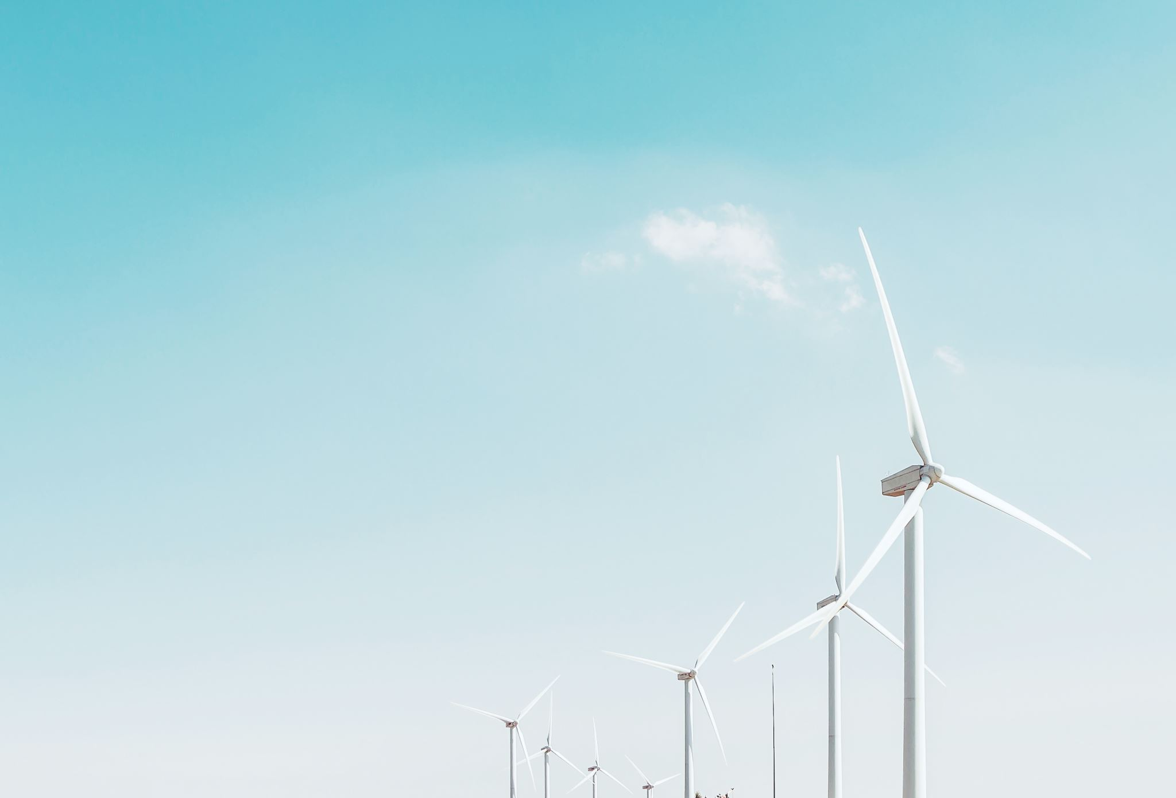
Energy Consumption
Goal to reduce monthly costs while consuming less energy and emitting less emissions
”Lighting can account for 20-50% of a businesses overall energy costs”(Hawaii Energy, 2020).

Slide 5
Ideal Situation
Enhance productivity while increasing customer shopping time
Utilize lighting sources such as LED
Lower costs and efficiency

Slide 6
Strategic Recommendation
Change out incandescent for LED
”Last on average 25,000 hours vs. 750 to incandescent, approximate savings of $200 per bulb lifetime”(Duthie, 2019).
Further support local businesses with changes
Solar panels to existing businesses
“average commercial property owner will save about $500 per month on electricity, equaling $587,377 over the life of a solar system”(Maryville University, 2019).

Slide 7
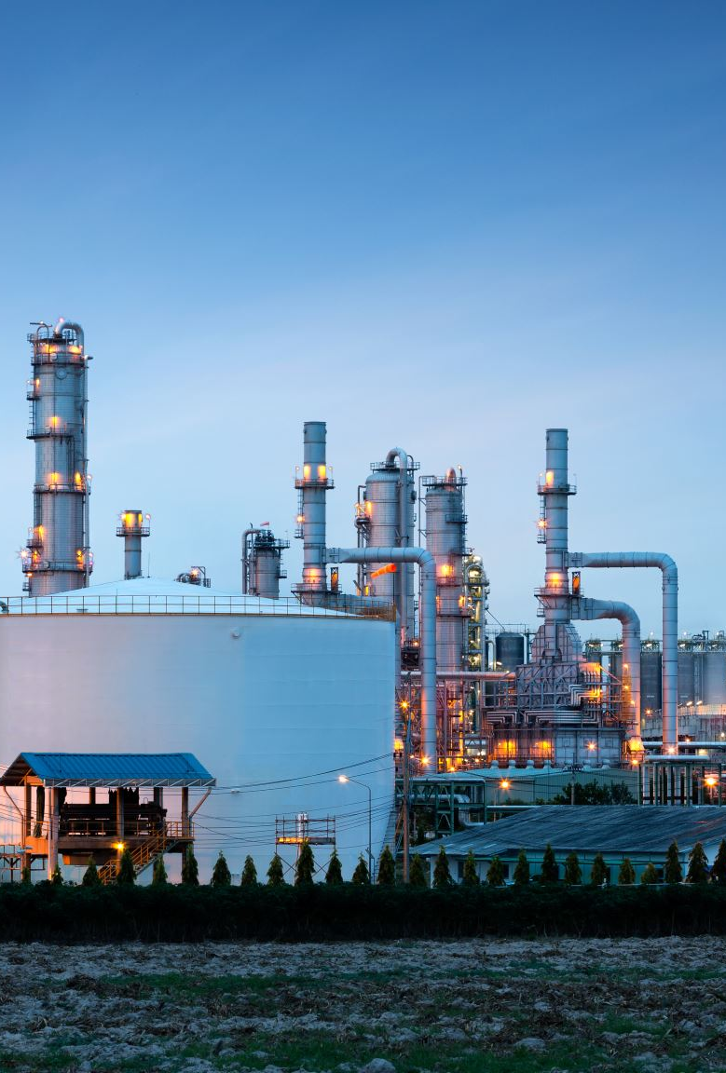
Waste Reduction
Keep the natural environment beautiful
Garbage patch in the ocean
  “79,000 tons floating in Pacific Garbage Patch between Hawaii and California”(New Scientist, 2018).
Scarce resources and land area

Slide 8

Ideal Situation
More sustainability promotes less expenditures on materials
Recycling funds used towards employees or positive programs
Less paper and products creates more space in workplace

Slide 9

Strategic Recommendations
Recycle
Plastic alternatives
Analyze Current Space

Slide 10

Employee Engagement
Advantages implementing change with a small footprint.
Company culture
Educating employees

Slide 11

Ideal Situation
Positive Relations
  “evidence showing positivity between employees feeling supported and job satisfaction”(Popescu & Gasior, 2019).
Responsibility within a company
  Key findings about millennials
Strong employee pact

Slide 12
Strategic Recommendations
Bike to work incentives
  ”Patagonia pays all U.S. and Canadian employees $2 per trip, up to two trips per day”(Mazzoni, 2014).
Electric vehicle charging station
Water stations for employees
Buy carbon credits for organization with employees
  ”Once you know your carbon footprint, you can balance it by paying a penance”(Mager, Sibilia, 2010).

Slide 13
Conclusion
Climate change isn’t going anywhere
Small businesses are impactful within the community and the natural climate

Slide 14
References
Duthie, R. (2019). Lighting Tips to Reduce Small Business Energy Costs NOPEC https://www.nopec.org/blognewsroom/blog/lighting-tips-to-reduce-small-business-energy-costs/.
Hawaii Energy. (2020). For Business, Energy Solutions. Retrieved October 17, 2020, from https://hawaiienergy.com.
Maryville University. (2019, July 26). Going Green: Benefits of Sustainability in Business. Maryville Online. Retrieved October 20, 2020, from https://online.maryville.edu/blog/importance-of-environmental-awareness-when-running-a-business
Mazzoni, M. (2014, May 9). 3p Weekend: Top 5 Corporate Bike-to-Work Incentives in the U.S. TriplePundit. https://www.triplepundit.com/story/2014/3p-weekend-top-5- corporate-bike-work-incentives-us/43951.
Pacific Garbage Patch fattens up. (2018, March 31). New Scientist, 237(3171), 20. doi:10.1016/S0262-4079(18)30563-3
Popescu, A. I., & Gąsior, A. (2019). Learning by Engaging in Pro-Environmental Behavior at Work (Ser. Case Studies, pp. 121–134). Ubiquity Press. http://www.jstor.org/stable/j.ctvggx1wj.14.
SBA Office of Advocacy (Ed.). (2018). Hawaii Small Business Profile. https://www.sba.gov/sites/default/files/advocacy/2018- Small- Business-Profiles-HI

