Slide 1

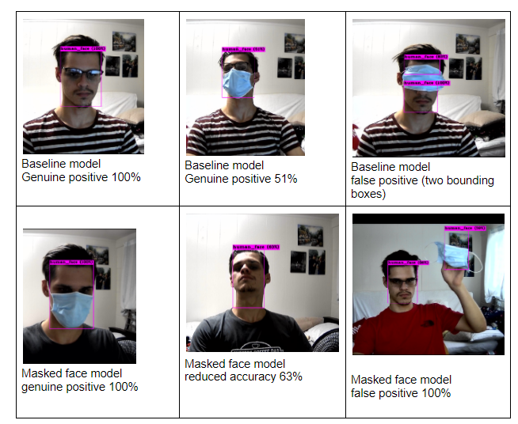
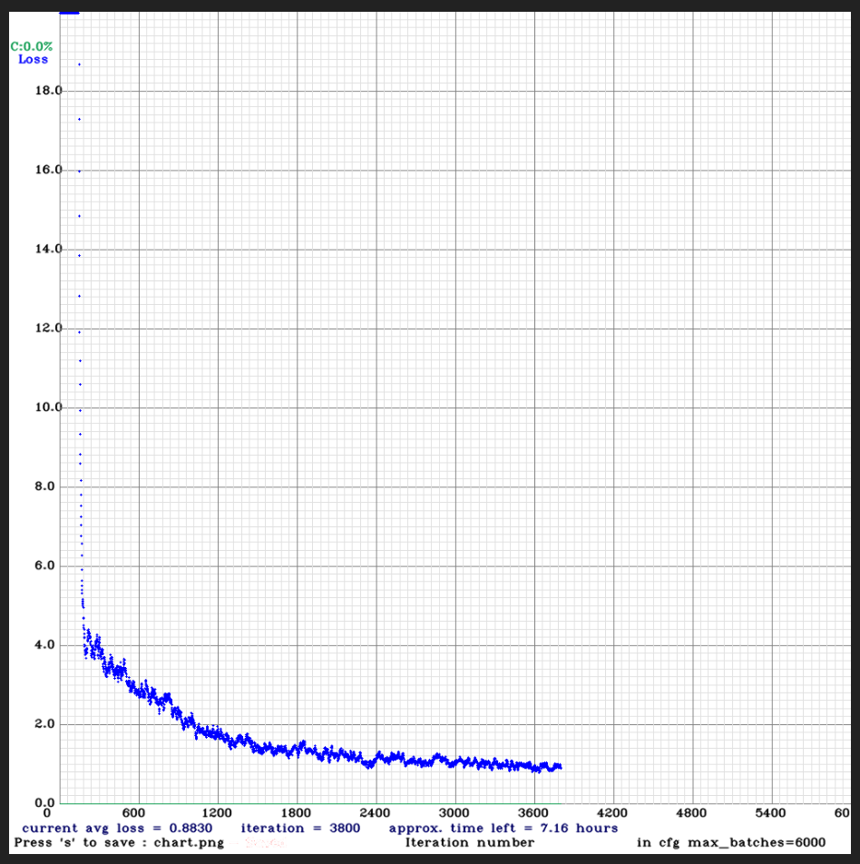
Impact of Facemasks on Face Detection
Anthony Chapman
University of Hawaii -- West Oahu
Abstract
Research Design & Data Collection
Research suggests that COVID-19 facemasks degrade the performance of face detection technology. The purpose of this study is to quantify this effect and identify the ideal way to train face detection models when facemasks are present. To do this, I trained a machine learning model for face detection with 1,000 regular human faces using the You Only Look Once (YOLOv4) object detection framework. I tested the face detection capabilities of the model on both regular human faces and masked faces, recording the accuracy and recall rate for each group. I then trained a new model, incorporating masked faces into the initial training dataset. The adjusted model was tested to determine if the adjusted training set imporoved performance. This research will benefit machine learning researchers and data scientists who will train and utilize facial recognition models in the midst of COVID-19 and beyond.
Quantitative Analysis: Trained two face detection models with different training datasets (masked vs unmasked faces) and analyzed the performance of each on both masked and unmasked faces.
Research Instruments:
Training data acquired through Google Open Image database as well as academic sources. Manually labeled over 600 images of masked faces.
Research conducted on personal desktop workstation: NVIDIA RTX 2060 GPU utilizing the NVIDIA CUDA toolkit.
Trained detection models using the YOLOv4 framework by Redmon et al.
Chart 1. Demonstrations of Detection cases and errors for each model
Introduction & Research Question
Results
Discussion
Introduction
In the COVID-19 pandemic, most people are wearing face coverings in public areas. Since face masks (obviously) cover portions of the subject’s face, they interfere with face detection algorithms (Ngan et. al, 2020), which are important for biometric authentication and other security applications.
Face detection (to be distinguished from facial recognition) involves determining the presence (and location, if applicable) of human faces in an image or video. In this paper, we explore the extent to which the presence of face masks in images degrade face detection performance, and how this can be compensated for.
Research Question
How do face masks affect face detection performance in machine-learning based detection systems, and how can this be overcome?
Hypothesis
By integrating images of masked faces into the training dataset, we can produce a face detection model that is more effective in detecting masked faces.
Baseline Detection Model
Training dataset: 1,000 images
Training composition: 100% unmasked faces
Adjusted Detection Model
Training dataset: 1,000 images
Training composition: 100% unmasked faces
The degradation caused by facemasks was substantial, about 18% reduction in MaP@0.50.
The mask-trained model has exceeding performance on masked faces, 99.99% MaP on test set.
masked-trained model is less accurate on non-masked faces compared to baseline
Future Research:
The models in this research only detected faces -- it did not detect facemasks or distinguish masked vs. unmasked faces. Future research could focus on the applications of facemask detection.
Although it was not the focus here, YOLO v4 is capable of making detections in real-time. More research could be conducted on real-time detection performance.
.
Performance
 | Masked Faces | Unmasked Faces
Mean Accuracy Precision (MaP) | 68.40% | 86.01%
Performance
 | Masked Faces | Unmasked Faces
Mean Accuracy Precision (MaP) | 99.99% | 71.19%
Conclusions
The results show a substantial degradation in performance in the baseline model when facemasks are present.
The hypothesis is supported: integrating masked-face images into the training dataset increased face detection performance where facemasks are present.
Limitations:
  False positives-- adjusted (mask-trained) model sometimes predicts that images of facemasks (not on a person) are faces themselves. This can be fixed with hard negative examples.
  Dataset size.
.
Chart2. Loss graph for baseline model training.
Contact
References
YOUR PHOTO
Anthony Chapman
UH West Oahu
Email:anchapma@hawaii.edu
Phone: 808-282-9741
Bochkovskiy, A., Wang, C. Y., & Liao, H. Y. M. (2020). YOLOv4: Optimal Speed and Accuracy of Object Detection. arXiv preprint arXiv:2004.10934.
Cheng, V. C., Wong, S. C., Chuang, V. W., So, S. Y., Chen, J. H., Sridhar, S., ... & Yuen, K. Y. (2020). The role of community-wide wearing of face mask for control of coronavirus disease 2019 (COVID-19) epidemic due to SARS-CoV-2. Journal of Infection.
Chowdary, G. J., Punn, N. S., Sonbhadra, S. K., & Agarwal, S. (2020). Face Mask Detection using Transfer Learning of InceptionV3. arXiv preprint arXiv:2009.08369.
Hjelmås, E., & Low, B. K. (2001). Face detection: A survey. Computer vision and image understanding, 83(3), 236-274.
Kirk, D. (2007, October). NVIDIA CUDA software and GPU parallel computing architecture. In ISMM (Vol. 7, pp. 103-104).
Redmon, J. (2013). Darknet: Open source neural networks in c.
Redmon, J., Divvala, S., Girshick, R., & Farhadi, A. (2016). You only look once: Unified, real-time object detection. In Proceedings of the IEEE conference on computer vision and pattern recognition (pp. 779-788).
Ngan, M. L., Grother, P. J., & Hanaoka, K. K. (2020). Ongoing Face Recognition Vendor Test (FRVT) Part 6A: Face recognition accuracy with masks using pre-COVID-19 algorithms.
Said, S. (2020). Pynq-YOLO-Net: An Embedded Quantized Convolutional Neural Network for Face Mask Detection in COVID-19 Pandemic Era In International Journal of Advanced Computer Science and Applications(IJACSA), 11(9)
Wang, Zhongyuan, Guangcheng Wang, Baojin Huang, Zhangyang Xiong, Qi Hong, Hao Wu, Peng Yi et al. "Masked face recognition dataset and application." arXiv preprint arXiv:2003.09093 (2020).
Wang, Z., Wang, G., Huang, B., Xiong, Z., Hong, Q., Wu, H., ... & Chen, H. (2020). Masked face recognition dataset and application. arXiv preprint arXiv:2003.09093.
Wu, J. (2017). Introduction to convolutional neural networks. National Key Lab for Novel Software Technology. Nanjing University. China, 5, 23.

