Slide 1
Mental Health during COVID-19
By: Elmarie Manuel, Maia Kawelo, Arthur Outlaw, and Lynn Ishii

Slide 2
TABLE OF CONTENTS
01
02
03
04
Introduction
About Us
PSA Video
What is a PSA?
Purpose/Relevance
Relation to field of interest and relevance to mental health
Activities
Exercise, gardening, and meditation.

Slide 3

Introduction
01
The Importance of Mental Health Awareness During COVID-19
Notes:
Aloha, We’re in Dr. Romine’s HLTH 395 Health and Wellness for Life class. Our group members are Elmarie Manuel, Maia Kawelo, Arthur Outlaw, and Lynn Ishii. We were required to develop a PSA covering an aspect of the material covered during our course. We decided to provide recommendations on dealing with the stress associated with being locked down and isolated from friends and family during the COVID 19 pandemic.

Slide 4
PSA Video
02
What is a Public Service Announcement?
Notes:
A public service announcement is a message in the public interest with the objective of raising awareness of a social issue. The purpose of our PSA was to provide healthy coping options for isolation related stress associated with the COVID 19 restrictions.

Slide 5
Purpose and Relevance
03
The purpose of our PSA was to provide activities that would alleviate some of the stress associated with the pandemic such as isolation, depression, and lack of a routine
Notes:
Our inspiration for this project came from the excess stress that COVID-19 has caused. The relevance of this topic to our group members are twofold. First, as future healthcare professionals, we wanted to apply what we learned in class on healthy stress coping methods to the current stressors related to the ongoing pandemic. Second, because we learned that on average, 61% of college students seeking counseling reported anxiety as their main concern (text, pp. 77) and the medical fields of study is inherently demanding, we wanted to also explore this topic to better understand how we, as students, can cope with stress healthily.

Slide 6
Activities
04
Discussion of the assignment of creating a Public Service Announcement.
Notes:
To provide a solution, or help the problems associated with mental health during COVID, we wanted to share different activities or hobbies to promote mental, emotional, and physical wellness. As a group we chose hobbies that have helped us such as: exercising, gardening, and meditation.

Slide 7

PSA Video

Slide 8
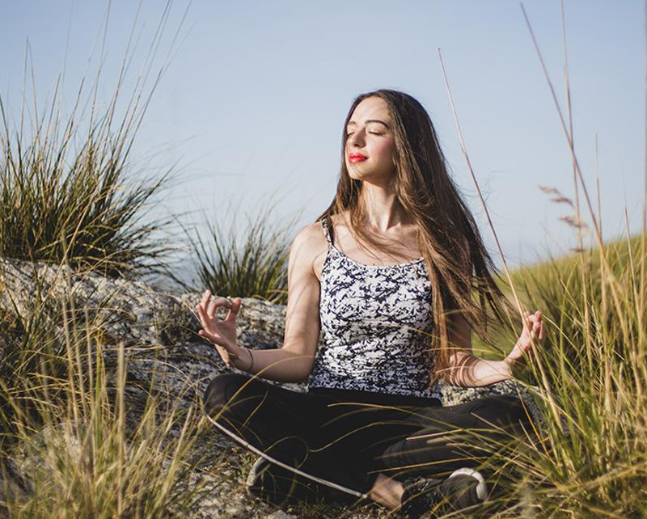
Make mental health a priority

Slide 9


