Slide 1
LET’S CATCH PIKACHU!
Zachary R Ramos
ICS 111
Prof. Eric Wen

Slide 2
CONTENTS
Introduction
Parent Class
Method
Child Classes
Program in action
Conclusion

Slide 3
Our Problem
We have just set out on our Pokémon journey but unfortunately, we have no Pokémon.
We have set our eyes on a Pikachu as our first Pokémon, but we only have so much money to spend on balls.
We would like to simulate our chances in capturing Pikachu and see how each ball performs and the likely amount of money that would be spent.

Slide 4

INTRODUCTION
Using OOP (Object Oriented Programming) I have created a simulator for catching Pikachu using 4 different balls
The program separates the balls into one parent class and the rest into child classes
Each ball has a unique multiplier and price point as quality increases
The program includes a method for multiple attempts and tallies the total amount spent until captured

Slide 5
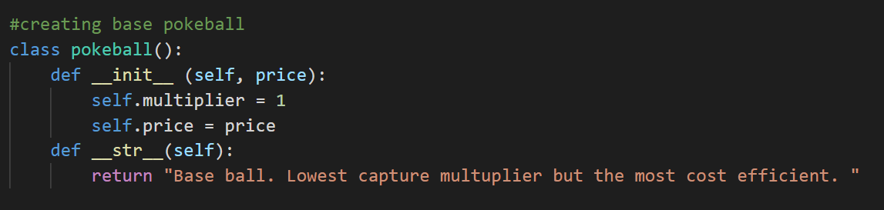
PARENT CLASS
Starting with the basic ball, the Pokeball. We will use this as our base or Parent Class. We give it a unique multiplier and assign the base with the attribute price so we can change the price later depending on discounts

Slide 6
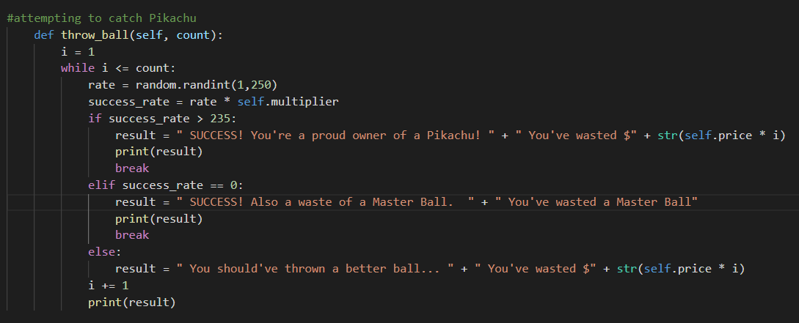
METHOD
Defining the method to run the desired amount of attempts
Imported Random to get a random number generator to determine the chance of success
Will print out the result depending on whether you hit the thresholds or not

Slide 7
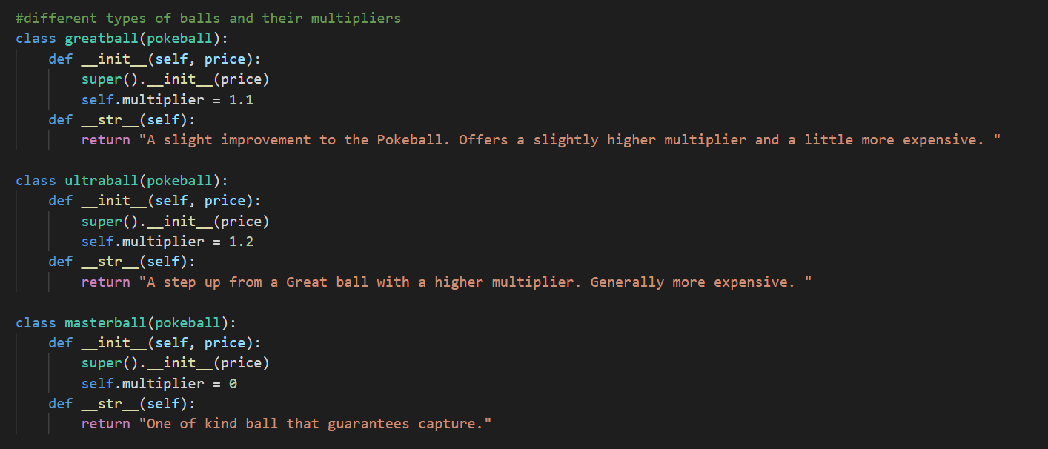
Child Classes
Each of the Balls inherit the method from the parent class used to catch Pikachu, allowing us to save time and space. Each ball also inherits the price attribute as well as assigned its own unique multiplier.

Slide 8
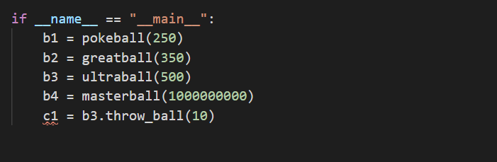
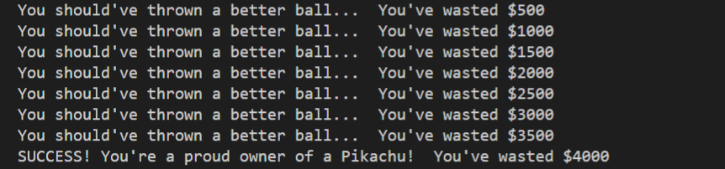
Let’s Start Catching!
Using an Ultra Ball, priced at $500 per throw
Using the throw_ball method and setting amount of attempts to 10
After each attempt the program prints the result of the throw
After 8 throws of an Ultra Ball, the finally tally of total money wasted is $4000

Slide 9
CONCLUSION
Utilizing OOP, we can create something simple without having to rewrite code. Decreasing the chance of errors occurring in the code
OOP is modular, allowing you to modify code without making drastic changes
You can get creative with it and enjoy seeing it in action

Slide 10

THANK YOU

