Slide 1

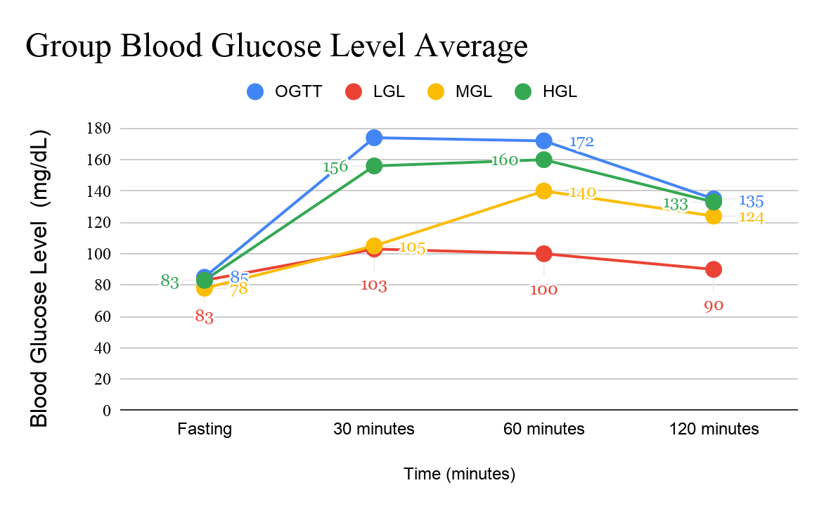
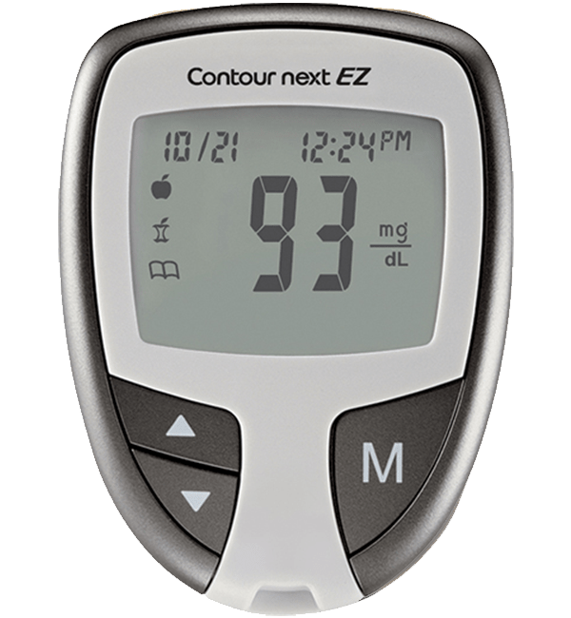

Effects of Glycemic Load on Blood Glucose Levels in a College Physiology Class
Jourdan Kaya, Shuntle Maneja, Mikaella Liban, Shanel Pagaragan, and Rebecca Romine
University of Hawaii at West Oahu
Abstract
Research Design & Data Collection
Thirteen participants fasted and took the fasted blood sugar level. The participants were split into four groups based on substances consumed after fasting blood sugar was measured: oral glucose tolerance test group (OGTT), a high glycemic load (HGL) meal, medium glycemic load (MGL) meal, and low glycemic load (LGL) meal. ​
Blood sugar levels were measured fasted, and 30 minutes, 60 minutes, and 120 minutes post-prandial. ​
Blood sugar levels were the highest in the OGTT group and the lowest in the low GL group. The high glucose meal had the highest blood sugar levels out of those who ate food. ​
Glycemic load affects blood sugar levels due to how food is digested.
Participants were instructed to fast for six hours. A light breakfast was consumed no later than 8 am on the day of the lab. ​
Using a ReliOn alcohol swab to clean the middle finger, a SurgiLance safety lancet was used to obtain blood. ​
The sides of the finger were squeezed to force out a small drop of blood, which was placed on a test strip that was inserted into a Bayer Contour glucometer. The blood glucose value was recorded.
Eating:​
  OGTT group: 75 g glucose solution ingested in five minutes​
  High GL: one 8.3 oz energy drink and two pop tarts ingested in 20 minutes​
  Medium GL: one medium bagel, one medium banana, and two tablespoons of peanut butter ingested in 20 minutes​
  Low GL: 16 slices of deli ham and four servings of 1 oz of string cheese ingested in 20 minutes​
Blood glucose was tested 30 min, 60 min, and 120 min postprandial following the same procedures outlined above used to test fasting blood glucose.​
Introduction & Research Question
Figure 3. Blood Glucose Levels vs. Time for UHWO College Students.
Introduction: The human body digests nutrients in different ways, breaking carbohydrates down to glucose to fuel daily activities. When blood sugar levels rise, insulin is released by the pancreas to stimulate glucose uptake by cells and use it as energy¹. Food have a glycemic load or the rate at which they raise blood sugar levels. If blood sugar is constantly rising or stays high, cells build up insulin resistance and glucose is not uptaken by the cells, resulting in a disease state. It is important to monitor the macronutrients we consume. This study investigated the effects of glycemic loads on blood sugar.
Research Question: How does the consumption of food, varying in glycemic load, affect blood glucose levels differently over time?
Hypothesis: Blood glucose levels will increase the most in the OGTT group and increase the least in the low GL group. Blood glucose levels for all groups are expected to have decreased by the 120 minute postprandial test.
Results
Discussion
Thirteen participants, twelve females and one male, were recruited from a college level Anatomy and Physiology course from the University of Hawaii at West Oahu (UHWO).
The average age group for each test group were as follows:
  OGTT: 22 years old
  High GL: 23 years old
  Medium GL: 20 years old
  Low GL: 20 years old
Of the twelve females:
  Four identified as Filipino
  Four identified as Native Hawaiian
  Two identified as Pacific Islander
  Two identified as Japanese
There was one male subject, who identified as Native Hawaiian.
Food, varying in glycemic load, affected blood glucose levels differently results over time. Higher glucose (HG) levels, such as OGTT and HGL, caused blood glucose levels to gradually increase. While lower glucose (LG) levels, such as MGL and LGL, increased blood glucose levels slowly. Factors such as age, gender, weight, and height affected the result, as well as postprandial blood glucose and glycemic load (GL). With the ingestion of carbohydrates it’s broken down into smaller molecules and released into the bloodstream, causing blood glucose level to increase. After 1 hour and 30 minutes OGTT and HGL participants' blood glucose level averaged 133-153 mg/dL, falling within the category of having an impaired glucose tolerance. MGL and LGL blood glucose levels averaged 90-124 mg/dL, which was considered normal. These results were expected. The foods that were higher in glycemic load caused a sharp increase in blood sugar levels over time. The pancreas releases two hormones known as insulin and glucagon, which are responsible for regulating blood glucose levels. If the pancreas isn’t able to regulate glucose level, it leads to diseases such as diabetes. One participant was prediabetic, with a blood sugar level of 151 mg/dL two hours after the OGTT. The class average shows that 7.7% of the class is prediabetic, which is lower than the state average for Hawaii (14%)⁴
Limitations
Time of last ingestion and activities of participants during fasting are unknown
Weight and height are not included on the data
.
Table 1: Average Blood Glucose Levels
Conclusions
Variable | Fasting | 30 mins | 60 mins | 120 mins
OGTT | 85 mg/dL | 174 mg/dL | 172 mg/dL | 135 mg/dL
Ham and Cheese (LGL) | 83 mg/dL | 103 mg/dL | 100 mg/dL | 90 mg/dL
Bagel (MGL) | 78 mg/dL | 105 mg/dL | 140 mg/dL | 124 mg/dL
Poptart (HGL) | 83 mg/dL | 156 mg/dL | 160 mg/dL | 133 mg/dL
Blood glucose homeostasis is the process of balancing the insulin and glucose levels in the blood. Glucagon is a hormone that increases blood glucose, while insulin is a hormone that decreases blood glucose. Insulin is important after eating to lower the blood glucose level. When the insulin is ineffective in lowering blood glucose, diseases such as diabetes mellitus can occur.
Food higher in glycemic load causes blood sugar to spike, which can have a negative effect on an individual’s overall health.
The group with the highest postprandial glucose was the OGTT group, and the lowest postprandial glucose was the LGL group that consumed ham and cheese.
This experiment showed that postprandial blood glucose is affected by the amount of macronutrients consumed and the glycemic load. Other factors that affect blood glucose levels are age, gender, weight, height, and ethnicity.
Figure 1. Bayer Contour Next EZ glucometer. Instrument used by participants to read blood sugar levels.
Figure 2. Participants obtained their own blood by using a lancet device.
References
Marieb, E. N., & Hoehn, K. (2020). Anatomy & Physiology. Hoboken, NJ: Pearson.
Glucose tolerance test. (2020, March 6). Retrieved from https://www.mayoclinic.org/tests-procedures/glucose-tolerance-test/about/pac-20394296.
Eyth, E. (2019, June 1). Glucose Tolerance Test. Retrieved from https://www.ncbi.nlm.nih.gov/books/NBK532915/
Prediabetes. (2019, June 14). Retrieved April 4, 2020, from https://www.cdc.gov/diabetes/library/reports/reportcard/prediabetes.html

