Slide 1
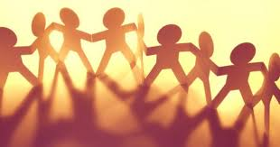
Building The Beloved Community
SD 250
Justin Angelo Giann Agudo, Tasha TRN Dela Rama, Kalāwena Kalehuawehe & Barbara Rocha
Source: http://ndcnews.org/2019/05/16/belonging-its-impact-on-your-organization-and-its-correlation-to-recognition/

Slide 2
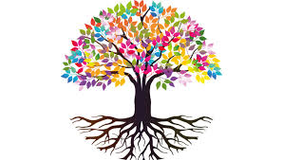
Research Subject:
What Impacts Has the BTBC Principles had on a Student’s Sense of Belonging?
In this presentation, we will discuss just a few of the many BTBC principles and how they directly create a sense of belonging in students
But First….WHAT IS BTBC????
Source: https://digitalworkplacegroup.com/2020/01/22/nurturing-cultures-of-inclusivity-and-belonging-with-the-digital-workplace/

Slide 3
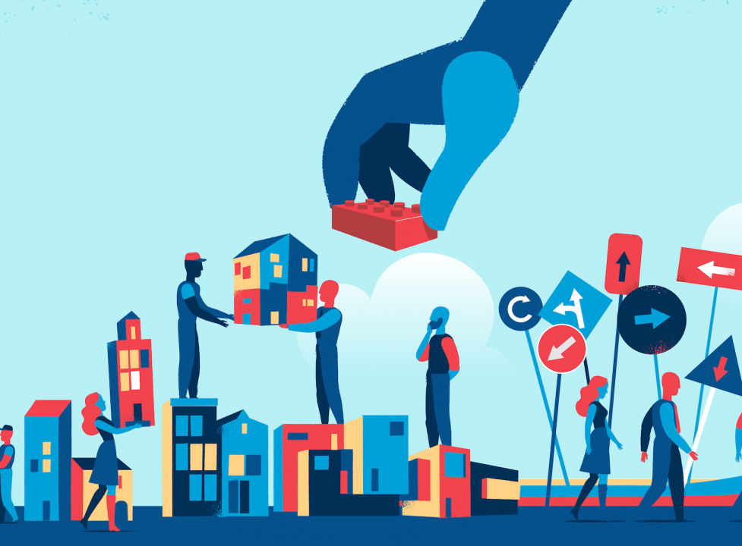
Building The Beloved Community (BTBC)
Building the Beloved Community, is known in short as the BTBC program
It is a community building and conflict transformation program created by Aunty Puanani Burgess based on bringing people face to face for ceremony, storytelling, and healing circles of trust and respect.
It has been taught all over the world; in schools, prisons and Fortune 500 companies.
How does this program help foster a sense of belonging??
Well what exactly is Belonging?
Belonging is a person’s own feeling of acceptance in a group or community.
Before we dive into how the BTBC helps create a sense of Belonging,
Let’s meet the creator and facilitator of it…..
Source: https://thriveglobal.com/stories/why-a-sense-of-community-is-more-important-than-ever/

Slide 4

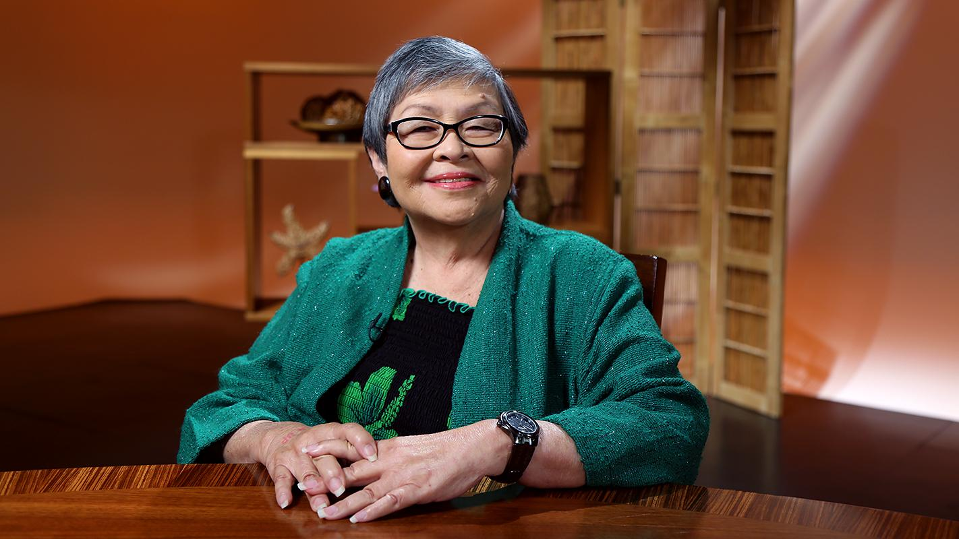
Who is Puanani Burgess?
**Known Lovingly & Respectfully as Aunty Pua**
Christabelle Yoshie Puanani Sonoda Burgess
(you MUST read her poem “Choosing my name”!)
She is also a poet and a cultural translator and mediator
Loving Wife and mother
Hawaiian community activist
Overall Bad
Mamma Jamma
Resident of Wai’anae
a community building facilitator, trainer and consultant in Hawai'i, the US and the Pacific.
“At one point I was an advocate, an activist; and now my activism is expressed in building beloved community, through mediation and deep dialogue”- Aunty Pua
Source: https://www.pbshawaii.org/long-story-short-with-leslie-wilcox-puanani-burgess/

Slide 5
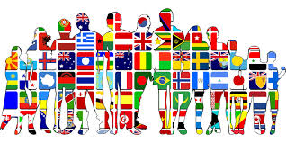
Community: What does it represent?
“ A feeling of fellowship with others”- Oxford Dictionary
Research indicates that we “have a fundamental need to feel that [we] are an important part of a larger community that is valuable, supportive, and affirming” (Gieg, 2016)
Community can be loosely defined by birthplace, social group, discourse, employer, sport teams, hobby groups, clubs, and many others in between. The importance of recognizing the community(ies) we belong to, help us to identify who we are and where we feel most understood and celebrated.
Communities represents our Sense of belonging. In essence, communities are a representation of our core values and beliefs, where all those apart of the same community(ies) share similar outlooks
The Building a Beloved Community Framework encourages the unification of all by using its core principles to help “people come together to dream, heal and build their beloved community” (Aunty Pua)
Source: https://huntnewsnu.com/60441/editorial/op-eds/coloumn-cultural-appropriation-or-cultural-appreciation/

Slide 6
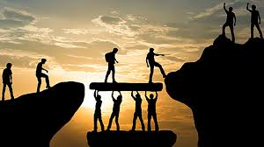
Trust: The Pillars of Foundation
According to Meyer et. al. “Trust is crucial in many different levels of society” (Meyer et. al, 2017)
Trust is not only needed for interpersonal relationships, but relationships of all levels.
To build trust, openness, acceptance, honesty, vulnerability, and responsibility are a few core values essential for the exchange of power.
How does trust relate to BABC?
  Trust is essential in team building and the creation of a community of strength.
An exercise to facilitate trust within communities is what we know as the “Weather Ball and Blue Sky Moment”
Source: https://digitalworkplacegroup.com/2020/01/22/nurturing-cultures-of-inclusivity-and-belonging-with-the-digital-workplace/
Notes:
Explain how this builds trust and why this is important

Slide 7

Weather Ball & Blue Sky Moment
Weather Ball - What emotions do you feel today and explain in as “your weather”.
ie. I’m excited = Sunshine all day, I had a few moments of anxiousness = partly cloudy, I’m a mess today = thunderstorming.
Whatever your weather ball may be, own it, and speak your truth.
Blue Sky Moment - What are you looking forward to that will “clear” up your weather?
ie. Clock strikes 5 and my favorite show is on, when my kids are sleeping and I get alone time, that morning run.
Blue skies, like the weather, is a break in the day of what makes you happy
How does this foster BABC?
To develop trust, the individuals participating, need to have some level of vulnerability.
https://www.shutterstock.com/video/clip-8739238-beach-ball-floating-on-water-loop-ready
Notes:
Share our weather and blue skies *Last person that speaks need to explain that in the beginning of the class we were not tal;kdfjls;dkfjkljdsfas vulne

Slide 8

Effects of Weather ball and Blue Sky Moment
So what’s the point you might be asking? Why do we share our “Emotional Weather”??
We asked ourselves the same thing in the beginning
-We were all nervous
-We didn’t know each other
-We felt VULNERABLE sharing our feelings with strangers
But Then…..
Our VULNERABILITY turned into a connecting factor to others in the group
-We learned others may be feeling just like us
-Or they may have dealt with similar things and could offer advice
-What was once a weakness, turned into a strength
-We began to build Trust
THE BONDING and ROAD TO BELONGING HAD BEGUN
Source: https://thementalfitnesscompany.com/blog/vulnerability-weakness-fear-hurt-betrayal-or-beauty-rawness-deep-love-power/

Slide 9
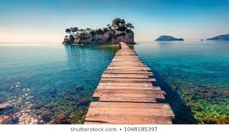
The Boy with the Gift Principle
Aunty Pua teaches a class, gets to the principle of your gift. She calls upon a student, he feels he doesn’t have a gift and both Aunty Pua and the boy feels ashamed and embarrassed. Aunty Pua bumps into the boy and he finally figures out his gift.
The importance of how we each see our VALUE
We can only truly love others, once we love ourselves.
Share your gift be proud of the value that you add to yourself and others around you
We all have gifts, what is yours?

Slide 10
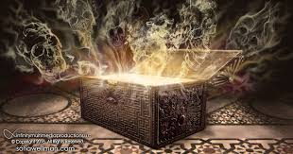
The Importance of your Gift
“Help people find and acknowledge their gift; this also applies to organizations, communities, schools…”
EVERYONE Has a Gift, it may not be a talent that we are used to hearing, but gifts come in all forms.
Dig Deep to Find YOUR Gift, Embrace It. Your gift makes you the person that you are today, your struggles, challenges and acceptance encompasses you as the shining individual that you are.
Share YOUR Gift with OTHERS, you may never know the impact your gift can have on another individual. We all add value to the lives of others that we surround ourselves with
Recognize and Appreciate the Gifts of others
Notes:
Justin or Tash should do this . need to summarize the boy with the gift story and how it relates to growing a sense of belonging
Maybe we see things in others we never would have known were there? We start to find similarities?

Slide 11
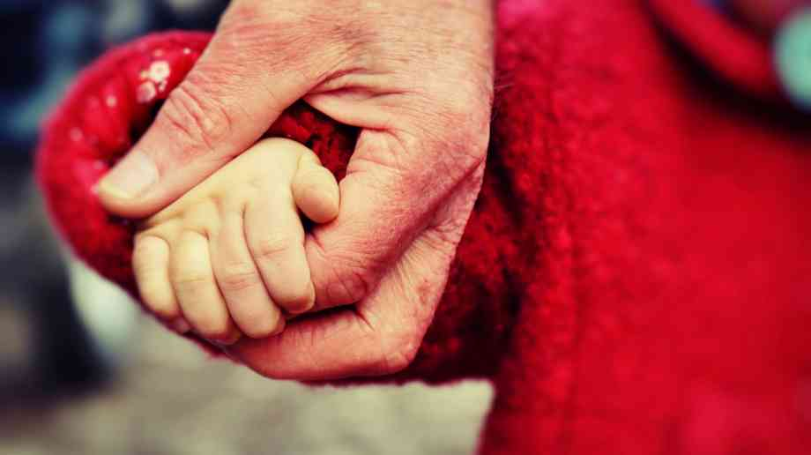
Poha and Popo Principle
A story of a grandma, her grandson and their daily adventures to the pasture. Their afternoon strolls were meant to engage Poha (grandson) in his surrounding and share in the beauty of the scenery and the animals.
The importance of EMPATHY
Care and take INTEREST in the perspective of another
Share your point of view
Kindness can invoke a positive change in Attitude and Perspective
Source: https://governmentbusiness.co.uk/news/16062020/report-warns-coronavirus-impact-vulnerable-children

Slide 12

The Importance of Perspective
“Be willing to see the world from another person’s perspective and be willing to show them your perspective. This creates processes that allow me to see you as human and you to see me as human.” - Aunty Pua
Ability to share emotions and experiences with others
  When we share in the emotions and experiences of others, we feel more validated, understood and respected
Positive conflict
  Positive conflict occurs when others are comfortable enough to embrace differences and remain open to receiving new knowledge
  We also uncover our own personal biases that we may not have known were present
Building meaningful relationships
  Decreases defensiveness and encourages empowerment that is not judgemental and is founded on a genuine care for others
Source: https://resilienceedge.com/the-success-perspective/

Slide 13
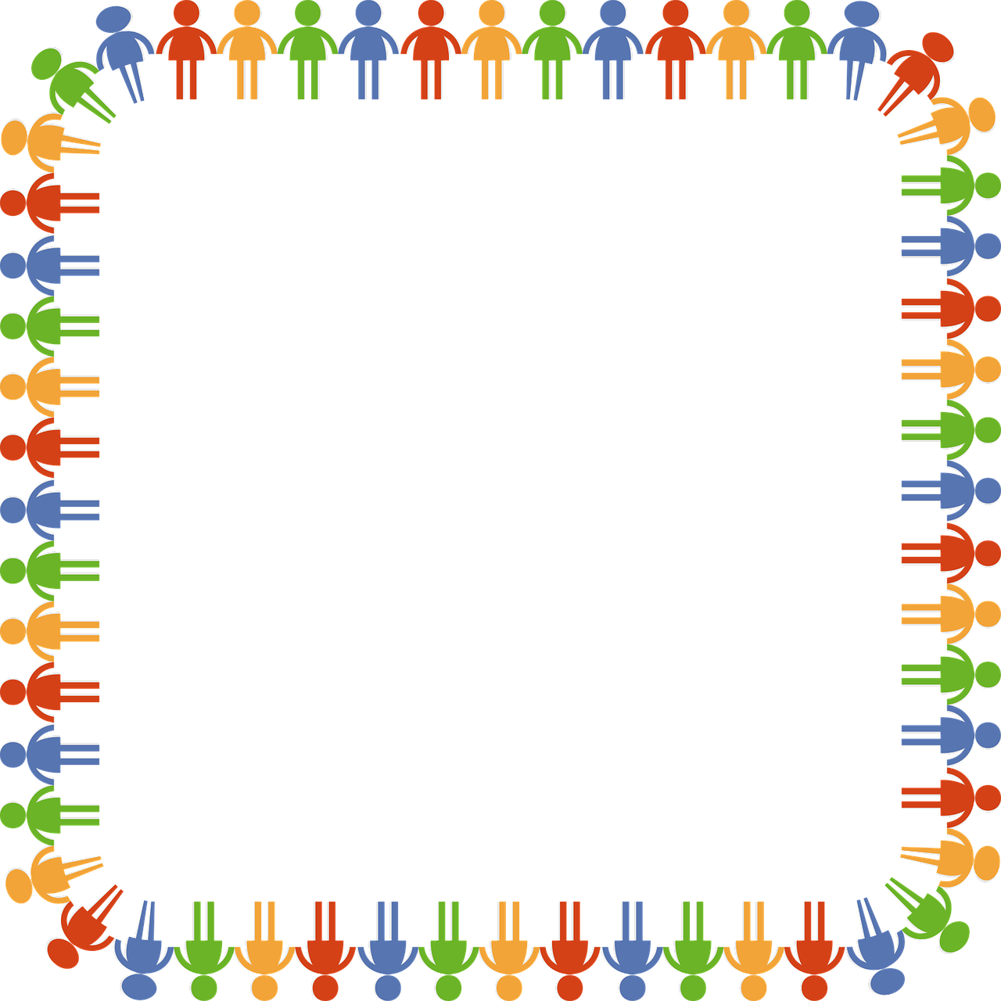
Benefits of BTBC principles in fostering
a sense of Belonging in students...
Vulnerability - (uncertainty, risk, and emotional exposure - Brene Brown)
As in WEATHER BALL & BLUE SKY MOMENT, If we practice being vulnerable and opening up to others, in return, others may feel comfortable opening up and sharing with us, creating trust. Trust creates a Bond. Bonding Creates Belonging
Empathy - (the ability to understand and share the feelings of another.)
As In the POHA & POPO PRINCIPLE, If we listen to others and try to see things from their perspective, it encourages a bond of understanding.
**By being vulnerable and empathetic toward others, this creates trust and a sense of community which can only enhance one’s sense of BELONGING**
...The BTBC Program teaches us these Skills...
Notes:
We should each do our own brief closing on how the BTBC course has individually helped us.

Slide 14
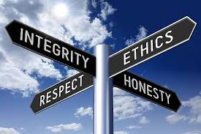
Community Building Principles
Poha and Popo Principle
Mauna ‘Ala and Gandhi Principle
Izzy Abbott Principle
How do you join two dots?
Castor Oil Principle
Dalai Lama Principle
Sylvester Stallone Movie Principle
Sylvester Stallone Movie Principle
The Gift Principle
Pearl City High School Principle
Listen Deeply to yourself and others
Source: https://www.lollydaskal.com/leadership/12-successful-leadership-principles-that-never-grow-old/
Notes:
*Building A Beloved Community encompasses 11 different principles, read principles and briefly describe principle as you read. We are unable to go over every principle, but we have chosen 4 principles that have resonated with us and how we see Building A Beloved Community gives us a foundation of belonging, empathy, trust and value to our communities.
You may be wondering what do all of these priniciples have in common? All these principles help with building a community of people that are strengthened with value based on the foundation of trust.

Slide 15
Bibliography
https://www.wearethebelovedcommunity.org/bcquotes.html
https://laulima.hawaii.edu/access/content/group/WOA.69563.202110/Week%201%20-%2008_26/Building%20a%20Beloved%20Community%20Article.pdf
https://keywiki.org/Puanani_Burgess
http://apiwomenfaithaction.blogspot.com/2010/10/puanani-burgess.html
Dictionary.com. (n.d.). Retrieved November 12, 2020, from http://www.dictionary.com/
Gieg, S., Oyarzun, L., Reardon, J., & Grant, J. C. (2016). The Impact of Student Organizations on Sense of Belonging for International Students.

