Slide 1

Databases
Autumn Gamble
ICS 129

Slide 2

SQL
This is a very general overview of databases and how they work.
Stands for Structured Query Language
One language for accessing and manipulating databases.
How we use data is different than how we store data

Slide 3

DDL
Data Definition Language
Used to create the structure of a database
Creates the Columns
List of Commands: CREATE, DROP, ALTER, RENAME
Example: Create Table <Name> (
<column 1> <character input type>
, <column 2> <character input type> ) ;

Slide 4
DML
Data Manipulation Language
Inputs data into the ROWS
SQL commands that manipulate data
List of Commands: INSERT, UPDATE, DELETE
Example:
INSERT INTO <Table Name> VALUES (‘Data’, ‘Input’)

Slide 5
DQL
Data Query Language
Used to retrieve data from a database
Command: SELECT
Examples: SELECT * FROM <Table Name> ;
SELECT <column name> FROM <Table Name> ;
Selects all columns from a table
Selects specific columns

Slide 6
Relational Tables
A way to organize data that creates an easy way to combine and manipulate data
Includes Primary and Foreign Keys
Primary Key: Data that very uniquely identifies a column of data
Some examples include but not limited to: Serial Numbers, ID Numbers
Foreign Key: Refers to a primary key from another table which links those tables

Slide 7

Normalization
Takes a table and breaks it down into Relational Tables to make it easier to manipulate the data.

Slide 8
Tying it all together:
GAMER | BADGE | BADGE CATEGORY | DATE EARNED
Aaron | Tunnel Swim | Earth Water | 2020-01-01 2020-03-09
Ben | Wind Flight Healing | Air Air Water | 2020-03-23 2020-07-18 2020-09-16
Courtney | Cultivation | Earth | 2020-08-19
Donald | Flame Sun Tunnel | Fire Fire Earth | 2020-03-13 2020-07-19 2020-08-03
Ernest | Wind Swim | Air Water | 2020-02-27 2020-08-22
Beginning Table (not normalized)

Slide 9
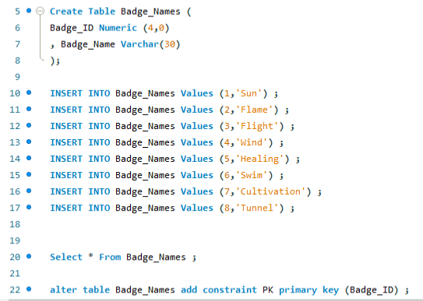
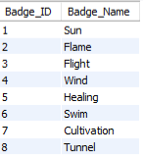
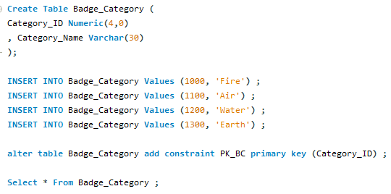
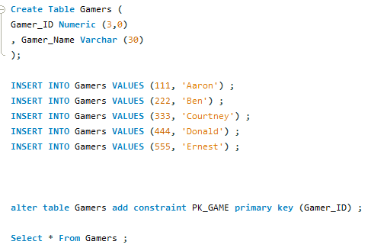
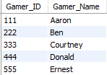

Create the relational tables
DDL
DDL
DML
DML
DQL
Also part of DDL; Making Primary Key Category_ID.
Also part of DDL; Making Primary Key Badge_ID.
DQL
DDL
DML
DQL
Also part of DDL; Making Primary Key Gamer_ID.

Slide 10
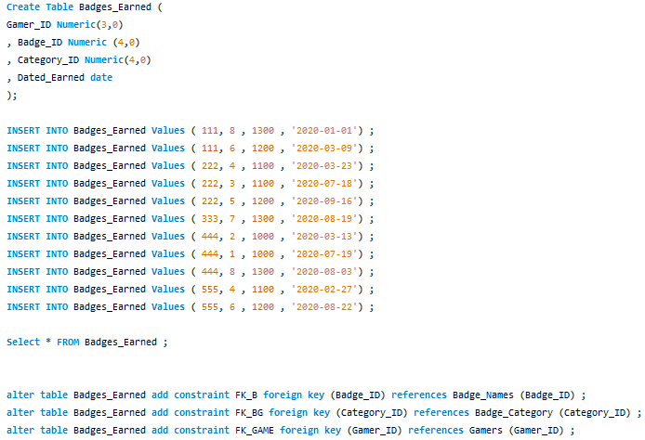
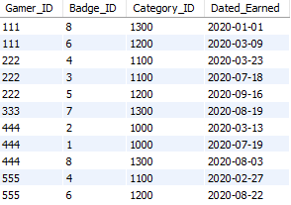
Normalized table
Notice that the table now only consists of Foreign Keys (The Primary Keys from the relational tables)

Slide 11
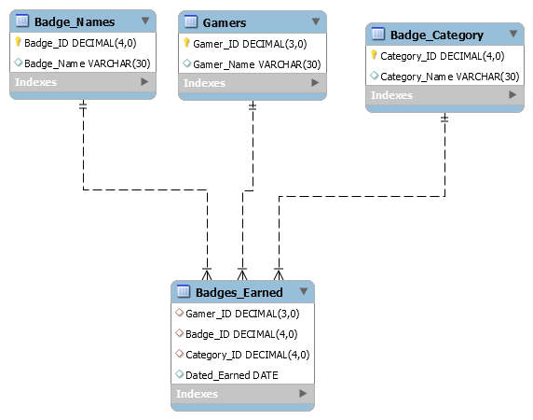
ERD (Entity Relationship Diagram)
Ties all the Tables Together and shows the relationships

