Slide 1


Equipment Organization
BUSA 490 Practicum
Garrett Fogg

Slide 2
About Mocon Pacific
Specialize in underground construction
Small but growing
Structure: President, Project Manager, Field Operations Manager, Foreman, Crew

Slide 3
Practicum Duties
Scheduling
Check-ups
Ordering Material
Training
Invoicing

Slide 4
Thesis
Mocon Pacific needs to establish an efficient equipment organization tool. Management at Mocon Pacific face three major issues including inefficient spending practices, inefficient time management, and unorganized jobsites.
Strategic recommendations presented are provided to address the inefficiencies and organization issues and include establishing tool and equipment care policies, a mobile app to track equipment in and out of the field and designating a specified resource manager to handle crews and the equipment they have with them.

Slide 5


Inefficient Spending Practices
Problem:
Employees spend excessive amounts of money on tools, equipment, and material that has either been lost or ruined due to carelessness when in use.
Solution:
Mobile apps are the easiest and most innovative way to keep track of tools and equipment.
50 to 60 percent of costs in this industry is from tools, equipment, and material (Tool Inventory Management, 2017).

Slide 6

Inefficient Time Management
Problem:
Employees waste countless hours looking for the tools and equipment that they need.
Solution:
Designating an employee as a ”Resource Manager” to allocate equipment and tools to the appropriate crews that need them.
Two-thirds of construction companies spend more than one quarter of their time waiting on things (Wolfe Jr., 2020).

Slide 7
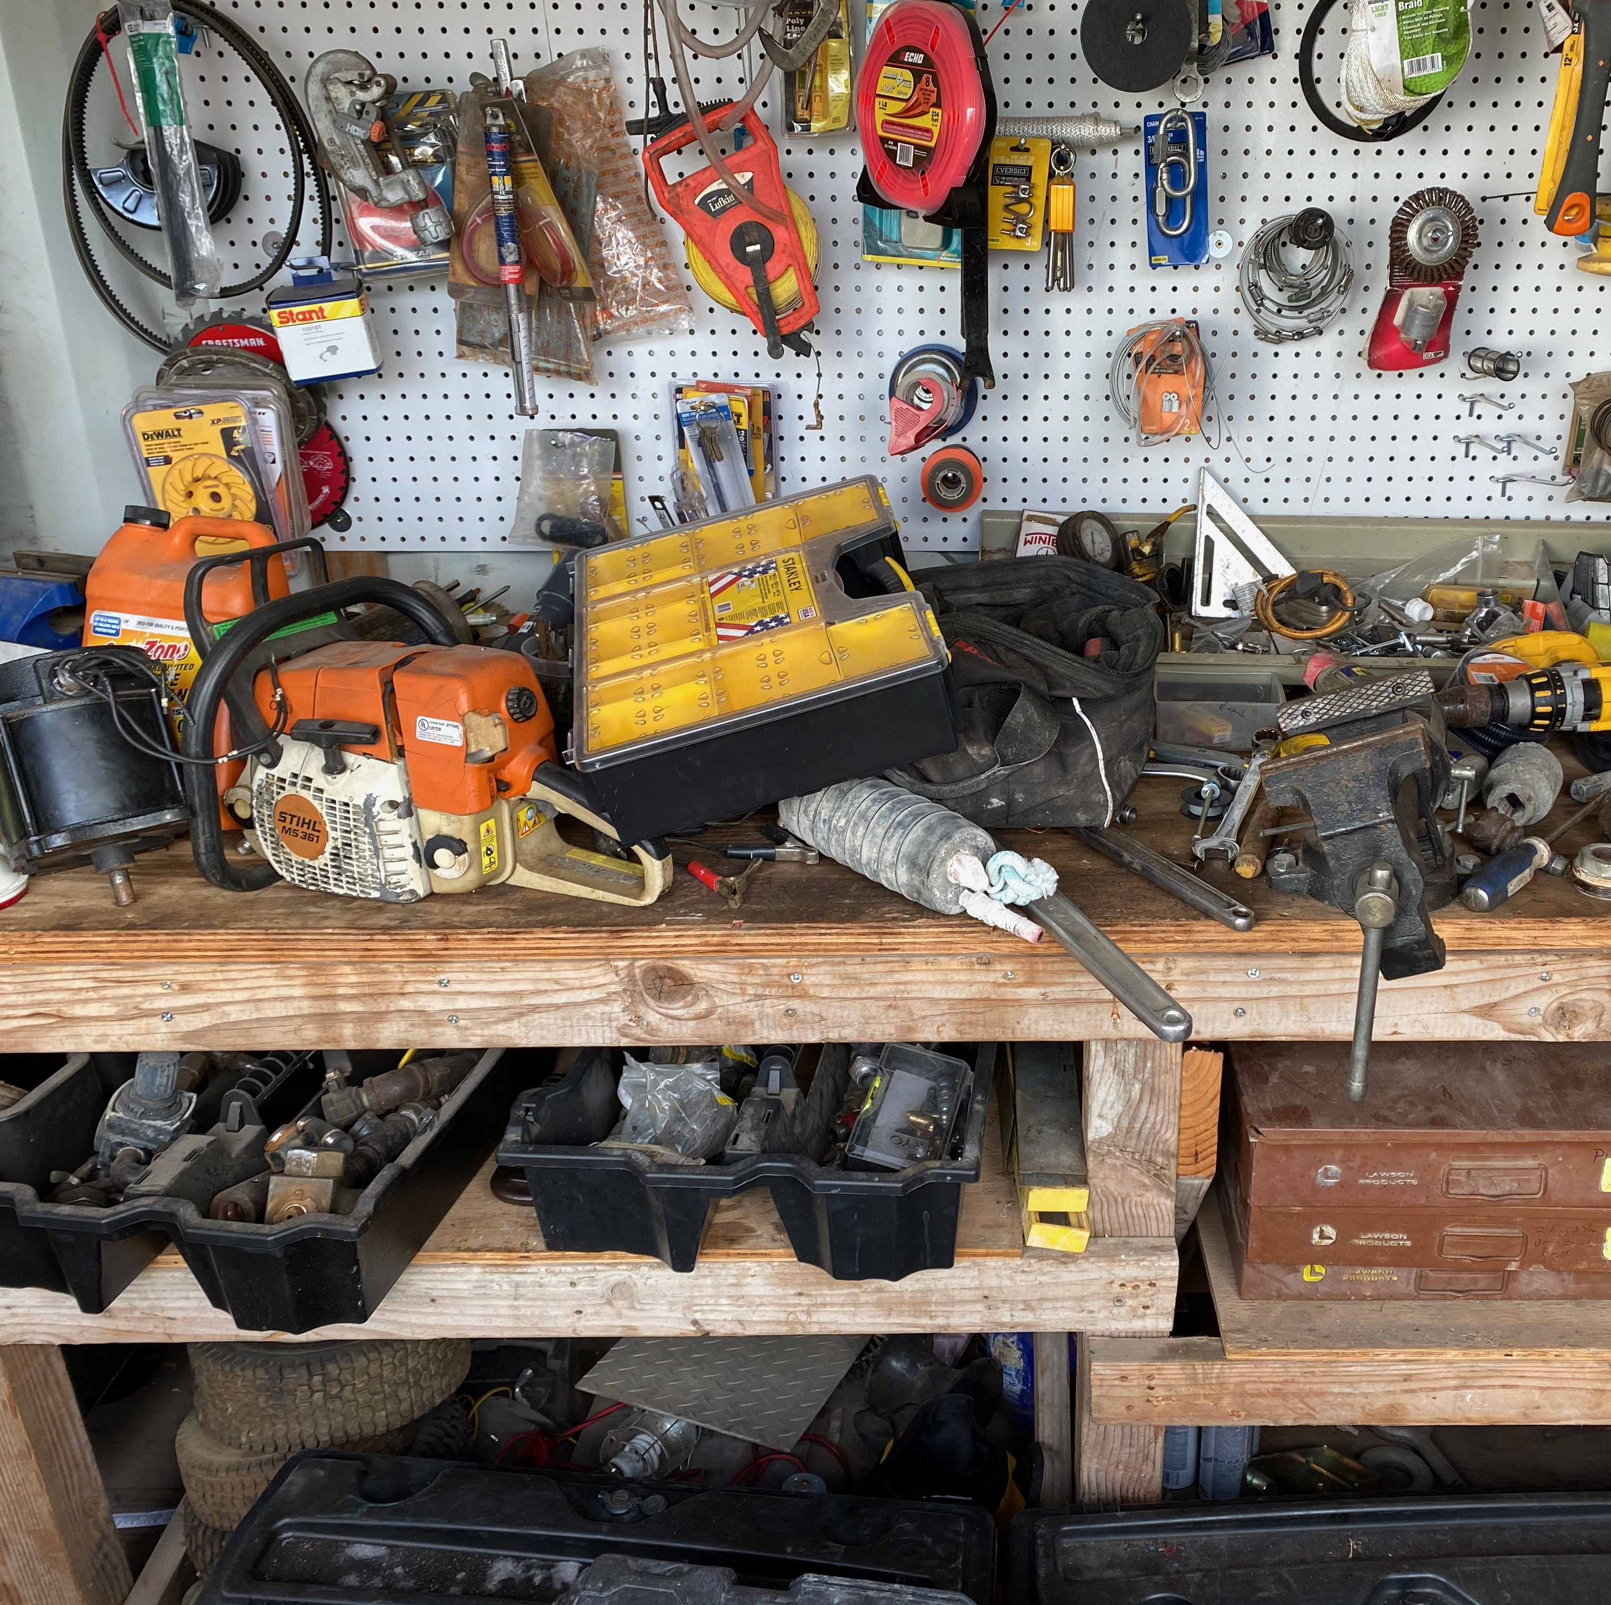
Unorganized Jobsite
Problem: Tools are laying everywhere on jobsites. They are not put back where they came from and make a mess on the jobsite
Solution: Policies to specifically define where and how tools need to be organized and cared.

Slide 8
Conclusion
Increase Productivity and Profit
Mobile Tracking App
Tool Care Policies
Resource Manager

Slide 9
References
Admin. (2017, September 8). Tool Inventory Management: Why Your Construction Firm Needs It? Retrieved from https://blog.ezofficeinventory.com/why-your-construction-firm-needs-tool-inventory-management/
Hedley, G. (2011, November 02). Construction Business Best Practices Series, Step 3: Organized and Systemized Business. Retrieved from https://www.constructionbusinessowner.com/strategy/business-management/construction-business-best-practices-series-step-3-organized-and-0
Humphrey, B. (2020, June 10). How to Reduce Wasted Time on a Job. Retrieved from https://www.forconstructionpros.com/pavement-maintenance/article/21132340/how-to-reduce-wasted-time-on-a-job
Kumar, A. (n.d.). 7 Common Problems of Construction Organization Without Asset Tracking Software - Asset Infinity. Retrieved from https://www.assetinfinity.com/blog/common-problems-of-construction-organization-without-asset-tracking-software
Mavenlink. (2019, June 26). Why is Managing Resources Important? Retrieved from https://blog.mavenlink.com/why-managing-resources-important
Netscher, P. (2017, September 18). How dangerous is a messy construction site? You might be surprised! Retrieved from https://www.clockshark.com/Blog/dangerous-messy-job-site-might-surprised
Wirtz, C. (2020, August 11). 3 Steps to Better Tool Management: Keep it Simple. Retrieved from https://www.sharemytoolbox.com/tool-management-3steps/
Wolfe, S., Jr. (2020, May 01). 2020 Construction Survey: Contractors Waste Time & Get Paid Slowly. Retrieved from https://www.levelset.com/blog/2020-report-construction-wasted-time-slow-payment/#Wasted_time

