Slide 1


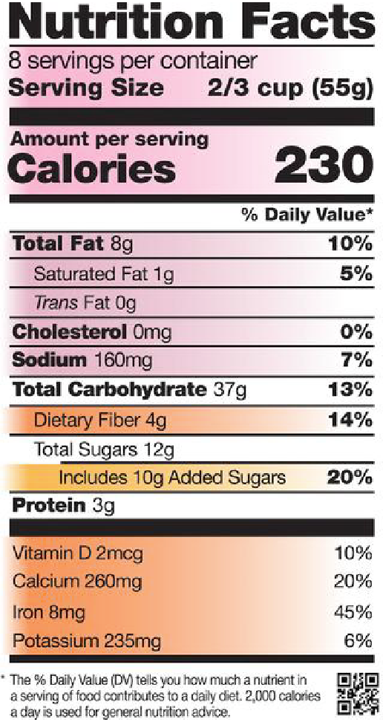

Math + Nutrition = Life
Jaqlyn Silva
University of Hawaii at West Oahu
Abstract
Research Design & Data Collection
Discussion
When we are in Math class with our students, it is the teachers responsibly to help shape their minds and scaffold from their prior knowledge to educate them on the ideals and practices that can improve their well-being. Teachers can introduce the topic of Nutrition and who reading the nutritional facts label and the students and begin a discussion. Teachers can walk around and listen in to hear about the amount of knowledge and types of conversations the group has before diving in deeper. When the students seem comfortable, then the class can learn about how the people who read the food labels on food tend to be: women, people who are highly educated or high income, prepare food, physically active or people who are trying to loose weight. As their teachers we have to remind them that they do not need to be any of those things to know how to read and understand a nutritional facts label! We have to be sure to mention the serving size on the nutritional facts label, which may change the outcome of how much each individual eats. Eventually students will be able to see a correlation with Nutrition and Math. With some modeling and examples, students can learn how to calculate the amount of sugar, fat, and calories are inside each food item. Teachers can teach this in a way that connects to the students life, by asking the students to conduct research from a food product that they usually eat at home.
Conclusions
Research states that, older adults might be prompted to eat better due to health conditions that may have developed due to poor eating choices, we need to find a way to provide support and motivation to young adults to eat well now since their diet throughout life can have a major impact on long-term health. With the knowledge of basic Nutrition and understanding the importance of reading a nutrition label students will have the ability to make proper food choices that will positively impact their life forever. When teachers make the first step to encouraging students to think twice about their health, then our students will be more likely to prevent future health problems and also share what they learn with loved ones and friends.
References
https://www.nctm.org/Publications/Student-Explorations-in-Mathematics/2012/What_s-on-Your-Plate_- _November-2012_/# https://www.nctm.org/Publications/mathematics-teaching-in-middle-school/2004/Vol10/Issue1/Math-at-Work_- Figuring-Fitness_-Nutrition-in-the-Middle-Grades/ https://www.nctm.org/Publications/mathematics-teaching-in-middle-school/2004/Vol10/Issue1/Math-at-Work_- Figuring-Fitness_-Nutrition-in-the-Middle-Grades/ https://www.nctm.org/Publications/mathematics-teaching-in-middle-school/2004/Vol10/Issue1/Math-at-Work_- Figuring-Fitness_-Nutrition-in-the-Middle-Grades/
Within the topic of Nutrition and Math, there have been many studies conducted to determine the amount of knowledge elementary school students and their parents may have obtained in the course of their life. With that being said the findings that stood out to me thus far, is that there is no direct correlation so far with food knowledge between parents and their children. Although some students may have proper nutrition at a young age, most of this gained knowledge significantly increases with age and exposure. The type of nutrition that students need to be incorporated in their life, needs to presented to them in an understanding and clear way, so that they can use the information in their everyday life’s and hopefully benefit from it.
Research Question: Based on two main questions:
Do our students know how to read the nutritional facts label on food products?
How can we start to encourage our students that it is important to learn about Math and Nutrition?
The information on this topic was collected by reviewing research articles from National Council of Teachers of Mathematics as well as many other scholarly article journals. The research conducted supported the research questions because there was evidence that explained that students do not care too much about their health or just never learned to care about it.
Introduction
LABEL MATH
Get to know the new Nutrition Facts label
Introduction:
The topic of nutrition in Math is as significant to students as it is to teachers because we are leading and modeling for our students the best way to live. Students should have the proper knowledge of how to choose what food choices are the best for their health and well-being by reading a food label on their own by the time they leave high school, if not by the time they enter high school. Why do so many students in the United States revert to unhealthy eating habits, is it because they like the food or because they do not know any better? If students have parents who are well informed about nutrition and healthy eating habits, then the student will also have the same knowledge because they are influenced by their parent's choices. With the additional time and effort of teachers striving to educate students about nutrition, they will be able to make the right choices and develop healthy joints, bones and muscles.
How many calories are there in a single serving of the food on this label?
Now calculate how many calories are in the entire container:
How many grams of added sugars are in one serving?
Hypothesis:
How many grams of added sugars are in the entire container?
If students have parents who are well informed about nutrition and healthy eating habits, then the student will also have the same knowledge because they are influenced by their parents choices.
How many macronutrients are featured in a serving of this food? What about micronutrients?
Copyright http://foodandhealth.com
Brought to you by:
Contact info
Jaqlyn Silva
University of Hawaii West Oahu Email: jaqlynes@hawaii.edu

