Slide 1


School Suspensions in Hawaii
By: Anthony Amos

Slide 2
Overview
Background
Analysis
Policy Options
  Pilot Program
  Do not Adjust
  Working Group
Recommendations

Slide 3

1.
Background

Slide 4


Legislative and Educational History
Dropout
Get involved in delinquent and criminal behavior
Require incarceration or medical care

Slide 5
1.2 Million High School Dropouts in the US Annually

Slide 6

$168,880
The Average Cost per dropout
Over 70,000 Days
Missed by students due to suspension in Hawaii
92-Day
Maximum for length of time a student can be suspended

Slide 7
2.
Analysis

Slide 8

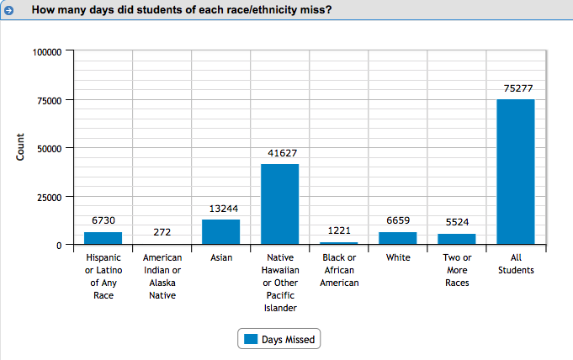
ACLU and Department of Education Statistics
Disparities in the cumulative days missed by Native Hawaiian and Pacific Islander Students
Disparities in the cumulative days missed by Students with Disabilities
Lack of Educational Training

Slide 9


The Impacts of Disparities in Suspension
Not Homogenous
THE
CONCEPT
Ineffective Mode of Deterrence

Slide 10
3.
Policy Options

Slide 11
Policy Option #1:
Establish a Pilot Program to reduce or ban suspension use with alternative rehabilitative practices

Slide 12
Policy Option #1
Reduces Maximum
Decreases the maximum number of days suspension is allowed
Behavior Management
Focuses on student competence and student support
Reporting
Focuses on more individualized, characteristic-driven reporting data
Controversial
Divisive and lacks support
Stunts Academic Growth?
Negative effects on academic performance
Economic Cost
Requires millions and a lot of time

Slide 13
Policy Option #2:
Do not adjust the school suspension policies and clarify that it is effective as is

Slide 14
Policy Option #2
Overall Costs
Administrative Support
Inflated Data

Slide 15
Policy Option #3:
Establish a working group to evaluate research and discuss appropriate measures to reduce school suspension use

Slide 16

Policy Option #3
Working group functions
Time and Cost
Note: Policy Options 1 and 3 are currently in the legislature as resolutions

Slide 17
4.
Recommendations

Slide 18

Why Policy Option #3 is the Best
Policy Option #3 has the following advantages that make it the best option to be implemented:
Cost Effective | $35,000
Diverse Opinions | Senate Approval
High Likelihood of Success | Led to reduction in suspension rates by 89.1%

Slide 19

Thank you very much for your time
If you have any questions about this presentation please don’t hesitate to contact me at:
aamos@hawaii.edu

