Slide 1

Databases
Project
NorMalization
ICS 129
Sara Riggs

Slide 2

What is SQL?
https://www.youtube.com/watch?v=27axs9dO7AE&t=201s
0:42 - 2:58

Slide 3
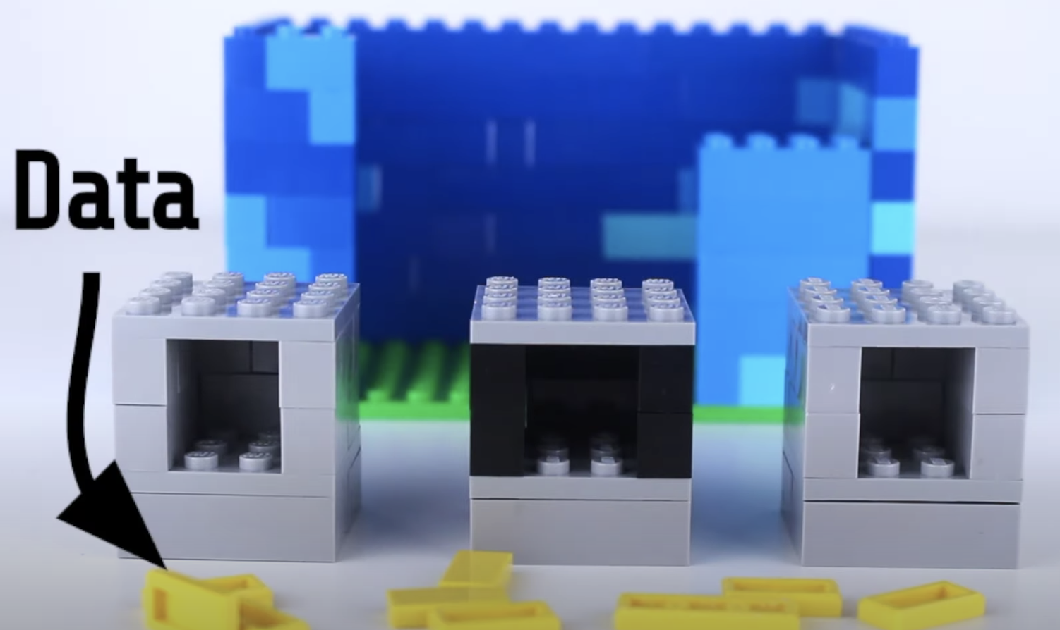
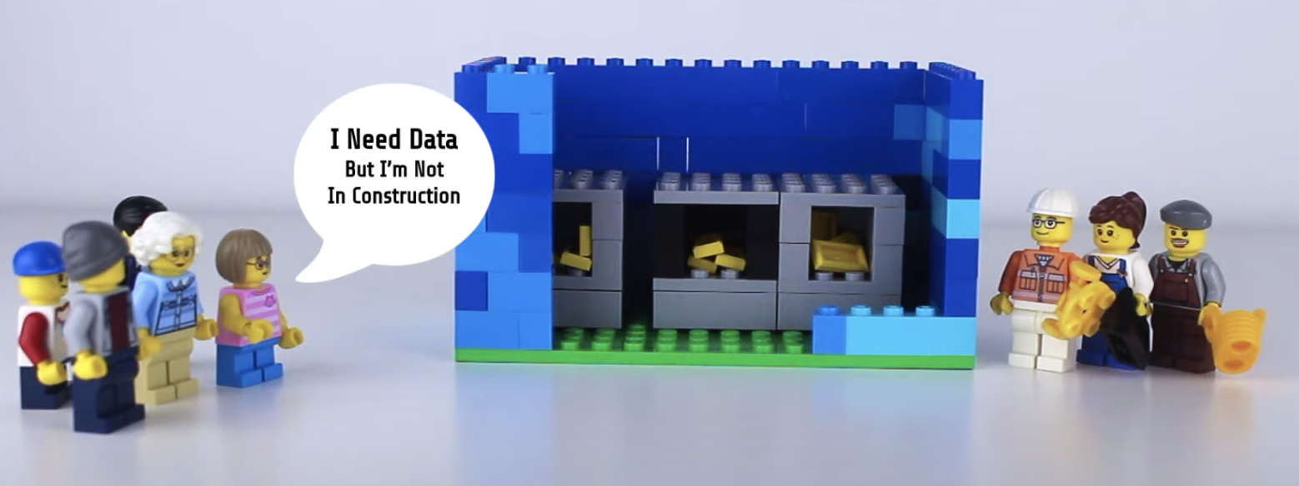
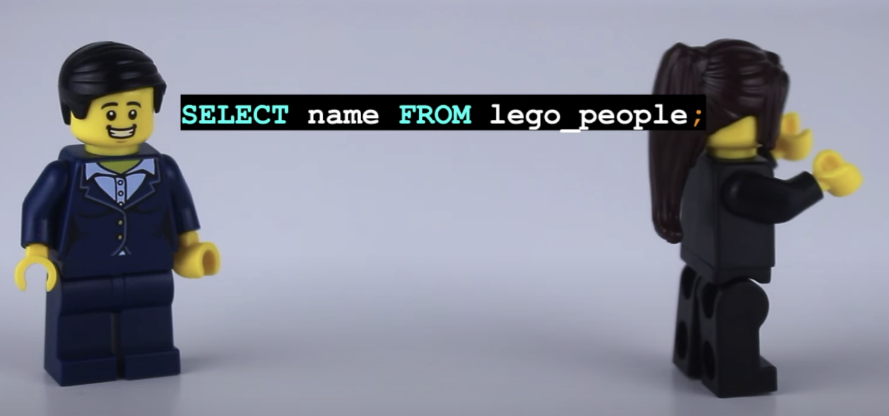
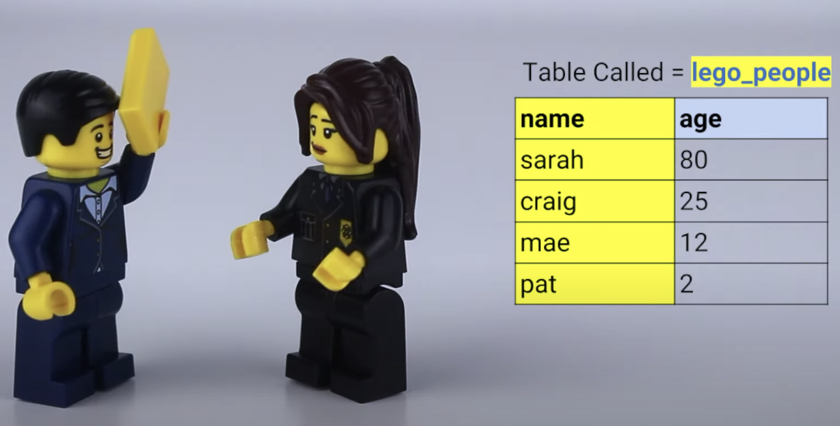
Imagine a lego data warehouse, that stores data using coding languages such as C++, Java, Python.
“Sally SQL” translates to retrieve items from the warehouse (developers)
”Lego mayor” wants to know the names of his citizens.
(customers)

Slide 4

Normalization
A technique of organizing data into multiple tables that are RELATED to one another to minimize DATA REDUNDANCY
Unnecessary data repetition increases the size of the database and also leads to more issues

Slide 5
Normalization Example: School
STUDENT Table
ID | Name | Dept. | Dept. Head | Office Number
1 | Aaron | ICS | Mr. Smith | 12345
2 | Barry | ICS | Mr. Smith | 12345
3 | Carry | ICS | Mr. Smith | 12345
4 | Danny | ICS | Mr. Smith | 12345

Slide 6
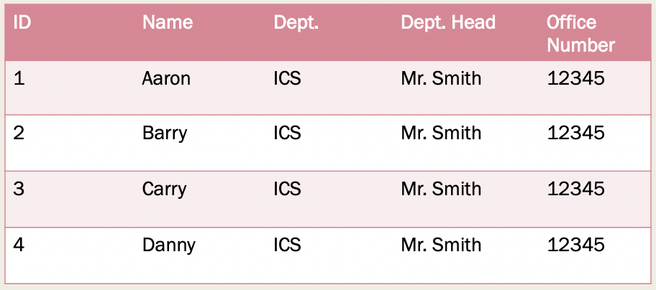
Modification
Insertion, deletion, and updating issues
Mr. Bean
Mr. Bean
Mr. Bean
Mr. Bean
Mr. Smith leaves the ICS department leave gets replaced by Mr. Bean

Slide 7

OLD STUDENT TABLE
ID | Name | Dept. | Dept. Head | Office Number
ID | Name | Branch
1 | Aaron | ICS
2 | Barry | ICS
3 | Carry | ICS
4 | Danny | ICS
Branch | Dept. Head | Office Number
ICS | Mr. Bean | 12345
Modification of the Dept. Head from Mr. Smith to Mr. Bean only required changes in the branch table. This avoids the redundancy of changing this value in every single row in the student table, because all students will be directed by one director.

Slide 8
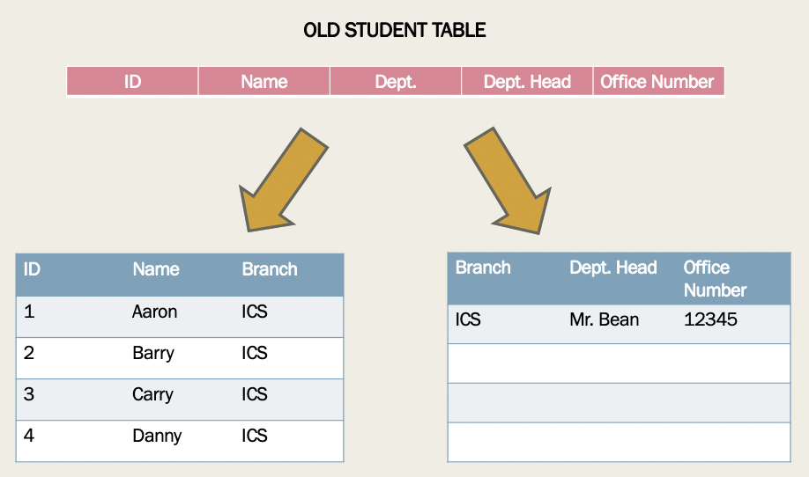
Insertion and Deletion

Slide 9
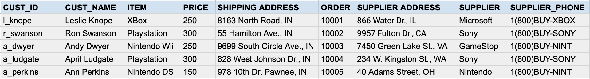
My project: Customer sales
First normal form: each cell to be single valued
Rows are uniquely identified

Slide 10
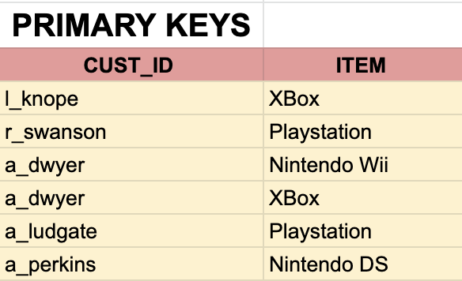
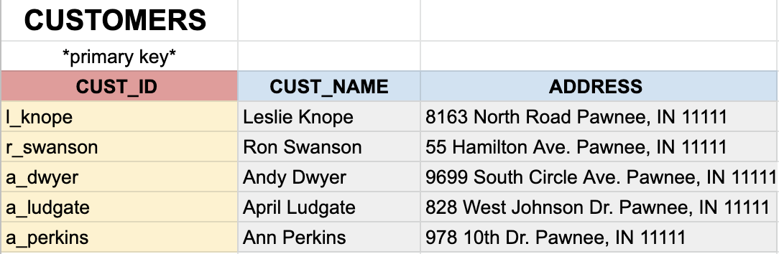
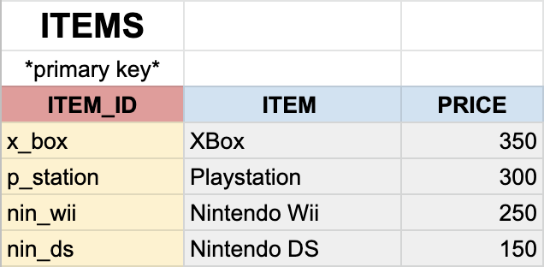
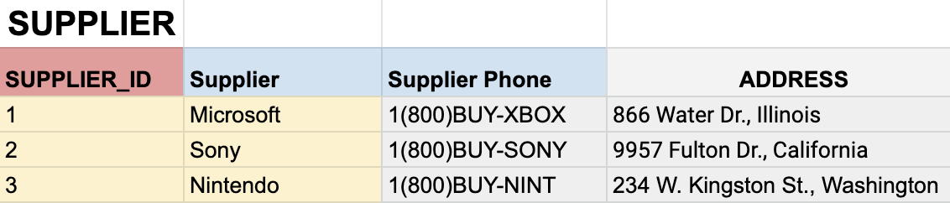
Normalized Version
Attributes are broken apart so that they are dependent on the key

Slide 11
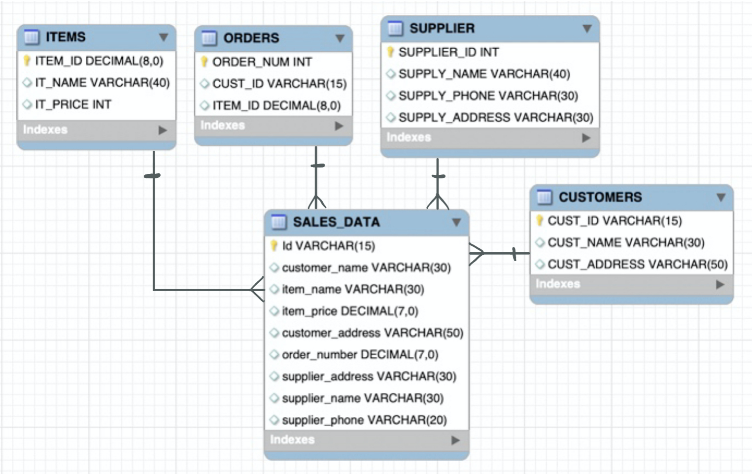
ER DIAGRAM

Slide 12
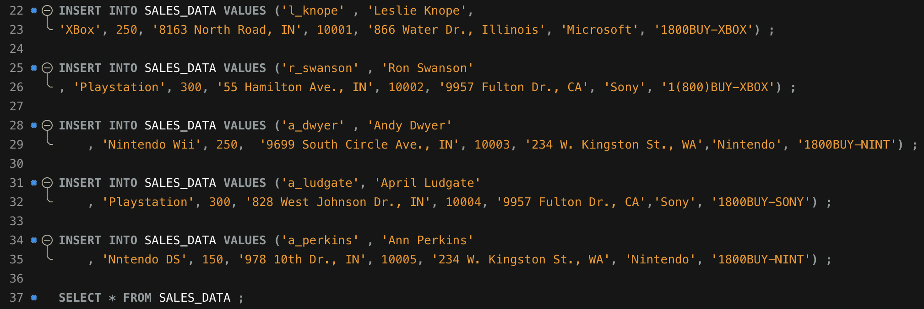
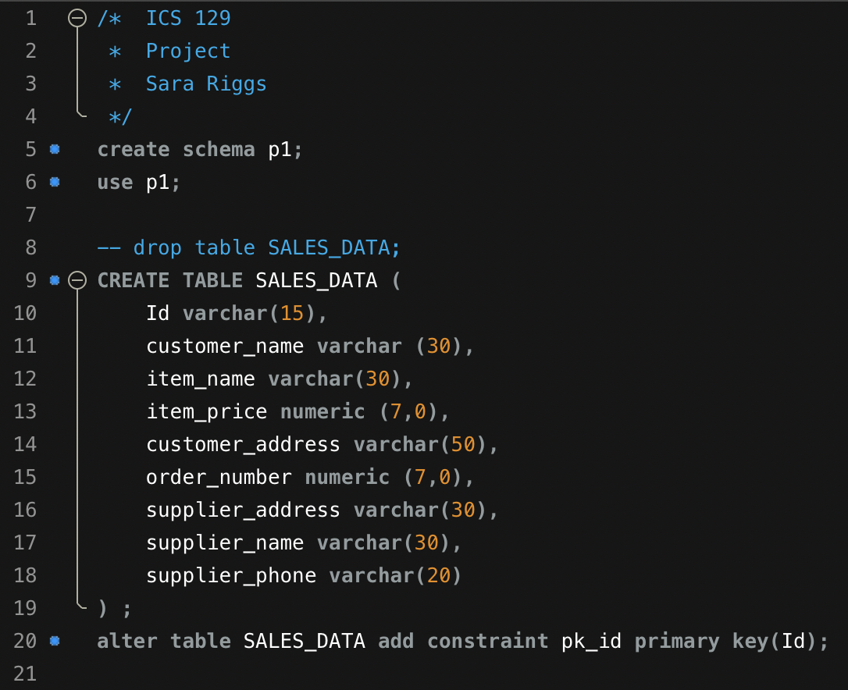
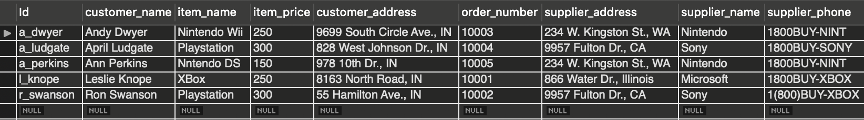
Source table:
Created schema (p1).
SALES_DATA: stores all customer information for video game purchases.
DML: Data manipulation language

Slide 13
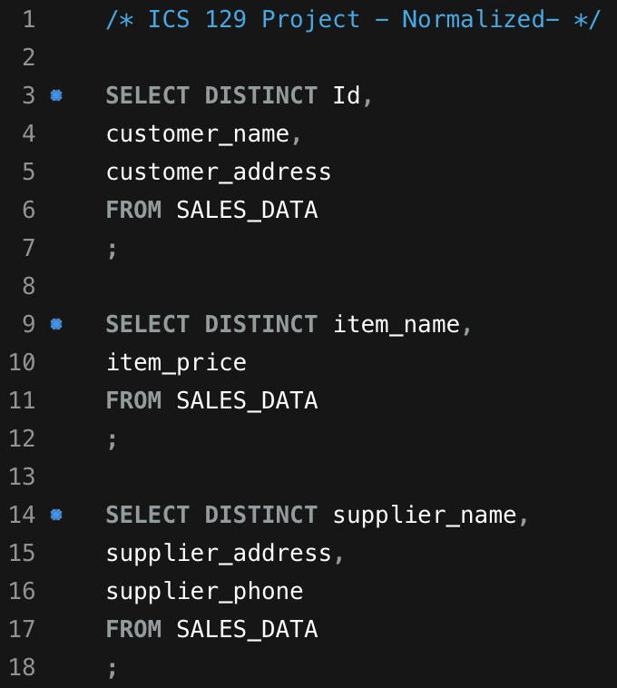
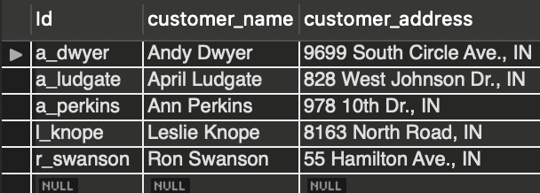
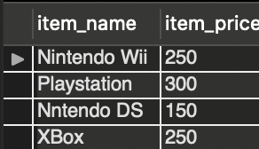
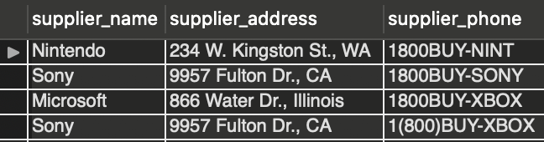
Normalization:

Slide 14
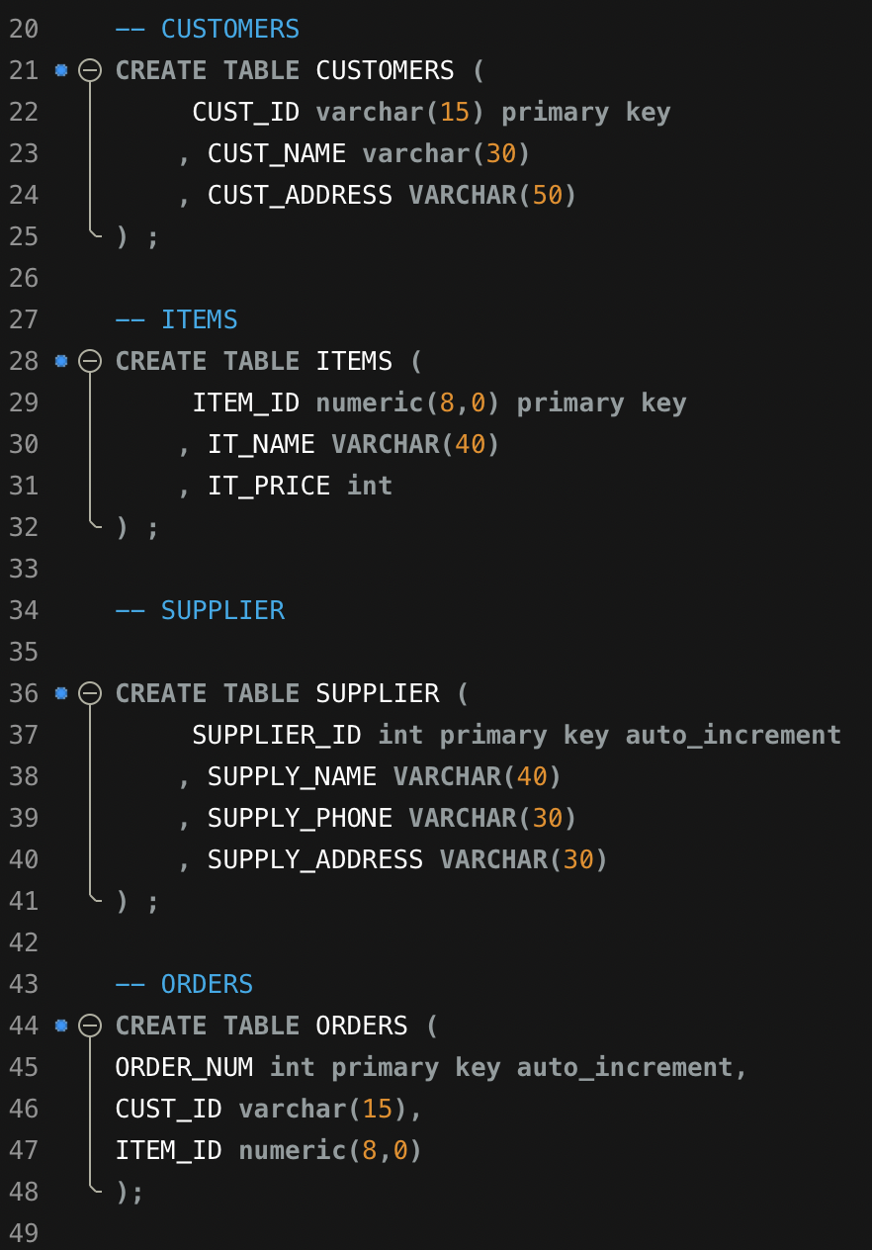
Create tables
Customer
Items
Suppliers
Orders
  Primary keys: customer ID, item ID, supplier ID and order number.

Slide 15
Normalization
Data normalization is a process that reduces and eliminates data redundancy, an important consideration for developers considering the difficulty of storing objects/data in a database that maintains the same information in different places.
Without normalization, data analysis may be adversely affected since there may be data and values that aren’t necessarily needed.

