Slide 1


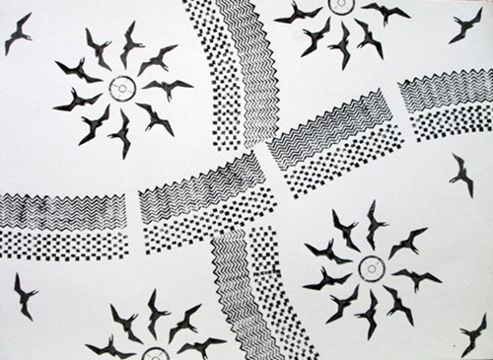
Research Project
Anela Nahulu, Charice Quiton, Liyah Tuiolemotu, Hiʻiaka Fernandez

Slide 2
Research question: How does storytelling and other indigenous (Hawaiian) ways of knowing and doing positively or negatively impacted a student’s educational experience

Slide 3

ANALYSIS
Indigenious learning digitally helps learners understand the environment more with lessons they gain such as relations with the land, others, identities, and ethics.
Even though we get different ways of information, this does not mean that one's knowledge is more valuable than another person's knowledge. Storytelling helps us see where weʻve been and paints a picture on where we can go.
There are many beneficial factors that relate to storytelling indegiously such as higher awareness, literacy development at early ages, expanded vocabulary, life lessons that students will use to build their community, improved visual imagery, and cultural awareness.
Even middle schoolers and high schoolers benefit from storytelling for their perspectives broaden and literary concepts become more understanding to them.
It was mentioned that since Hawaii has such a big melting pot of different races and cultures that it empowers students to become more vibrant and view their own world through stories of their communities and their culture. It’s important because it encourages students to engage with their kupunas and their ohana to help them learn their culture.
Liyahs article- “Indigenous ways of knowing, digital storytelling, and environmental learning - a confluence of tradition and new media technology” by Jason N. Corwin
Charices article- “The Power of Story: Using Storytelling to Improve Literacy Learning” by Sara Miller and Lisa Pennycuff
Hiʻiakas article- “Preserving Traditions through storytelling: teaching kids how in Hawaii by Dr.Katie Klinger”
Anelas article-Infusing Traditional Knowledge and Ways of Knowing Into Science Communication Courses at the University of Hawai‘i By Judith D. Lemus,1,a Kanesa Duncan Seraphin,2,3 Ann Coopersmith,4 and Carly K. V. Correa5

Slide 4
Analysis
Biases that we have caught in our articles (positive and negative)
Were written from people who have a hawaiian background
Speak from personal experiences
Some of the experiments done were performed at schools in hawaii
Western ways of knowing highlighted as the norm for this day and age
Indigenous and non-Indigenous young people of color didnʻt keep an open mind on westernized way of learning and vice versa

Slide 5
Background
Storytelling and other indigenous (Hawaiian) ways of knowing and doing impacts a student’s educational experience positively.
Digital storytelling useful for research on health and environmental topics, and documenting culture
Digital media and related arts used to teach young people growing up in a digital age
Electronic media technology used for environmental learning
Students can have social interactions and collaborations with one another
Reading comprehension are easier to understand
Writing improves
Better understanding of audiences vision since they were once an audience
Higher awareness
Better understanding of each culture/ Cultural awareness
Literacy development at early ages
Expanded vocabulary
Life lessons that students will use to build their community
Improved visual imagery
Education programs embrace Indigenous ways of knowing through critics, ethics, identities, and even memories of significant life experiences.

Slide 6
Conclusion
In conclusion after analyzing all 4 articles we feel that storytelling and other indigenous (Hawaiian) ways of knowing impacts a student’s educational experience positively. Storytelling helps us see not only that being rooted may make students feel a sense of belonging but also gives a student leadership. Having storytelling incorporated into educational system would help students by taking their fear and questions of failing in school will reassure them that everyone has felt the same way at some point. Indigienous ways of knowing is just saying knowledge being passed down to the younger generations. In hawaiian culture storytelling is one of the key foundations on how we live life. Not only how we stay a close community but how show our love by sharing where we been. It’s important because it encourages students to engage with their kupunas and their ohana to help them learn their culture.

Slide 7
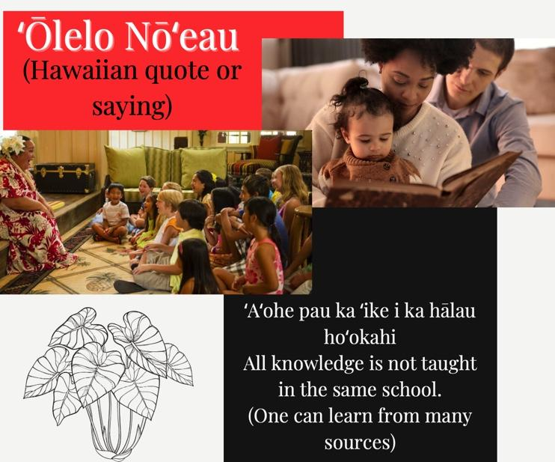

Slide 8


Mahalo Nui
Aloha Mālama Pono

