Slide 1

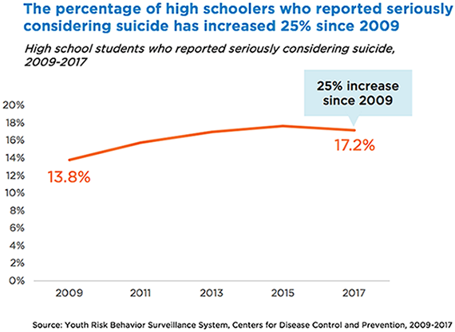
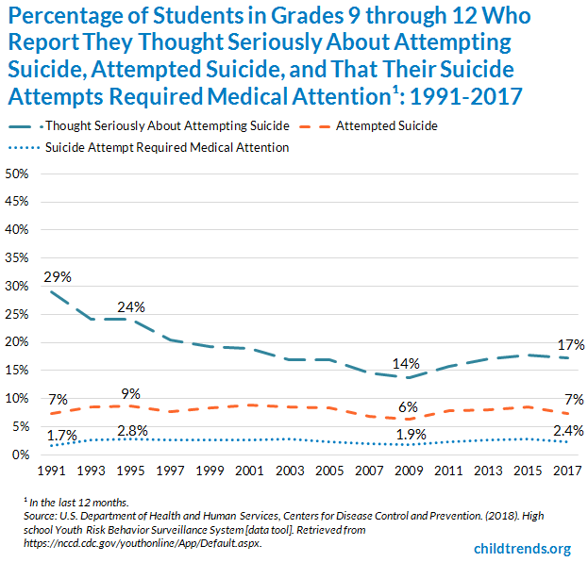

Community Based Participatory Research:
Overcoming America’s Youth Suicide Outbreak Through Youth Outreach
Emily Jenie Maluyo
University of Hawaii – West Oahu
Background
Steps of CBPR Approach
Today, according to the Center of Diseases Control (CDC), suicide is the second leading cause of death among the ages of 15 to 24-year-old youths. CDC also states that about 1 in every 15 students report attempting suicide every year. This means that there may be as many as 100 to 200 suicide attempts for each suicide death among young people. But for some youth groups--including those who are involved in the child welfare, juvenile justice systems, LGBTQ community, minorities, and military service members--the incidence of suicidal behavior is even higher. With the increase of youth suicide, it brings influence on others which can cause additional potential suicide attempts or deaths. It breaks the social construct and sensitivity of youth culture and raises a more prominent issue outside the youth community.
Although suicidal thoughts and attempts are common in the youth community, there are many suicide prevention and interventions that care for them about an attempt or death. Specifically, multilevel and multimodal interventions have been suggested for suicide prevention. However, few studies have reported the outcomes of such interventions for suicidal behaviors. There are insufficient data available from controlled trials to recommend one intervention over another for the treatment of suicidal youth.
Establish Research Objectives.
  The insufficient data that is available pertaining to the effectiveness of each intervention for treatment of suicidal youth allows for a clearer objective of the research approach. The objective for the overall research is to determine the most effective mental health initiatives to reduce youth suicide rates in America.
2. Develop Data Collection Instrument.
  Through the collaboration between a community and research team, it determines the approach that should be taken to collect data effectively. Youth test subjects will be tested through a survey prior to the actual study. Feedback was taken in order to improve the execution of the survey
3. Data Collection Analysis.
  The survey collected data amongst the youth test subjects as a bench marker to see the improvement after the community health interventions are implement into the community. Afterward, the post-assessment was taken to clearly see the effectiveness of those implementations.
4. Dissemination Plan.
  After the data has been analyzed, discussion of the results and establishment of a scientific dissemination plan was done. The results were used to see interventions should be used to reduce youth suicide rates. It provides a baseline for future survey and research designs.
Graphic 2. Percentage of High Schoolers Who Reported Seriously Considering Suicide (2009 -2017)
1
Social and Community Context
More than 1,100 communities and 170 national collaborating organizations and federal programs across the country participate in community events, youth educational programs, etc.
2
Health Care
In 2017, the National Institute of Health spent $37 million on research grants for suicide prevention compared to $6.6 billion spent on cancer research.
Supported Results
3
Neighborhood and Environment
Four out of Five teens who attempt suicide have given clear warning signs and wasn’t offered help.
The following graphics are results from projects like the hypothesized project using a CBPR approach.
The percentage of high school students who reported they seriously thought about attempting suicide in continuously decline from 29 percent in 1991 to 14 percent in 2009. Since 2009, prevalence has increase reaching 17% percent in 2017. (Graphics 1 and 2)
The top 3 structural determinants of health related to youth suicide are social and community context; access to healthcare; and neighborhood and environment. These factors represent the priorities that needs to be improved in order to address and reduce the risks of youth suicide. (Graphics 3)
Graphic 3. Top 3 Structural Determinants Related to Mental Health and Youth Suicide
CBPR Methods
Conclusion
Community-based Participatory Research (CBPR) is a collaborative research partnership approach which equitably includes community members, representatives of organizations and academic researchers in all aspects of the research process. This allows all participants to contribute their expertise with mutual accountability and ownership, enhances awareness of a specific phenomenon, and combines the knowledge gained with action. CBPR is a newly emerging research method that addresses and reduces current health disparities experienced by a community. The CPBR method has already been proven to reduce health disparities and the status of a disadvantaged community by implementing structural change. With a CBPR approach, it allows policy-making scenarios and implementation of effective community health intervention. Because of this, a CBPR approach can be applied in overcoming America’s youth suicide.
To address the rise in youth suicide, three community health intervention were created: addressing signs and risks in social and community context, making it more difficult to die in act of deliberation throughout the neighborhood and environment, and increase the access to mental health care resources.
The structural determinants of health (SDOH) is seen in Graphics 2. The top 3 represented the top priorities that the CBPR had to focus on.
The overall study shows the validity and reliability the C
The results found in relation to youth suicide further proves that the community health interventions are relevant and effective in reducing youth suicide in communities. Through the analysis, the risks of suicide decreased due to the interventions implemented.
After the conduction of CBPR, further research activities and follow-up checks should be done in order to ensure the youth suicide rates are reduced. This can be done with pre-assessment and post—assessment to compare the effectiveness of implemented community health interventions.
This CBPR approach to overcoming America’s youth suicide will enhance the structure of the selected population and the community itself. It allows for a solution and prevention aspect in relation to youth suicide. To acknowledge the issue and implement community health interventions it will significantly lower the amount of youth’s who attempt suicide across America.
Establish Research Objectives
Develop Data Collection Instrument
Data Collection
Analysis
Graphic 1. Percentage of Students in Grades 9-102 Who Report They Thought Seriously About Attempting Suicide, Attempted Suicide, and That Their Suicide Attempt Required Medical Attention (1991-2017)
Dissemination Plan
Emily Jenie Maluyo
University of Hawaii - West Oahu
Email: maluyoe@hawaii.edu
Phone: (808) 699-9622
Barber, Catherine W., and Matthew J. Miller. “Reducing a Suicidal Person’s Access to Lethal Means of Suicide.” American Journal of Preventive Medicine, vol. 47, no. 3, Sept. 2014, pp. S264–72. DOI.org (Crossref), doi:10.1016/j.amepre.2014.05.028.
Cash, Scottye J., and Jeffrey A. Bridge. “Epidemiology of Youth Suicide and Suicidal Behavior:” Current Opinion in Pediatrics, vol. 21, no. 5, Oct. 2009, pp. 613–19. DOI.org (Crossref), doi:10.1097/MOP.0b013e32833063e1.
Israel, Barbara A., Eng, Eugenia, Schulz, Amy J., Parker, Edith A. (2013). Methods For Community-Based Participatory Research. Jossey-Bass.
Child Trends Databank. (2019). Suicidal teens. Retrieved from, https://www.childtrends.org/?indicators=suicidal-teens
Kann, Laura, et al. “Youth Risk Behavior Surveillance — United States, 2017.” MMWR. Surveillance Summaries, vol. 67, no. 8, June 2018, pp. 1–114. DOI.org (Crossref), doi:10.15585/mmwr.ss6708a1.
Mann, J. John, et al. “Suicide Prevention Strategies: A Systematic Review.” JAMA, vol. 294, no. 16, Oct. 2005, p. 2064. DOI.org (Crossref), doi:10.1001/jama.294.16.2064.
Miron, Oren, et al. “Suicide Rates Among Adolescents and Young Adults in the United States, 2000-2017.” JAMA, vol. 321, no. 23, June 2019, p. 2362. DOI.org (Crossref), doi:10.1001/jama.2019.5054.
Santhanam, Laura. (2019 Oct 9). Youth suicide rates are on the rise in the U.S. NewsHour Productions LLC. Retrieved from, https://www.pbs.org/newshour/health/youth-suicide-rates-are-on-the-rise-in-the-u-s
Shepard, Donald S., et al. “Suicide and Suicidal Attempts in the United States: Costs and Policy Implications.” Suicide and Life-Threatening Behavior, vol. 46, no. 3, June 2016, pp. 352–62. DOI.org (Crossref), doi:10.1111/sltb.12225.
Teen Suicide. Standford Children’s Health. Retrieved from, https://www.stanfordchildrens.org/en/topic/default?id=teen-suicide-90-P02584
Contact
References

