Slide 1

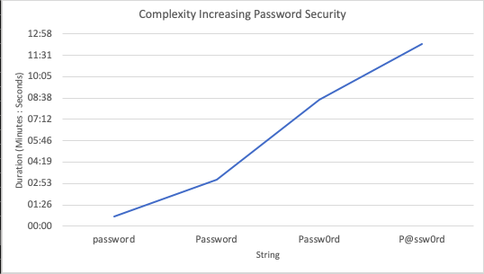
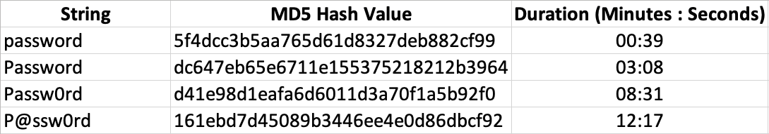
Complexity Increasing Password Security
April Joy Bucaneg;
¹University of Hawaii – West Oahu,
Abstract
Research Design & Data Collection
In most cases, a password is what prevents a criminal from gaining unauthorized access to protected information. Online services that handle sensitive information require users to create passwords by following their criteria for selecting a strong password. The criterion can include meeting a certain length of characters that consist of uppercase letters, lowercase letters, numbers, and special characters. Meeting the criterion assists in making passwords harder but not impossible to be discovered by criminals.
The results of this project intend to support the idea of how creating strong user password are essential for preventing unauthorized access to sensitive information and guide future studies in methods of increasing technical security:
Average users and corporations are the intended stakeholders that can benefit from this project
Average users can become more aware of how managing their passwords for accounts can impact the likelihood of criminals gaining access to sensitive information.
Corporations in establishing proper password guidelines for corporate accounts.
The method used to collect data to support the theory for this project is through an experimental design. There will be four different passwords that will be tested. The complexity of each one will increase by adding a different characteristic to each password in combination with previous password characteristics. The characteristics are a length of at least eight characters, including lowercase letters and uppercase letters, numbers, and symbols. Each password was converted into an MD5 hash. The reason for using the hash of the passwords is because typically user passwords in systems are stored as hashes.
The method of password cracking would simulate an offline attack. A password cracking tool called Hashcat was used to test the MD5 hashes. The passwords are going to be tested against Hashcat’s brute force attack mode with the use of a wordlist.
The experiment was performed using the latest version of a virtualization software VMware Fusion installed on a MacBook Air laptop. A virtual machine was configured with the Kali Linux 2020 distribution that includes Hashcat to perform password recovery. Data collection included four password strings, MD5 values, and the time to discover each password.
Graph 1. Results from Table 1 converted into a graph
Discussion
As shown in the Graph 1, there is a positive linear relationship between the two variables. There was an increase in time to discover a password with each addition of a different characteristic. There is also a clear difference in duration when comparing the password with the lowest level of complexity to the password with the highest level of complexity. The time difference between the two variations was 11 minutes and 38 seconds. A detail that is interesting about the results is the time difference to discover the second password and the third password was 5 minutes and 23 seconds. The addition of a digit roughly doubled the amount of time required to discover the password. The time differences between the first variation and the second variation were two minutes and 29 seconds. The third variation and fourth variation had a time difference of three minutes and 46 seconds.
Introduction & Research Question
Results
Introduction
The use of passwords is the most common method of securing user data. Studies have shown that users tend to create weak or predictable passwords, especially when the user is not required to meet a certain criterion to create a strong password. Users who do not follow the criterion are vulnerable to guessing attacks or brute force attacks. In addition, there are many password cracking tools available online that are accessible to malicious actors. Malicious actors are aware of and take advantage of this trend. This has led to many cases of identity theft and financial fraud which can be difficult to recover from. Taking note of this trend in weak passwords presents the need to reinforce the requirement for users to follow the criterion for creating stronger passwords. The purpose of this project is to compare the amount of time required to generate and compare hash values corresponding to increasingly complex passwords to determine a potential match condition through the use of a well-known password cracking tool called Hashcat.
Hypothesis
Password length and complexity has an impact on the effectiveness on password attack methods.
The amount of time to discover each password variation are as shown in Table 1. The password chosen as a baseline for this project was the word “password”. The baseline characteristics included a minimum length of eight characters in length containing only lowercase letters and the password was discovered using Hashcat in 39 seconds. The letter “p” in the second variation was converted to an uppercase letter which increased discovery time to three minutes and eight seconds. The letter “o” was changed to the number zero in the third variation which increased the discovery time to 8 minutes and 31 seconds. In the final variation, the letter “a” was changed to the “@” symbol which increased discovery time to 12 minutes and 17 seconds.
Conclusions
In conclusion, the experiment produced results that support the hypothesis that length and complexity in passwords has an impact on the effectiveness of attack methods in terms of how likely an attacker may recover a password in a short or reasonable amount of time. There was a clear difference in the time required for Hashcat to discover the password with the lowest level and highest level of complexity. Also, the amount of time required to discover each password increased by two to three minutes after adding a new characteristic. The results from this experiment not only supports the proposed hypothesis but also helps to highlight the importance of passwords of sufficient complexity and length to secure user data.
Table 1. Durations recorded from testing
Contact
References
April Joy Bucaneg
University of Hawaii – West Oahu
Email: ajib@hawaii.edu
de Carné de Carnavalet, X., & Mannan, M. (2014). From very weak to very strong: Analyzing password-strength meters. In Network and Distributed System Security Symposium (NDSS 2014). Internet Society.
Florencio, D., Herley, C., & Coskun, B. (2007). Do strong web passwords accomplish anything? HotSec, 7(6), 159.
Han, A. L. F., Wong, D. F., & Chao, L. S. (2014). Password cracking and countermeasures in computer security: A survey. arXiv preprint arXiv:1411.7803.
Kelley, P. G., Komanduri, S., Mazurek, M. L., Shay, R., Vidas, T., Bauer, L., ... & Lopez, J. (2012, May). Guess again (and again and again): Measuring password strength by simulating password-cracking algorithms. In 2012 IEEE symposium on security and privacy (pp. 523-537). IEEE.
Keszthelyi, A. (2013). About Password. Acta Polytechnica Hungaria, 10(6), 99-118.
Pittman, J. M., & Robinson, N. (2020). Shades of Perception-User Factors in Identifying Password Strength. arXiv preprint arXiv:2001.04930.
Sanders, C. (2010). How I Cracked your Windows Password (Part 1). Retrieved from WindowsSecurity.com.
Summers, W. C., & Bosworth, E. (2004, January). Password policy: the good, the bad, and the ugly. In Proceedings of the winter international synposium on Information and communication technologies (pp. 1-6).
Varrone, A. (2011). Ethical Hacking.
Wiercioch, A., Teufel, S., & Teufel, B. (2018). The Authentication Dilemma. Journal of Communications, 13(8).

