Slide 1
Accreditation Update
Chancellor’s Advisory Council
October 8, 2019

Slide 2
Thank you!
For all your patience and support as
processes were created to address
ACCJC Recommendations 1 and 2.

Slide 3
Spring and Summer 2019 Highlights
What has been accomplished?
  Completed draft Continuous Improvement Plan
  Launched Continuous Improvement Webpage
  Launched Accreditation Updates Webpage
Created Integrated Planning Model for Student Success

Slide 4
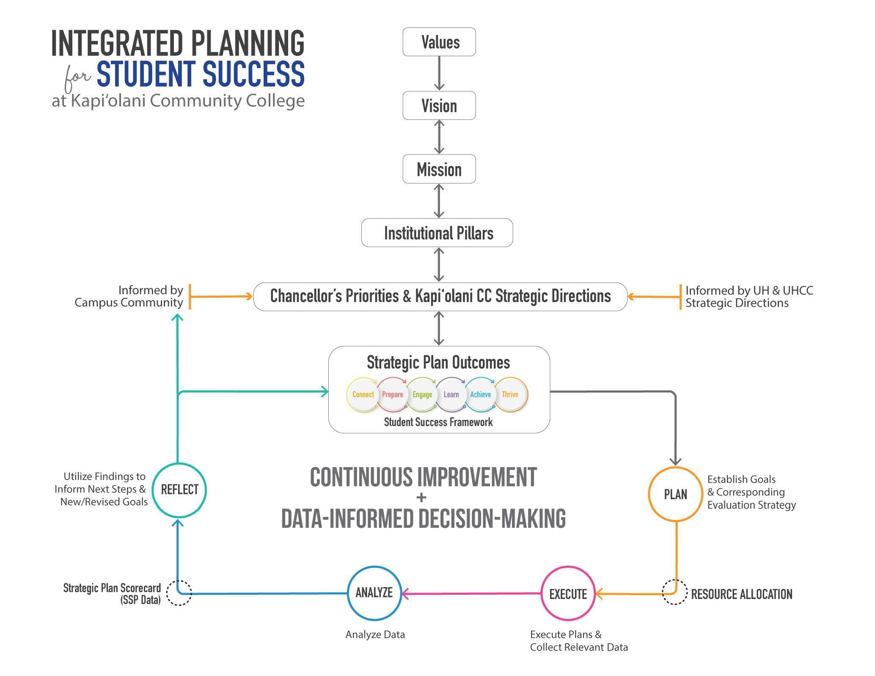

Slide 7
Recommendation 1
Continuous Improvement (Recommendation 1)
  Integrated Planning Model Discussions
  Student Success Pathway Plans 3.0 launched (CI + SSP)
  SSP Dashboard created
  AGOs, Councils, Plan Administrators - cross-collaboration meeting

Slide 8
Recommendation 2
SLO Assessments for Program Improvement (Recommendation 2)
  CI + CLRs distributed, course coordinators identified
  20% of CLRs identified
  LASRs created

Slide 9
What’s next?
ARPD Process and Timeline (CI + ARPD)
ARF Process

Slide 10
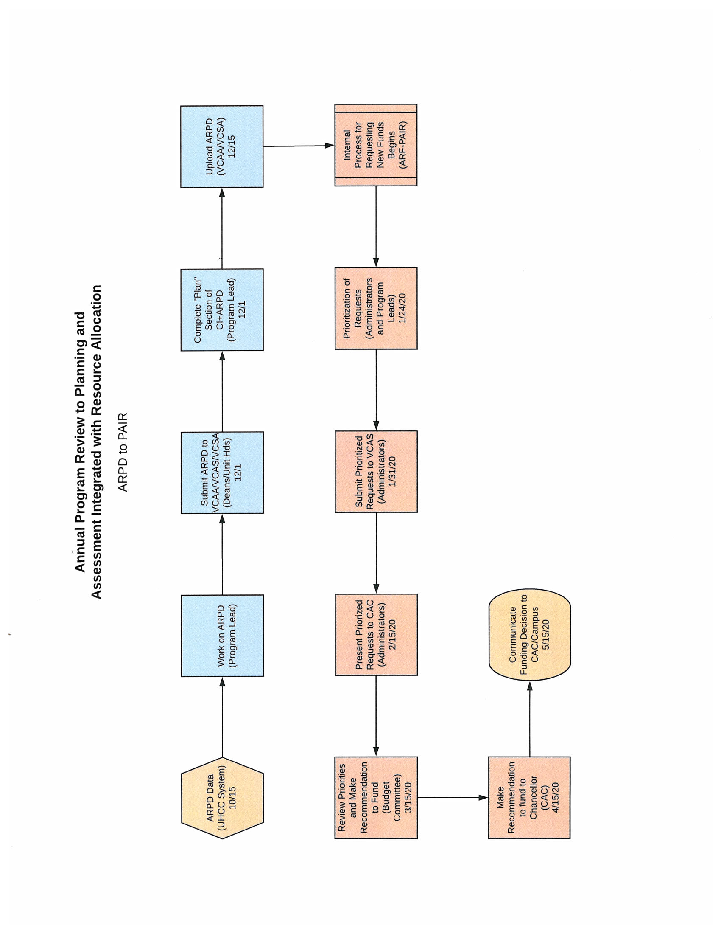

Slide 11
Friendly Reminder
December 15, 2019 - SSP Progress Report 1 due
January 10, 2020 - CLRs completed in the fall due

Slide 12
Thank you…Really!

