Slide 1

Structured Query Language in Action
A practical example of using SQL to
solve problems in the work environment
James Bautista
ICS 129

Slide 2
Overview
Current Workstation Inventory Worksheet
Define common database terminology
Entity Relationship Diagrams (ERD)
Design and create a relational database using the normalization process
Use Structured Query Language (SQL) to manipulate data

Slide 3
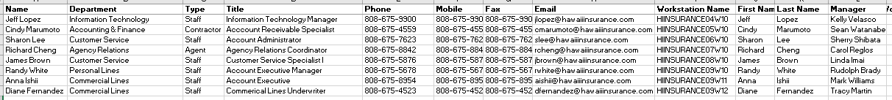
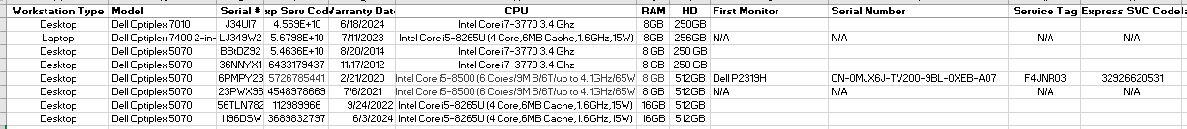
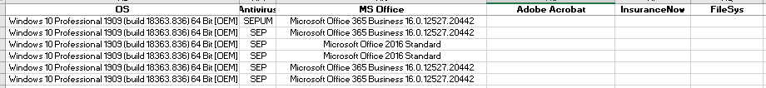
Workstation Inventory in Excel

Slide 4
Common Database Terminology
Database: (Merriam-Wester) - “A usually large collection of data organized especially for rapid search and
retrieval (as by a computer)”.
Tables: A logical vessel for storing data.
Query: Requests information from the database.
Attribute/Field: Column in a table.
Record/Tuple: One row in a table.
Primary key: A column in a table that uniquely identifies a record.
Foreign key: Links tables together by being a primary key in one table.
Entity relationship: Defines the association between tables as one-to-one, one-to-many, or many-to-many.
Referential integrity: Ensures accuracy and consistency of data within a relationship between tables.
Data Definition Language: creates/modifies data structures such as the database schemas and tables.
Data Manipulation Language: inserts, updates, and delete records.
Data Query Language: Performs queries on the database.
Normalization: (Wikipedia) The process of structuring a database to reduce data redundancy and improve data
integrity.

Slide 5
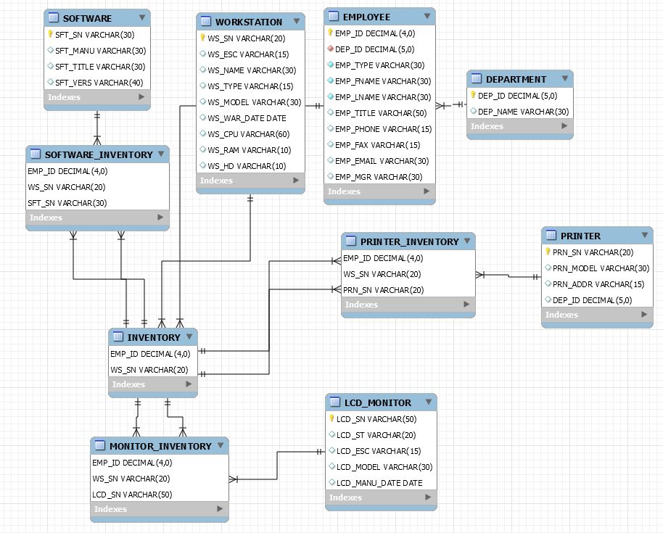
Entity Relationship Diagram

Slide 6
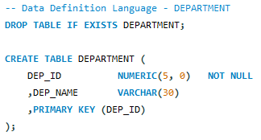
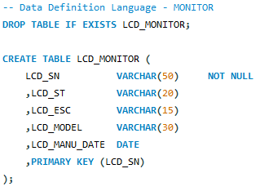
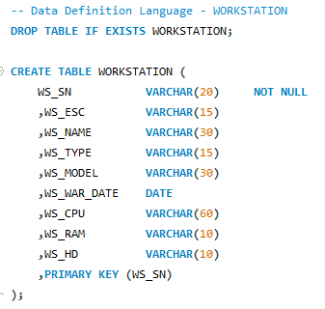
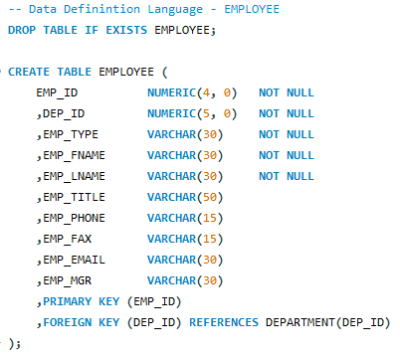
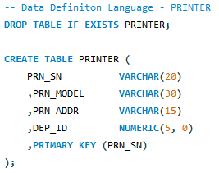
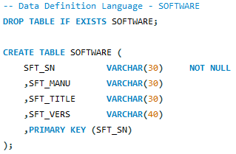
Relational Database Using Normalization Process (1)

Slide 7
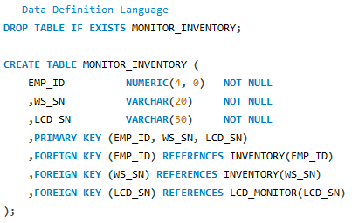
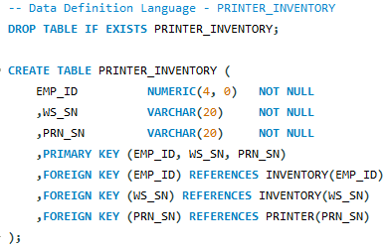
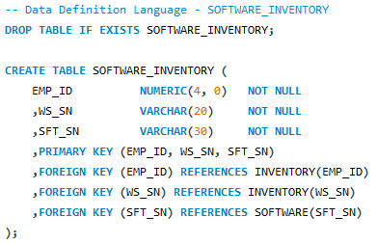
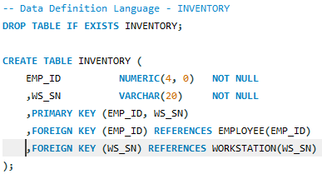
Relational Database Using Normalization Process (2)

Slide 8
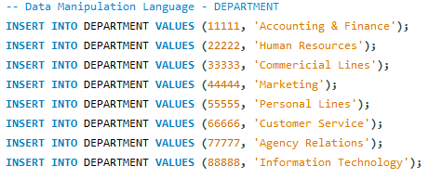
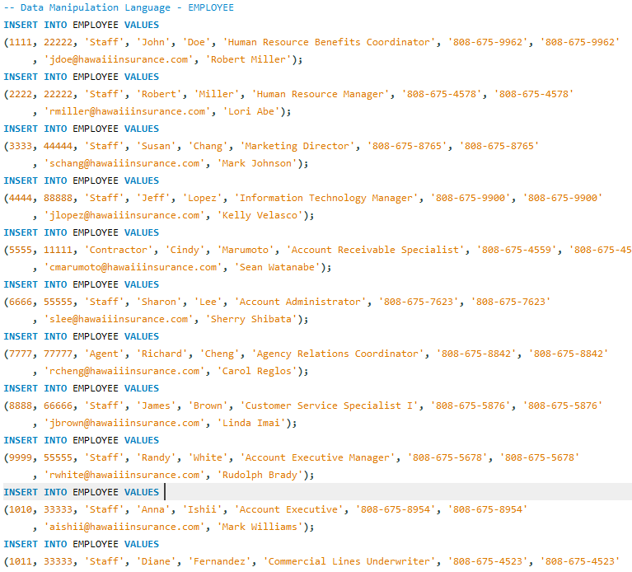
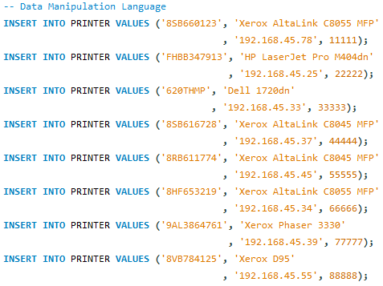
SQL to Manipulate Data (1)

Slide 9
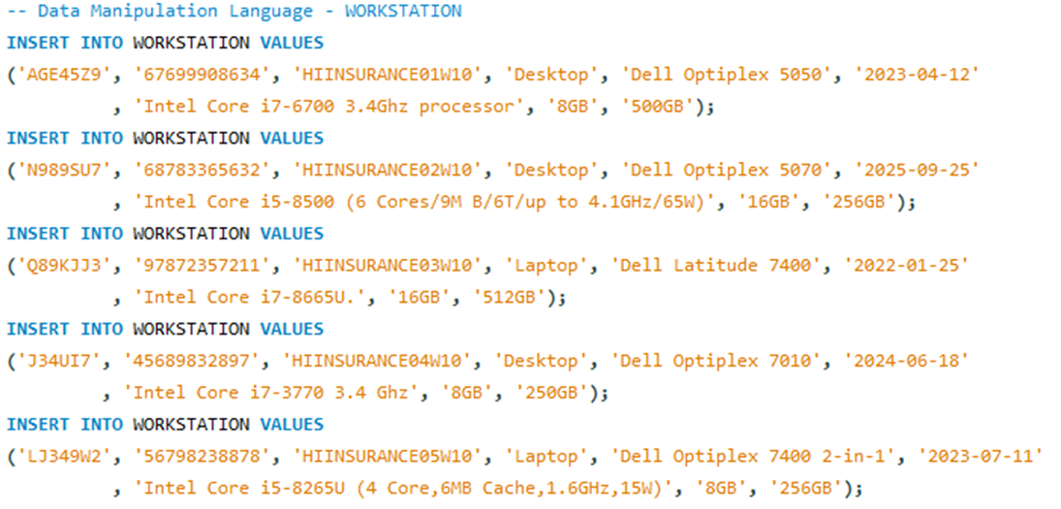
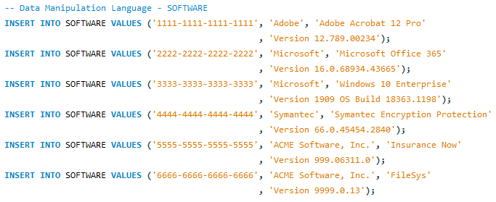
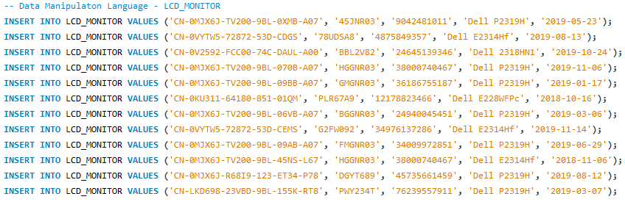
SQL to Manipulate Data (2)

Slide 10
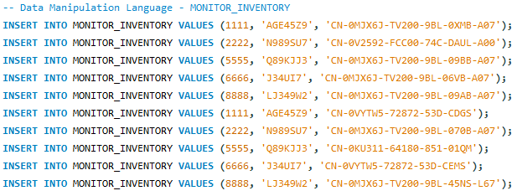
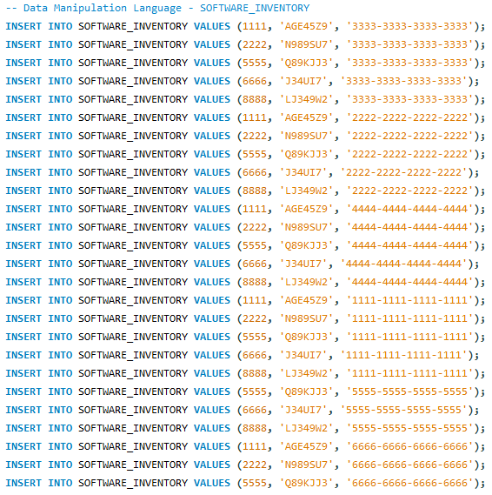
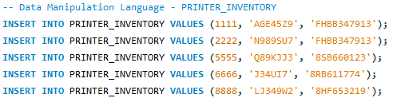
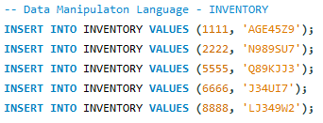
SQL to Manipulate Data (3)

Slide 11
Mahalo!

