Slide 1



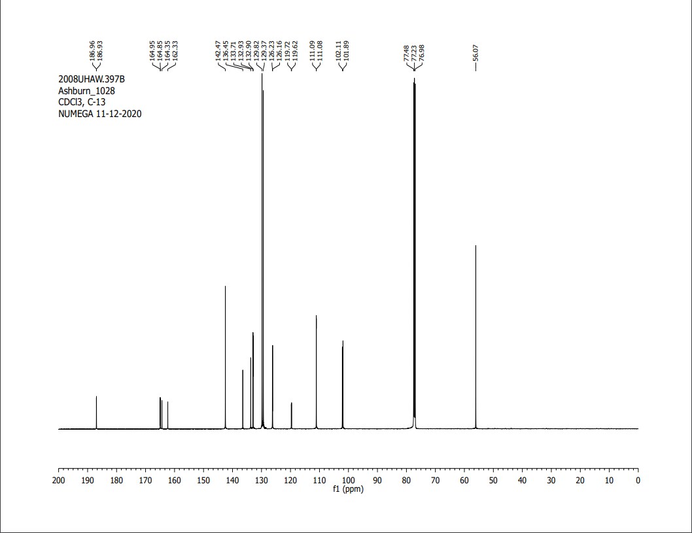
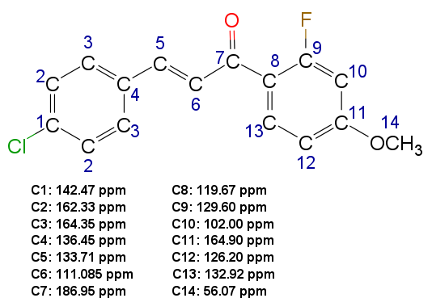
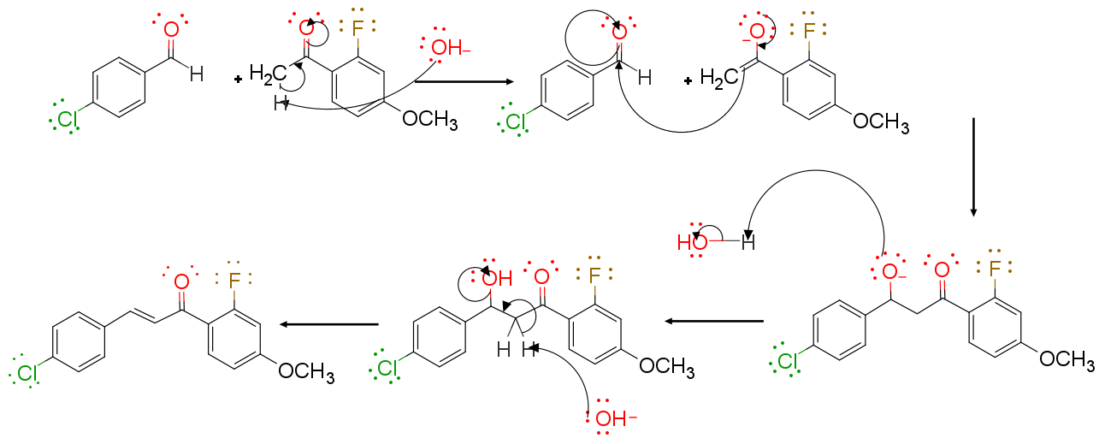
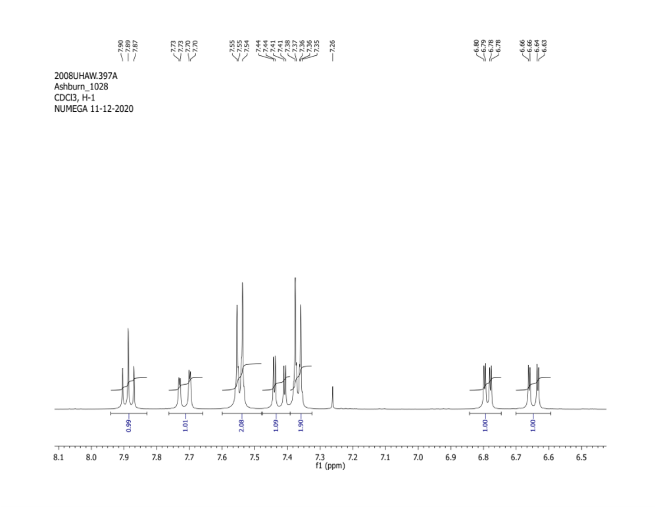
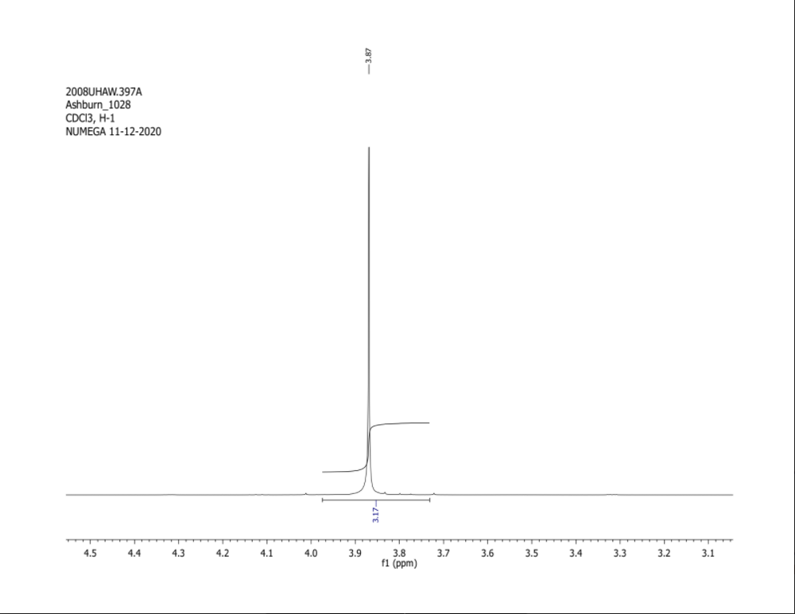
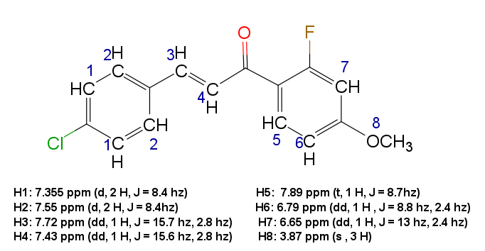
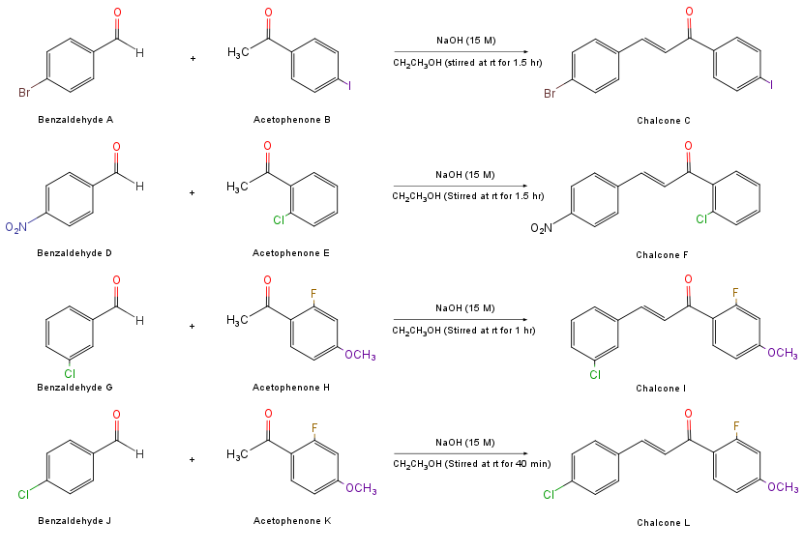
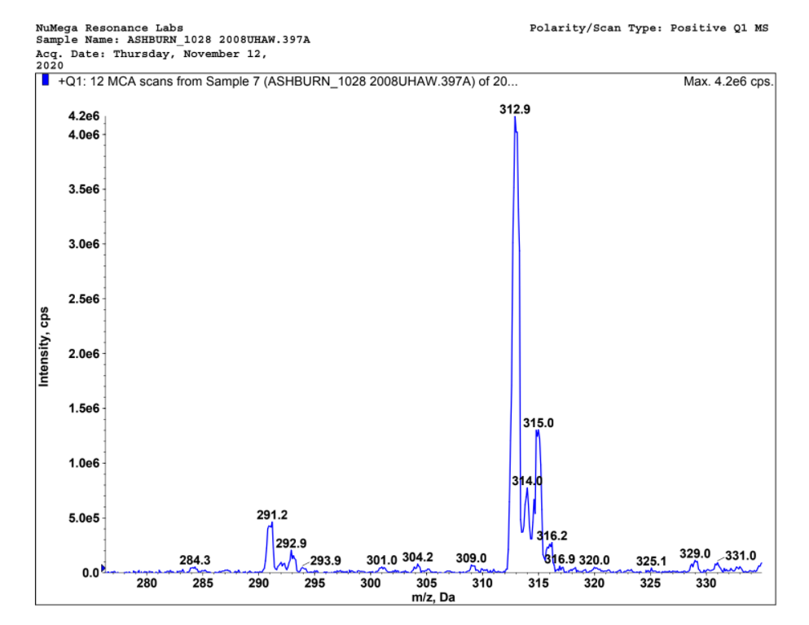
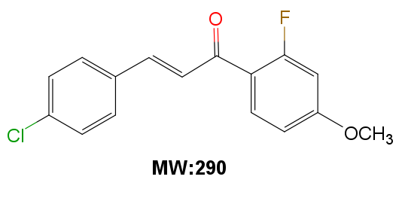
Synthesis of Potential Agents to Combat
the Neglected Tropical Disease Leishmaniasis
Nicholas M. Bailey, Alaina Atanes, Bradley O. Ashburn*
Mathematics, Natural, and Health Sciences Division • University of Hawai‘i West O‘ahu
Introduction
Mechanism
Leishmaniasis is an ongoing endemic that affects the lives of millions in Asia, Africa, the Americas, and the Mediterranean. Leishmaniasis is notoriously labeled as both the second-largest parasitic killer and one of thirteen neglected tropical diseases. It is estimated that there are 70,000 deaths and 1.3 million new cases per year. Leishmaniasis is engendered by intracellular parasites that belong to the genus leishmania. These parasites are transmitted via the bite of a group of sand flies.
Once infected, Leishmaniasis is manifested in one of three ways: cutaneous, mucocutaneous, and visceral. Symptoms are dependent on the specific form of leishmaniasis contracted. Symptoms can vary from skin lesions, cutaneous/mucosal ulcers, spleno- and hepatomegaly, and organ failure. Currently, there remains no vaccine and contemporary treatments have adverse side effects or are too expensive. Considering that many of these endemic countries are impoverished, it is vital that an innocuous and affordable alternative is found. Recent literature has ascertained the antiparasitic properties of the classification of molecules known as chalcones. This research seeks to synthesize various chalcones for future analysis for anti-leishmanial properties.
Figure 2: Aldol Addition and Condensation Mechanism
Figure 4: Carbon-13 NMR for 4-Chloro-2'-fluoro-4'-methoxychalcone
Methods and Materials
Results
A select benzaldehyde (2.50 mmol) and acetophenone (2.50 mmol) were dissolved in a round bottom flask containing 5-10ml of ethanol (200 proof). NaOH (3.75 mmol, 15M) was added to the flask and allowed to stir at room temperature for 40 min (completion monitored by TLC using 10-20% ethyl acetate/hexanes). During this time, a precipitate was formed. 10 mL distilled water was then added to the mixture and chilled for 30 minutes. Purified products were accumulated via vacuum filtration and washed using distilled water. Products were then further purified through a mixed solvent recrystallization using ethyl acetate/hexanes. These products were vacuum filtered and weighted to obtain the yield.
Data Summary
Product | Melting Point | Actual Yield | Percent Yield | IR Wavenumber Carbonyl | IR Wavenumber Alkene | IR Wavenumber Aryl Chloride
4-Bromo-4’iodochalcone | 204-205℃ | 0.289 g 1.13 mmol | 28% | 1658.43 cm⁻¹ | 1608.99 cm⁻¹ | n/a
4-Chloro-2’-fluoro-4’-methoxychalcone | 98-100℃ | 0.619 g 2.12 mmol | 85% | 1658.43 cm⁻¹ | 1586.52 cm⁻¹ | 808.99 cm⁻¹
3-Chloro-2’-fluoro-4’-methoxychalcone | 95.5-96.5℃ | 0.163 g 0.561 mmol | 45% | 1653.93 cm⁻¹ | 1600.00 cm⁻¹ | 835.98 cm⁻¹
4-Nitro-2’chlorochalcone | 167-169℃ | 0.537 g 1.87 mmol | 75% | 1676.40 cm⁻¹ | 1608.99 cm⁻¹ | n/a
Figure 5: Proton NMR for 4-Chloro-2'-fluoro-4'-methoxychalcone
Table 1: Yield, percent yield, melting point, and IR peaks for chalcones
Discussion and Conclusion
Engender by the ongoing leishmanial endemic and research that substantiated the antiparasitic properties of chalcones, four chalcones were synthesized. This was performed using a Claisen-Schmidt condensation of various substituted benzaldehydes and acetophenones using aqueous sodium hydroxide in ethanol. The target chalcones were confirmed using IR, H-NMR, and C13-NMR spectroscopy and mass spectrometry. Since previous research has established the antiparasitic properties of chalcones, these chalcones might prove to be an ideal candidate for the development of an antileishmanial therapeutic. Future studies should evaluate the effectiveness of these chalcones against some of the various leishmanial species. In addition, since two of the chalcones showed signs of decomposing in the air these compounds might be stabilized through further study. In a prospective study, these chalcones will be assessed for antileishmanial properties against L. major.
Figure 1: Substituted benzaldehydes and acetophenones to yield chalcone derivatives
Figure 3: Mass spectrum of 4-Chloro-2’-fluoro-4'-methoxychalcone
This project was supported by grants from the National Institutes of Health (NIH), National Institute of General Medical Sciences (NIGMS), IDeA Networks of Biomedical Research Excellence (INBRE), Award number: P20GM103466. The content is solely the responsibility of the authors and do not necessarily represent the official views of the National Institutes of Health.

