Slide 1


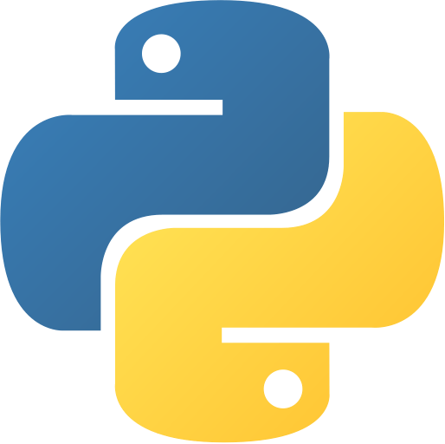
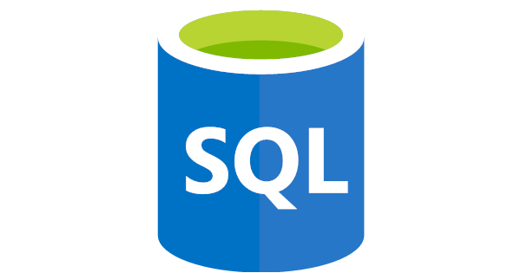
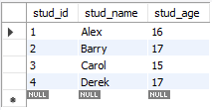

SQLAlchemy – Python’s Database Toolkit
Joshua Fruean
University of Hawaii – West Oahu
Introduction
MySQL (SQL)
SQLAlchemy (Engine Query)
With the vast amount of data that can be collected and utilized from today’s various business operations and activities, having the ability to efficiently store and manage data effectively is essential in improving data access, data security, decision making, and overall productivity₁.
With the database language SQL, we gained the ability to transform raw data into useful information and provided end users a means of developing manageable information systems₁.
Along with the introduction of SQLAlchemy, we are introduced to a system that provides a consistent interface between the dozens of relational database management systems that use SQL.
The purpose of this project is to describe the benefits in using SQLAlchemy and displaying SQLAlchemy’s ability to create and manipulate databases through Pythonic code.
CREATE TABLE students ( #creates students table (DDL)
stud_id INT PRIMARY KEY
, stud_name VARCHAR(50) NOT NULL
, stud_age INT
) ;
INSERT INTO students VALUES (1, ‘Alex’, 16) ;
INSERT INTO students VALUES (2, ‘Barry’, 17) ;
INSERT INTO students VALUES (3, ‘Carol’, 15) ;
INSERT INTO students VALUES (4, ‘Derek’, 17) ;
#inserts values into table (DML)
SELECT * FROM students ; #queries all data (DQL)
tupdat = ( #presents values to be inserted (DML)
("Alex", 16)
, ("Barry" , 17)
, ("Carol" , 15)
, ("Derek", 17)
)
for tuprow in tupdat:
rowdata = STUDENTS( stud_name=tuprow[0], stud_age=tuprow[1])
s.add(rowdata) #inserts data into table (DML)
sel_rows = select([Student])
rs = s.execute(sel_rows)
for r in rs: #queries rows in table (DQL)
print( "Student Information:" , r )
Overview
SQLAlchemy is a platform that links users of Python with a library of tools for managing and accessing data in a database, essentially giving users the ability to use SQL in their Python codes.
SQLAlchemy is designed for efficient and high-performing database access, adapted into simple Pythonic domain language₂. This toolkit allows its user to dictate the organization and construction of their database and code, while it takes care of the automation on the backend₂.
SQLAlchemy is also an ORM (object relational mapper) used specifically for Python, which provides a code library that allows users to query and manipulate data from a database. Though, it still requires users to be familiar with their relational database management systems in order to use the toolkit. However, this does not mean that a pre-existing SQL database is required to create, maintain, and query a database using SQLAlchemy.
SQLAlchemy’s ORM can be used to create SQL commands like DDL, DML, and DQL₅:
Data Definition Language (DDL) – CREATE, ALTER, DROP
Data Manipulation Language (DML) – INSERT, UPDATE, MERGE
Data Query Language (DQL) – SELECT
The mapping allows SQLAlchemy to handle the underlying database so developers can work with their Python objects instead of writing bridge code to get data in and out of relational tables₄.
Companies that use SQLAlchemy
Reddit
Yelp!
DropBox
SQL v. SQLAlchemy
In comparison to MySQL, the codes are very similar and function the same. Though with more syntax found in the use of Python and SQLAlchemy, the code is not extremely redundant in larger databases and allows for the use of Python classes and methods, allowing for efficient functionality and easier maintenance of code.
Raw SQL syntax varies across each platform (MySQL, PostGreSQL, SQLite, Oracle, etc)
SQLAlchemy simplifies database workflows and allows for automation of database entry
SQLAlchemy (Session Query)
class Student(Base): #creates the table (DDL)
__tablename__ = ‘STUDENTS’
stud_id = Column(Integer, primary_key = True)
stud_name = Column(String)
stud_age = Column(Integer)
newstudent = Student( #presents value inserted (DML)
stud_name = ‘Alex’,
stud_age = 16
)
Session.add(newstudent)
Session.commit() #inserts values above into table (DML)
Students = Student.query.all()
#queries all entries in table (DQL)
Benefits
SQLAlchemy allows users to efficiently access databases through Python. Python was created with readability in mind, being one of the easier programming languages to take up. This library of tools allows users to create efficient code that is very understandable and fairly simple to utilize effectively. SQLAlchemy is highly beneficial for programmers and developers as it allows user to utilize databases within their Python programs.
SQLAlchemy provides portability across database cross-platforms, creating consistent syntax and features among the database management systems.
  Provides syntax that is similar to other database management systems, while recognizing the special functions from each database API
Provides automation and reduces overall redundancy
Able to integrate into other major Python libraries (Flask, Pandas, Apache Airflow)₆
Contact
References
Joshua Fruean
University of Hawaii – West Oahu
Kapolei, HI 96707
Email: jtsf@hawaii.edu
Coronel, Carlos & Morris, Steven. (2019). Database Systems Design, Implementation, & Management 13th Edition. .Cengage.
https://www.sqlalchemy.org/
http://pypl.github.io/PYPL.html
https://www.fullstackpython.com/sqlalchemy.html#:~:text=No%20SQL%20is%20required%20to,and%20out%20of%20relational%20tables.
https://www.geeksforgeeks.org/sql-ddl-dql-dml-dcl-tcl-commands/
https://hackersandslackers.com/python-database-management-sqlalchemy/
Notes:
Intro
Read abstract. This includes systems like MySQL, SQLite, Oracle, DB2, PostGres, etc.
- IMPROVES DECISION MAKING
Overview
First, we’ll start with what SQLAlchemy is.
Now if you’re unfamiliar with Python, Python is a programming language and it’s actually the most popular programming language in the world, infront of languages like Java, Javascript, and C sharp (C#)₃. Python can be used in a wide variety of fields including artificial intelligence, automation, software testing, data analysis, etc. The interesting thing about Python is that it allows its users to utilize other Python codes or related-software in their own code. This is where SQLAlchemy comes into play.
SQLAlchemy is basically the bridge between both Python and SQL databases management systems
“manipulate data from a database”: which basically means it allows users to translate Python classes into tables and move data between instances of classes and rows of these tables
SQLAlchemy can be used to fulfill the same commands that SQL would in fairly similar fashion (DDL, DML, DQL)₅:
DDL – which is used to define the database schema
DML – which is used to manipulate data present in the database
DQL – which is used to perform queries on the data (query means to request for information)
Coding differences
Typically, when you run Python, any data that is inputted into the code will be gone when the code is terminated. When using SQLAlchemy, the toolkit allows the data to be persistent, where the data will be saved in a file even when the code is terminated.
Utilizing SQLAlchemy in Python keeps data persistent within your IDE, storing data that has been inserted and queried into statements until otherwise altered or deleted.
One of the big advantages is the ability to automate the creation of databases. Though they function the same, SQLAlchemy provides a more robust approach and is not extremely redundant in comparison to raw SQL code
SQLAlchemy allows Python to lean on the SQLAlchemy ENGINE to provide a sort of gateway between SQL and Python.
Benefits
SQLAlchemy provides portability across database cross-platforms, creating consistent syntax and features among the database management systems
instead of hiding away SQL and object relational details behind a wall of automation, all processes are fully exposed within a series of composable, transparent tools, allowing for a reduction in redundancies

