Slide 1


Data manipulation in
Justin Labiano
BUSA 342

Slide 2

What is pandas?
Wes Mckinney
Quantitative Analysis on financial data
Released in 2009
“Panel data”
Usage: Data manipulation & analysis

Slide 3
Daily number of new reported cases of COVID-19 by country
Via: European Centre for Disease Prevention and Control

Slide 4


What was the average number of cases per day in the U.S. in October?

Slide 5
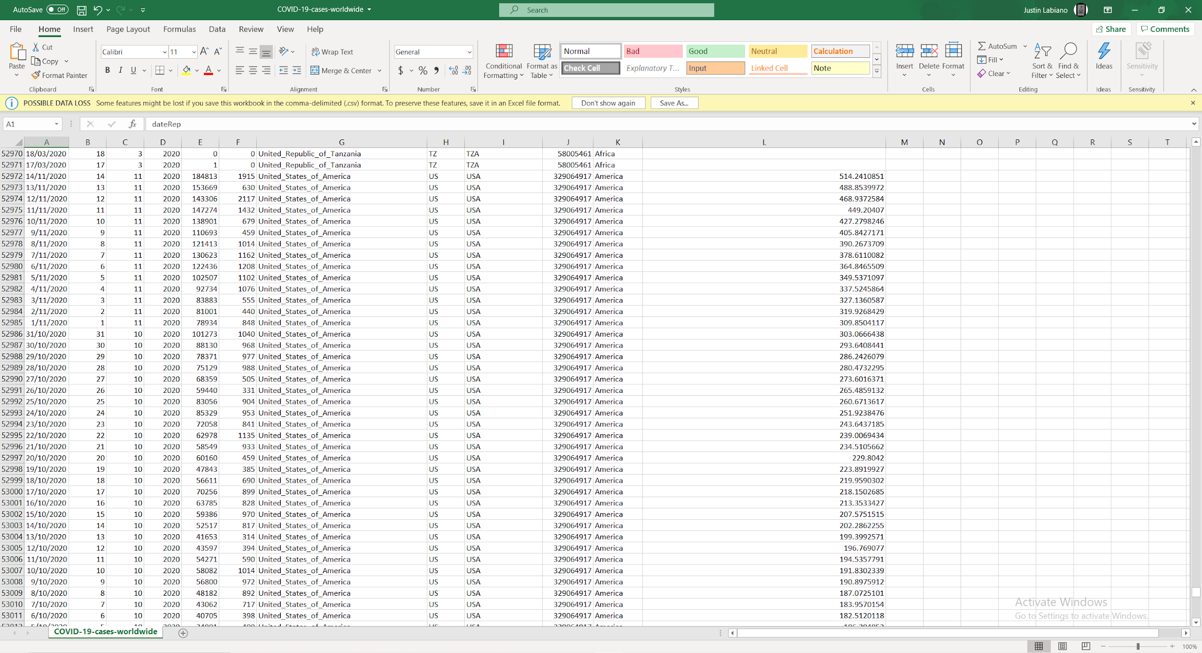
Over 50,000 rows!

Slide 6
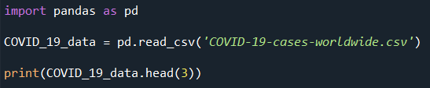
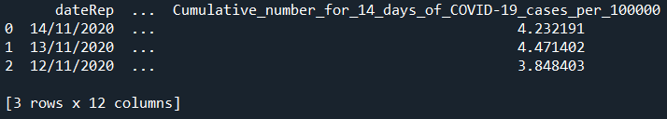
Reading the file

Slide 7

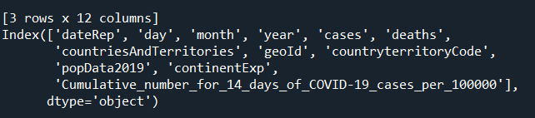
What are the columns?

Slide 8
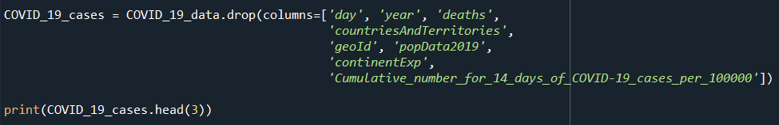

Removing Unwanted columns

Slide 9
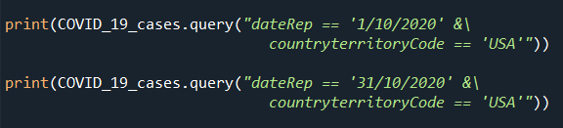

Finding Indexes

Slide 10

Computing average
Let’s change this

Slide 11

Changing column name

Slide 12
The average number of cases per day in the U.S. in October was 59,883

Slide 13

Why not use excel?
Excel
Data must be seen
Slows down after 10,000 rows
pandas
Don’t have to look at entire data
No limits
Easier to use complex equations
Free!
They can be used together!

Slide 14
THANKS!
Any questions?
You can contact me at:
labianoj@hawaii.edu

