Slide 1


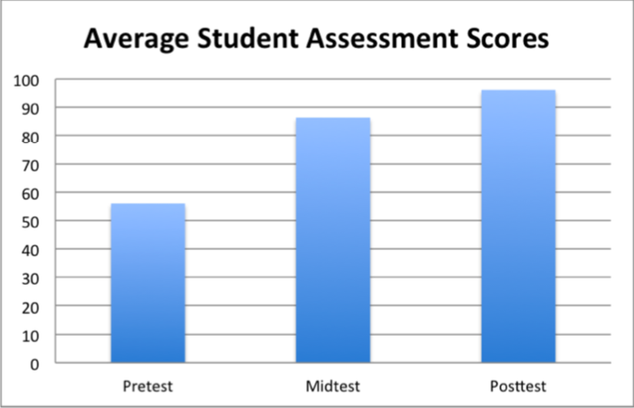
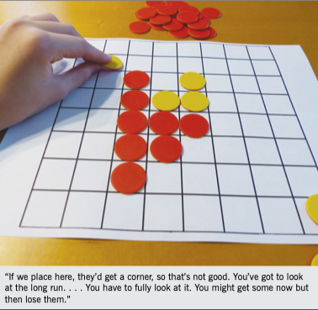

Implementing Games in Math Class
University Logo
Briana Nagasawa
University of Hawaii West O’ahu- Kapolei,HI 96707
Abstract
Results
Discussion
With games being such a huge source of fun and excitement, educators are interested in understanding children’s motivation for using games in the classroom. This study explores the motivation and engagement levels in playing and introducing game-based learning in mathematics. Although some people may think having games be used in the classroom looks more like a social gathering, it’s simply the opposite. While playing games, students are forming conjectures, explaining moves, and justifying their strategies. The popularity of games is evident as a research done proves that 60% of youth play video games on a daily basis. This enormous amount, already displays the love of games that we can simply use in our math classes (Mcfeetors, 2017).
Below is a graph that is taken from Effects of Game-Based Learning on Attitude and Achievement in Elementary Mathematics.” Networks: An Online Journal for Teacher Research. The research that was conducted studied the game-based learning as 5th grade math students completed a unit based on ordered pairs implementing game-based lessons. Three tests were taken, pre-test, mid-test, post-test. Results showed that students attitudes improved toward math as well as achievement scores increased.
Based on the various research, it has been proven that, incorporating games into mathematics lessons has improved students' attitudes, critical thinking skills, and achievement scores. Playing games and figuring out different strategies to win, has enabled students to become more successful in math. Below, there is a photo in which students are playing Othello, using counters. The student explains to a partner, how she needs to adjust the way she plays and to think about the long run of the game. This displays students strategic thinking and engagement while playing their games.
Introduction & Research Question
Math is fun! Says nobody ever. Why is that? A huge conflict in mathematics is that it strictly has to be based on learning how to do it and taking tests. Many people don’t have great experiences in math class beginning when they are young. It’s usually filled with numbers, formulas, and problems. Where is the fun in that? Incorporating fun games and activities into math class can be proven to improve not only the attitudes of students, but class engagement and assessment scores. Math doesn’t always have to be hard and boring, it CAN be fun!
Is Implementing Games in Math Class Effective?
Mcfeetor & Palfy (2017)
White & Mccoy (2019)
Conclusions
References
Using math games will help students to ease their fear of math in the classroom.
Through games, students can come up with strategies and become better critical thinkers, which in turn, will increase math scores.
There is a positive impact of games on attitude, achievement, and success.
With math games, students will try harder in class because they are actually having fun!
.
Research Design & Data Collection
Mcfeetors, P. J., & Palfy, K. (2017). Were in Math Class Playing Games, Not Playing Games in Math Class. Mathematics Teaching in the Middle School, 22(9).
Barreto, Daisyane, et al. (2018).“Motivation And Learning Engagement Through Playing Math Video Games.” Malaysian Journal of Learning and Instruction, 1–21.
White, Kyli, and Leah P. Mccoy.(2019). “Effects of Game-Based Learning on Attitude and Achievement in Elementary Mathematics.” Networks: An Online Journal for Teacher Research, 1–17.
To find the information and support needed to support my hypothesis, research was found on the National Council of Teachers of Mathematics and through other channels. These articles targeted key points relating to the hypothesis.
Contact
Briana Nagasawa
brianana@hawaii.edu

