Slide 1

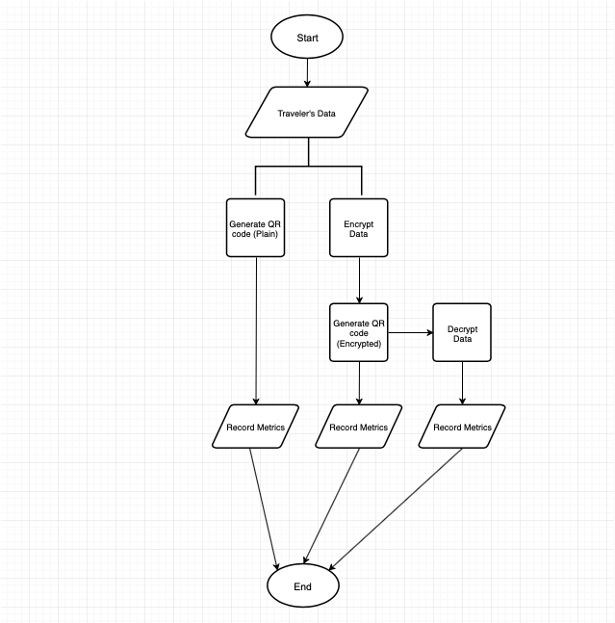
Secure Storage of Personally Identifiable Information in Quick Response Codes
Daniel Thipphavong;
University of Hawaii - West Oahu, Fall 2020
Abstract
Research Design & Data Collection
The COVID-19 pandemic has affected people all around the world. A system that enables routine, rapid, and secure storage and communication of a person’s health information would aid in the recovery of daily life, including in the State of Hawaii.
This research project investigates the feasibility of private-key encryption of this Personally Identifiable Information (PII) in a Quick Response (QR) code to provide insight into expanding the use of QR codes by the Safe Travels Hawaii web application.
Research Design
A program was written with Python 3 to simulate the process of encrypting a traveler’s PII before encoding it into a QR code. As well as decrypting it afterwards. Plain QR codes without the encryption step were made for comparison purposes. Data was collected as the program ran and made each QR code, with and without encryption. A hundred iterations was done to produce an average for comparison of the following metrics.
Metrics
The time it takes to generate the QR code in seconds (sec)
The resulting size of the QR code in kilobytes (kb)
The time it takes to decrypt the QR code post-scan in seconds (sec)
Introduction & Research Question
Results
Introduction
September 1, 2020, the State of Hawaii implemented its Safe Travels program to meet the challenge of re-opening the islands to trans-pacific and inter-island travelers while minimizing the risk of COVID-19 spreading to the local population from travelers.
On October 15, 2020, with the successful implementation of the Safe Travels program, the State of Hawaii proceeded to the next phase of re-opening the islands with its Pre-travel Testing program. Participating travelers may receive an exemption from their quarantine obligations if they provide proof of a negative COVID-19 test result that meets the State’s requirements upon arrival into the state.
The issue with this is that even the most accurate tests available are not 100 percent accurate in detecting the virus.
The research objective is to provide travelers with a secure, contactless mode of self-identification to prove their quarantine status when visiting a place of business.
Research Question
How has the usage of QR codes been affected by incorporating private-key encryption into its generation process?
Hypothesis
The encryption process would take less than three seconds to complete.
The size of the QR code would be the same, with or without, encryption.
The decryption process would be the same, with or without, encryption.
Flowchart of the Program
The feasibility of securely storing PII in a QR code has been proven based on the analysis of the results. The following are the averaged results based on the data collected.
The significance of these results is that the traveler’s user experience would be maintained because the increased amount of time wouldn’t be noticed. The encryption process took less than three seconds to complete. And, although the size of the QR code doubled, those additional kilobytes also won’t be noticed by the traveler’s device. The decryption process took the same amount of time.
 | Without Encryption | With Encryption
Time (sec) | 0.14 | 0.29
Size (kb) | 0.96 | 1.88
Decrypt Time (sec) | 0.00 | 0.00
Discussion
The feasibility of securely storing PII in a QR code has been proven based on the results meeting the metrics. This insight can be used to expand the use of the QR code produced by the Safe Travels Hawaii program for travelers.
For example, it could be used as a tool to aid contact tracers in their investigations by creating a timeline of placed visited by travelers with each scan of their QR code. It would become another layer of defense by the State of Hawaii for minimizing the spread of the virus by travelers.
Conclusions
Based on the results of the three metrics, I conclude that it is feasible to incorporate encryption into the QR code generation process to expand its usage for secure storage of personally identifiable information.
Contact
References
Daniel Thipphavong
UHWO, APSC 486 I
Email: danielty@hawaii.edu

