Slide 1

Python Programming in Action
A practical example of increasing productivity and
efficiency in the workplace environment
Jame Bautista
ICS 111
Eric Wen

Slide 2
Overview
Identify programming problem in a workplace environment
Propose the Python solution and value to the organization
Discuss the application of Python, SQLAlchemy, and SQL database coding

Slide 3
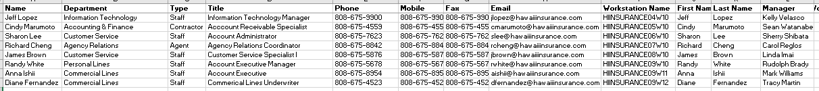
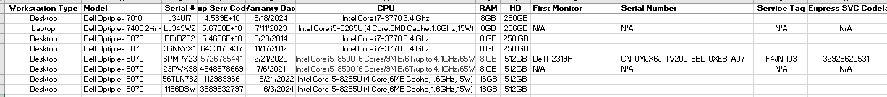
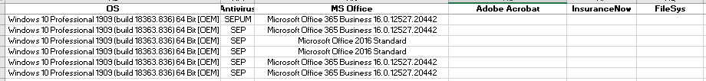
Identify Programming Problem
This is the Workstation Inventory worksheet from a local business with about 200-employees.

Slide 4
Problems
Redundant data in workstation inventory worksheet and data integrity in terms of accuracy and consistency.
Inefficiency in managing, creating, modifying, and retrieving data as the organization is experiencing extended growth.
Need to provide accuracy in the annual reporting for internal auditors for the purpose of verifying the corporate asset inventory listing.

Slide 5
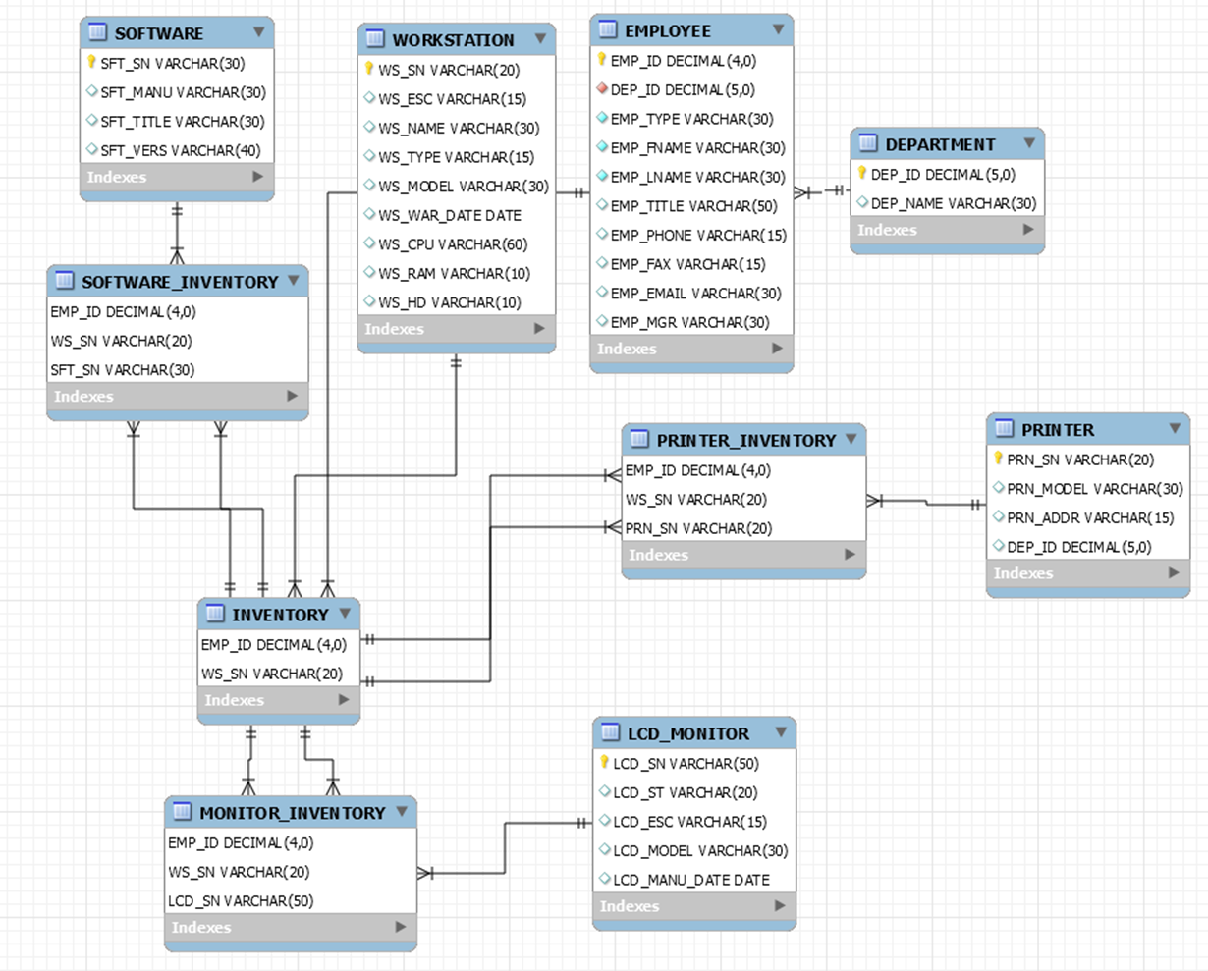
Proposed Solution
The Workstation Inventory worksheet would see a data restructuring to a SQL database and “normalize” the data to reduce data redundancy and ensure data integrity (accuracy and consistency).
In Python, we would be able to write code to connect to the SQL database and enter queries.

Slide 6
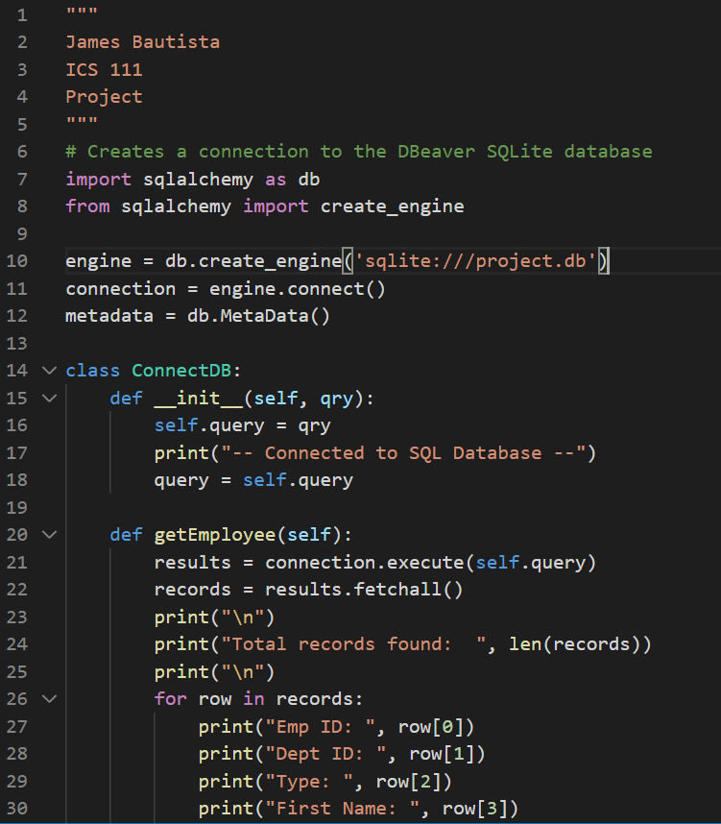
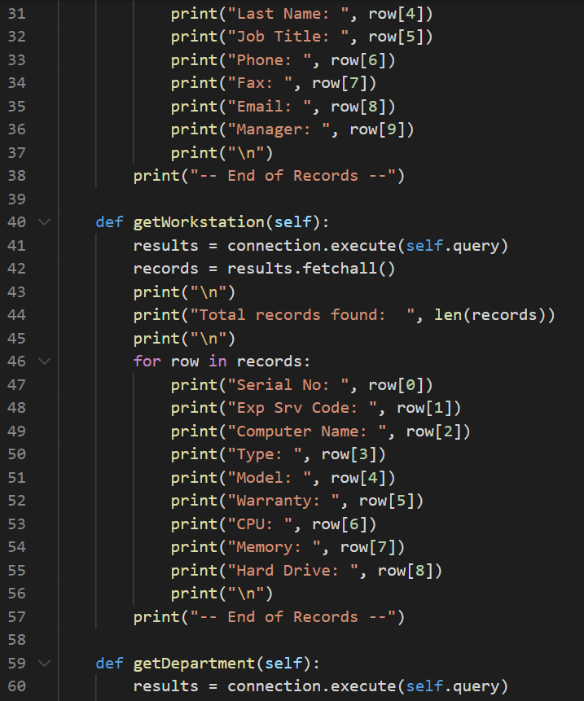
Overview on the Python, SQLAlchemy, and SQL Coding

Slide 7
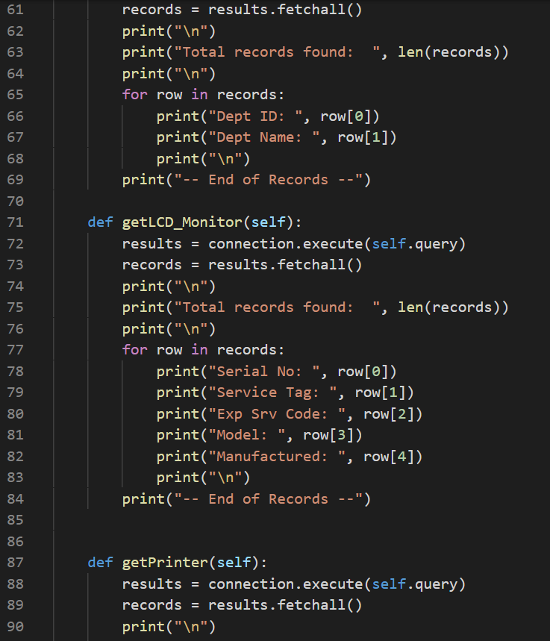
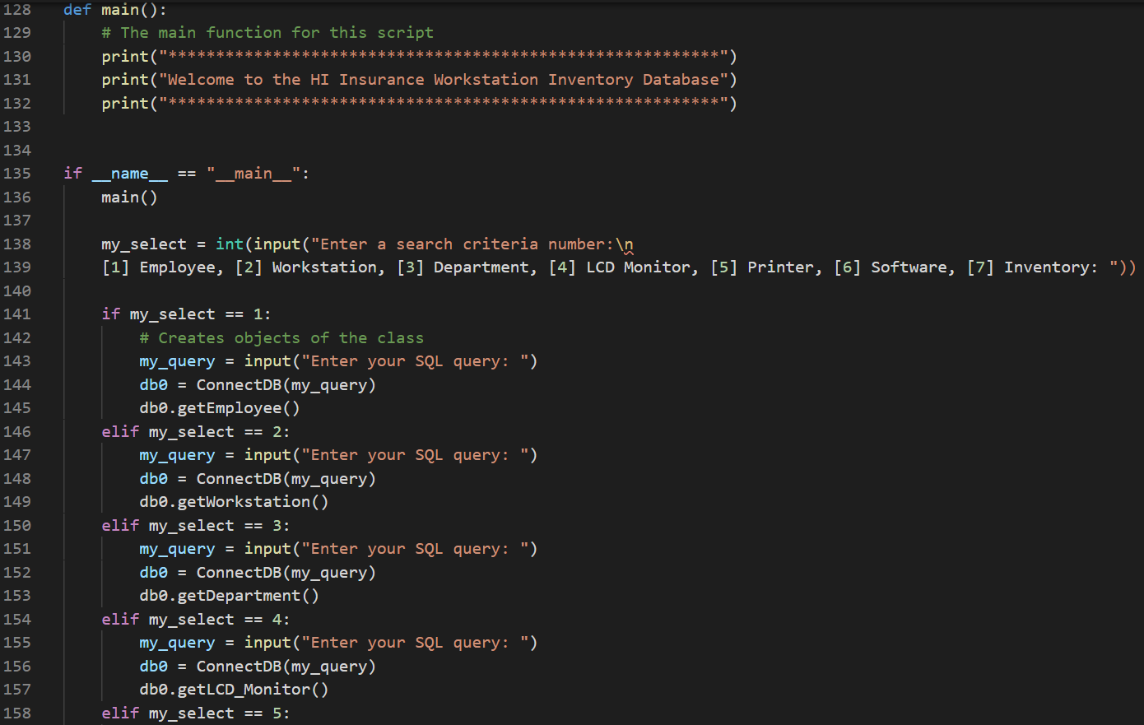
Overview on the Python, SQLAlchemy, and SQL Coding

Slide 8
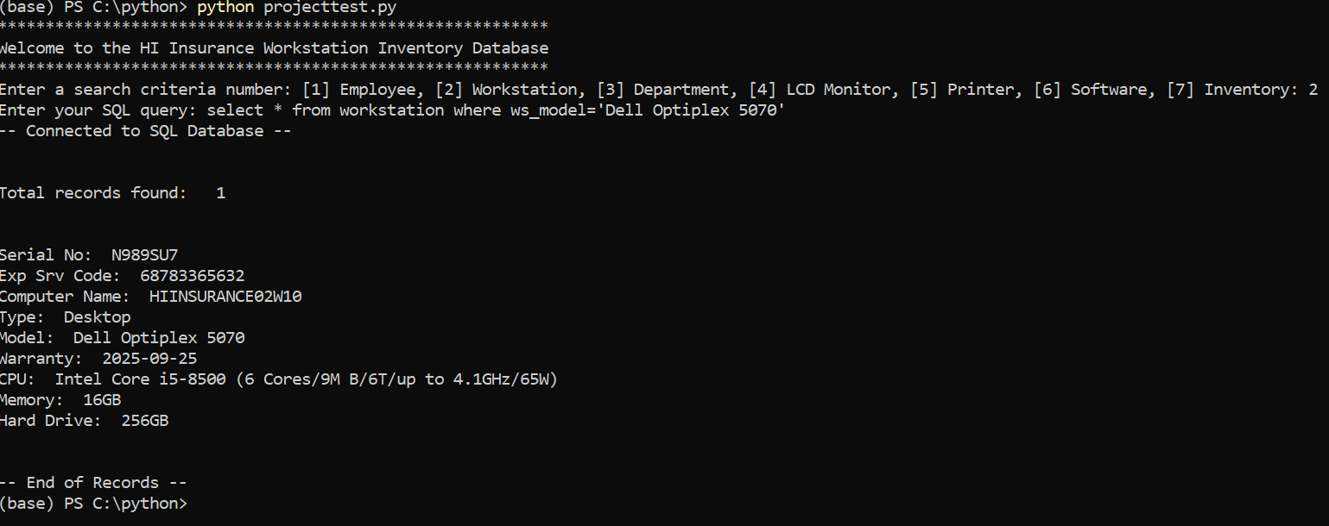
Overview on the Python, SQLAlchemy, and SQL Coding

Slide 9
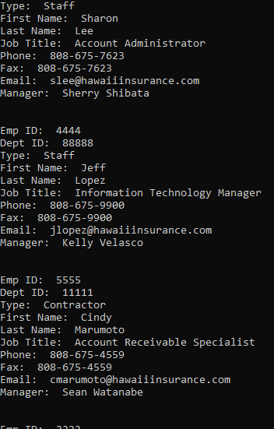
Query a SQL Database Table
The figure to the right is an output example of running a SQL query in Python program.
SQL Query code:
SELECT * FROM EMPLOYEE ORDER BY EMP_LNAME
The query returns a list of all employees and ordered in descending order by the employee’s last name.

Slide 10
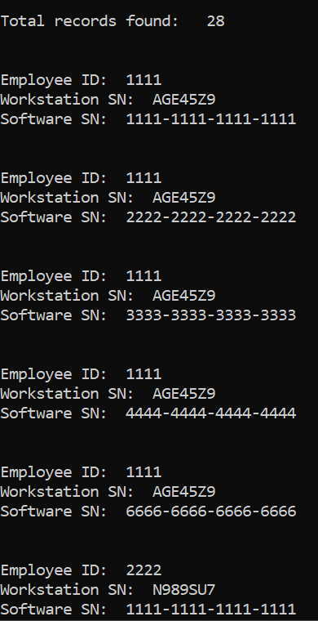
Query SQL Database with Two-Linked Tables
This is an output example of running a query on two-linked tables in the SQL database by selecting “[7] Inventory”.
In SQL database, I linked the INVENTORY table with the SOFTWARE_INVENTORY table.
SQL Query code:
SELECT inventory.emp_id, inventory.ws_sn, software_inventory.sft_sn
FROM inventory inner join software_inventory
WHERE inventory.emp_id=software_inventory.emp_id

Slide 11
Mahalo!

